Slide 1
BEFORE WE START
Turn on Meeting Recording
Make sure the recording is running, and only then begin.
R E C
Financial Management in Digital Products

Slide 2
0
INNOPOLIS UNIVERSITY · SUMMER 2026
Financial Management
in Digital Products
Unit Economics · Financial Modelling · Business Valuation
Lecture 1 — Introduction
Max Popov · Course Instructor

Slide 3
TODAY
1
Course Structure
What we'll cover
2
Introduction
3
Unit Economics Foundations
4
Where UE Came From
5
Calculating the core metrics — CAC & LTV
6
The key question of unit economics
Lecture 1 · Unit Economics

Slide 4
1
PART ONE
Course structure
Schedule, grading, and the plan.

Slide 5


LOGISTICS
12
3
Course structure
lectures
exam classes
Wednesdays · 09:00–12:10
Consultation · Exam · Retake
The three exam classes
1
2
3
Exam
Consultation
Exam
Retake
Review & Q&A
The graded sitting
A second chance
Lecture 1 · Introduction

Slide 6
LOGISTICS
Exam
45%
How you're graded
Practical Tasks & Homeworks
25%
45%
exam
Attendance
15%
Activity
15%
GRADE SCALE
A
B
C
D
84%+
71–84%
51–71%
0–50%
Lecture 1 · Introduction

Slide 7






LOGISTICS
Twelve lectures, four big ideas, plus the practical glue.
The road ahead
Unit Economics
L1–2
Financial Modelling
L3–4
LTV, CAC, cohorts, cases
Building financial statements
Business Valuation
L5–6
Tax, legal
L7–9
DCF, multiples, startups
Taxation in Russia, legal forms
Prioritization
L10
Media · Analytics
L11–12
RICE, ICE, value vs effort
Planning and operating
Lecture 1 · Introduction

Slide 8

LOGISTICS
By the end of the course, you will be able to:
What you'll be able to do
Read and build a financial model of a digital product
Estimate what a digital business is worth — and why
Compute and interpret unit economics (LTV, CAC, payback)
Connect everyday product decisions to financial outcomes
Prioritise initiatives with a clear value-vs-effort logic
Lecture 1 · Introduction

Slide 9

LET'S BEGIN
Now — your turn
Before we dive in, I want to know what’s your interest.
Pass the survey on https://max-ppv.ru/survey.html
On each question you may answer both, one or none.
Lecture 1 · Introduction

Slide 10
2
WELCOME
Introduction
Let's set the stage for the term.

Slide 11




MEET YOUR INSTRUCTOR
I work across the whole life of a digital product — building it, funding it, and figuring out whether it actually makes money. This course is the toolkit I use every day.
Hi — I'm Max
I build products as a Product Lead in MNTX
I run ventures as an entrepreneur
I invest in businesses, stocks and real estate
I teach here, at Innopolis University
Lecture 1 · Introduction

Slide 12
PRODUCT MANAGER LENS
I am a product manager –
Who is a product manager?
Before we calculate unit economics, let's align on the product manager’s lens.

Slide 13
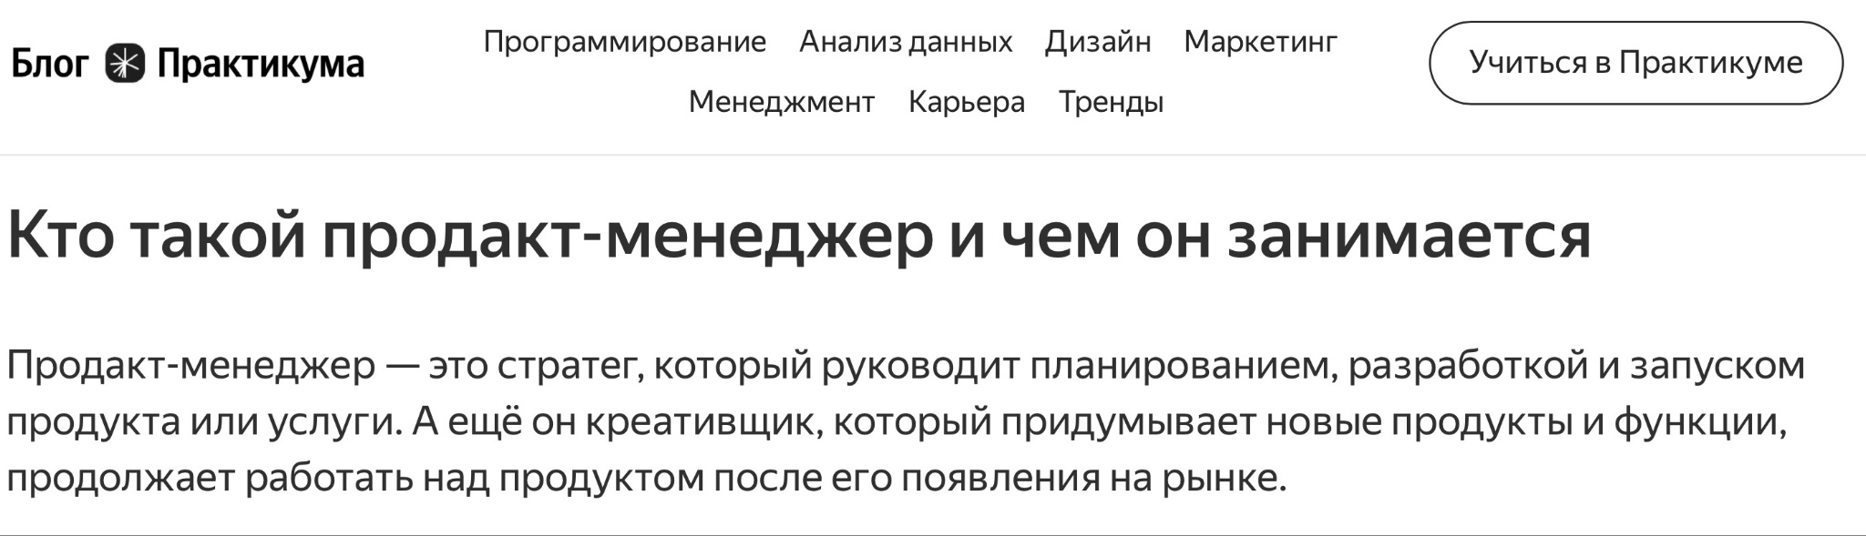
РАСХОЖЕЕ МНЕНИЕ
Как обычно отвечают
Источник: блог Практикума
Продакт-менеджер — это стратег, который руководит планированием, разработкой и запуском продукта. А ещё креативщик, который придумывает новые функции и работает над продуктом после запуска.
Lecture 1 · Unit Economics
Lecture 1 · Unit Economics

Slide 14
НО ЭТО НЕ ТАК
Чего здесь не хватает
НЕ ПОЛНО
Ни слова про деньги, прибыль и юнит-экономику.
А ведь именно ради них цифровой продукт и создаётся — поэтому определение стоит переписать.
Lecture 1 · Unit Economics
Lecture 1 · Unit Economics

Slide 15
DEFINITION
Product manager
A product manager is a specialist who creates and develops an IT product to generate profit for shareholders by satisfying customer needs.
Creates value
Satisfies needs
Generates profit
Not just features.
The user problem is the starting point.
The product must work as a business.
Lecture 1 · Introduction

Slide 16
SEQUENCE
First I check whether the product can make money.
What I do first
First
Then
1
Build unit economics
Customer development
2
Build a financial model
Backlog prioritisation
3
Estimate product valuation
Development roadmap
A beautiful roadmap cannot save a broken unit.
Lecture 1 · Introduction

Slide 17

WHERE WE START
Unit Economics
The first — and most concrete — lens.

Slide 18
THE GOAL
Understand what unit economics is — and learn how to calculate it.
Goal of this lecture
Why start here?
Before custom development, backlog prioritisation, or a roadmap — you first check whether the economics work. Code that ships a money-losing unit just loses money faster.
Lecture 1 · Unit Economics

Slide 19

FRAMING
Economics
Unit economics
Unit economics vs. economics
A science
An applied method
Macro level
Micro level
Studies the laws of the system
Helps you make money
Lecture 1 · Unit Economics

Slide 20
DEFINITION
What unit economics is
A method for analysing a business's financial efficiency by focusing on the revenue and costs tied to a single unit — a product, a service, or a customer.
Lecture 1 · Unit Economics

Slide 21

THE BASICS
Two metrics run the show
CAC
LTV
Customer Acquisition Cost
Lifetime Value
What you spend to win one paying customer.
What one customer brings you over their whole life.
Lecture 1 · Unit Economics

Slide 22

THE BASICS
When does a unit work?
Healthy
Broken
LTV
LTV
$2000
$1500
CAC
CAC
$1500
$2000
LTV > CAC — you profit on each customer
CAC > LTV — you lose money on each one
Lecture 1 · Unit Economics

Slide 23


FURTHER READING
Who to follow
Ilya Krasinsky
Daniil Khanin
CEO & product
Entrepreneur
Author on Telegram & YouTube
Popularised unit economics in Russia
Creator of the well-known UE template
khanin.info · author of the book
Lecture 1 · Unit Economics

Slide 24



Slide 25

HOW IT CAME TO BE
Where unit economics came from
From the dot-com crash

Slide 26

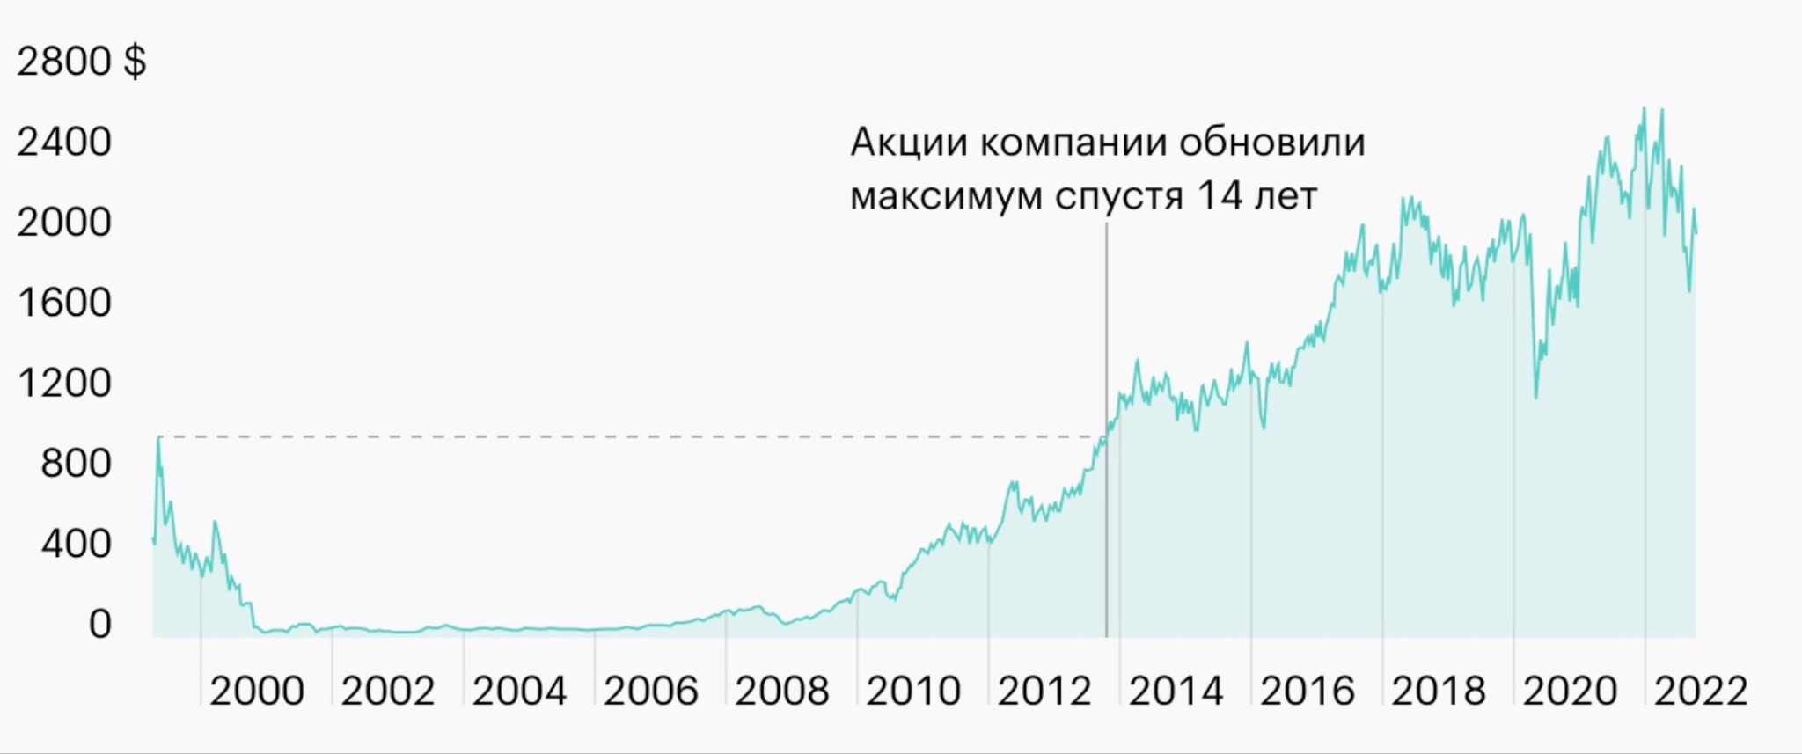


Slide 27

HOW IT CAME TO BE
Around 2000, internet companies scaled users at any cost — while losing money on every single one. When cheap capital vanished, many collapsed.
The dot-com crash was the trigger
So investors started asking a new question:
Does ONE unit actually make money — before you scale it to millions?
Lecture 1 · Unit Economics

Slide 28



Slide 29

FRAMING
Why not just read the financials?
A whole company
A single unit
Cash-flow, balance sheet, P&L
One customer: money in, money out
Dozens of line items, IFRS rules
A handful of numbers
Powerful — but overwhelming
Clear enough to act on
Complicated
Actionable
Lecture 1 · Unit Economics

Slide 30
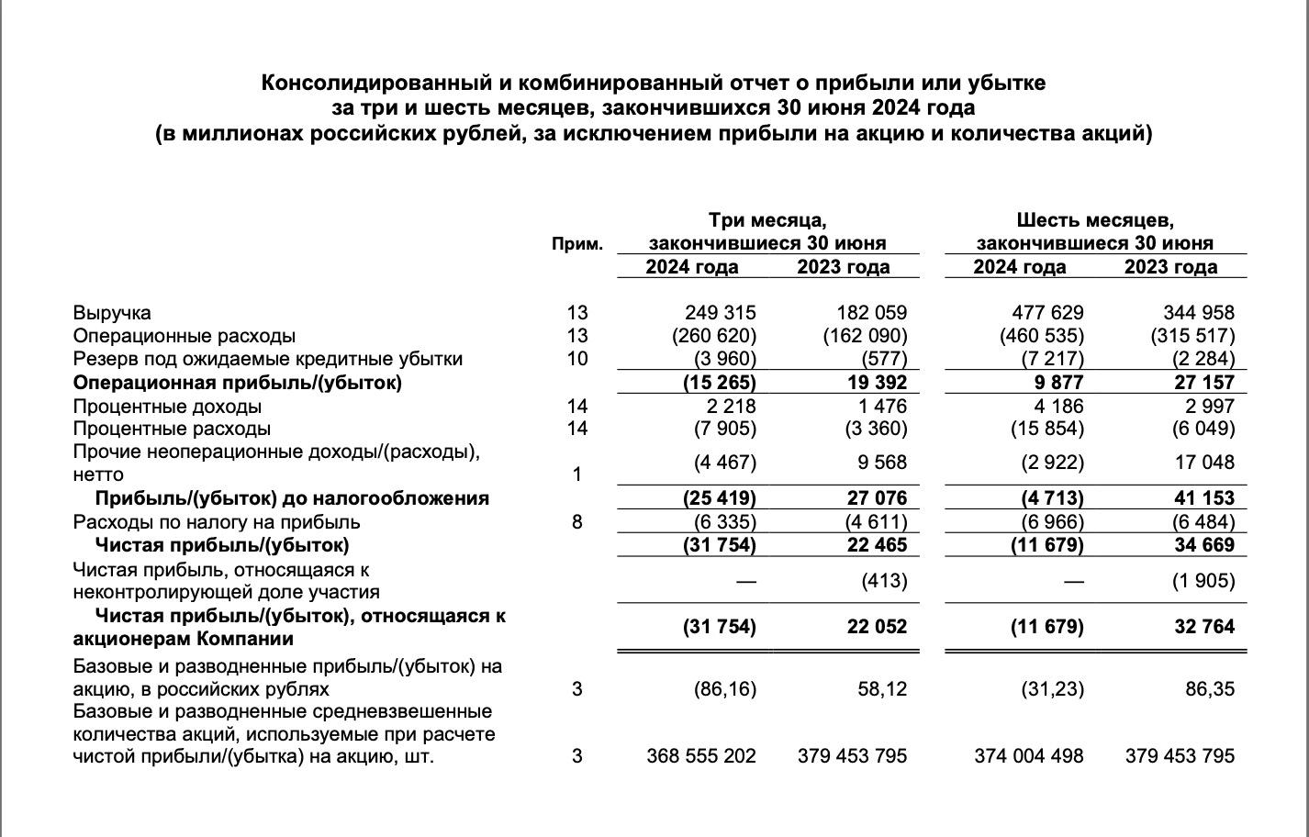
ФИНАНСЫ ВСЕЙ КОМПАНИИ
Отчёт о прибылях и убытках
Lecture 1 · Unit Economics

Slide 31
THE BASICS
Two metrics run the show
CAC
LTV
Customer Acquisition Cost
Lifetime Value
What you spend to win one paying customer.
What one customer brings you over their whole life.
Lecture 1 · Unit Economics

Slide 32
CALCULATING CAC
How to calculate
CAC & LTV
Define the unit, map the funnel, run the numbers.
LECTURE 1 · UNIT ECONOMICS

Slide 33
CALCULATING CAC
1
Define the unit
How to calculate CAC
Who exactly are you paying to acquire?
2
Pick the channel
Which paid channel brings them in?
3
Map the sales funnel
Click → install → register → pay
4
Forecast or experiment
Estimate the conversion rates, or test them
Lecture 1 · Unit Economics

Slide 34




OUR EXAMPLE
A mobile app that uses AI to log meals from a photo. Users pay a monthly subscription.
An AI calorie tracker
What's the unit?
Which channel?
Dev note
A paying subscriber
Apple Search Ads
AI tokens = your variable cost
Lecture 1 · Unit Economics

Slide 35
GIVEN
CALCULATING CAC
Task 1 — find the CAC
You are promoting a mobile app: an AI calorie tracker. To acquire users, you use Apple Search Ads.
Your task is to calculate the cost of acquiring one paying customer (CAC) based on the advertising funnel data.
Click-to-install conversion: 20%; cost per click (CPC): $0.50; install-to-registration conversion: 50%; registration-to-subscription conversion: 10%.
Lecture 1 · Unit Economics

Slide 36
CALCULATING CAC
CAC = $50
Answer — $50 per customer
THE FORMULA
CAC = CPC ÷ end-to-end conversion
End-to-end conversion = 20% × 50% × 10% = 1%
CAC = $0.50 ÷ 0.01 = $50
Lecture 1 · Unit Economics

Slide 37
CALCULATING LTV
How to calculate LTV
Find the average cheque
1
How much a customer pays per purchase
Find the number of purchases
2
How many times they pay over their life (retention)
Subtract the cost to serve
3
The operating cost of each purchase
Lecture 1 · Unit Economics

Slide 38
GIVEN
CALCULATING LTV
The app earns revenue from subscriptions and uses AI to process user requests, which creates additional costs.
Average subscription check: $10 per month. Retention rate: month 1: 100%; month 2: 60% of users continue their subscription; month 3: 40% of users continue their subscription.
After month 3, users stop renewing their subscription. The cost of one token for processing AI requests is $0.01. The average number of tokens a user spends per month is 200 tokens.
Task 2 — find the LTV
Lecture 1 · Unit Economics

Slide 39
CALCULATING LTV
LTV = $16
Answer — $16 per customer
Average lifetime = sum of retention = 1 + 0.6 + 0.4 = 2 months
LTV = (avg cheque − cost) × purchases
= ($10 − 200 × $0.01) × (1 + 0.6 + 0.4)
= ($10 − $2) × 2 = $16
Lecture 1 · Unit Economics

Slide 40
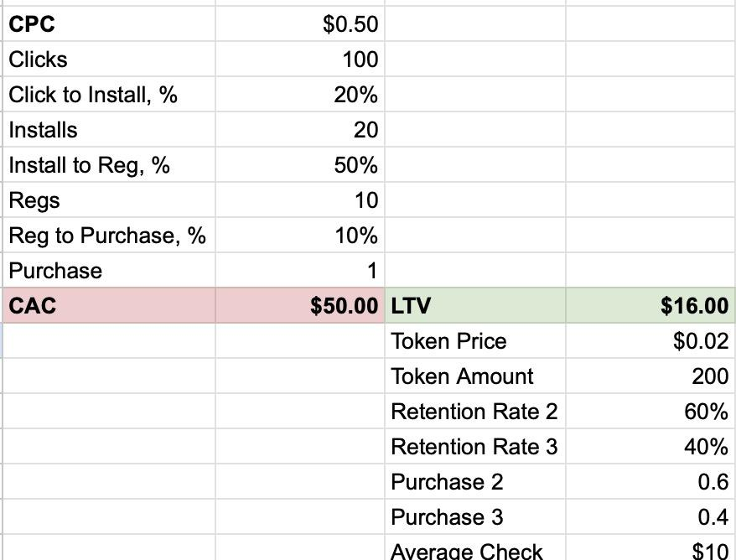
CALCULATION IN TABLE
CAC & LTV
UE Model
Lecture 1 · Unit Economics

Slide 41

ESSENTIALS
The key question of unit economics +
Types of costs

Slide 42
THE KEY QUESTION
For most B2C IT products and anything with repeat purchases or renewals, the whole game is one inequality:
For most products: LTV > CAC?
LTV > CAC
A customer must be worth more than what you paid to get them. As a healthy benchmark: LTV / CAC > 3.
Lecture 1 · Unit Economics

Slide 43

THE KEY QUESTION
Consulting, software development, ad business — one-off contracts, not repeat purchases. There is no lifetime to speak of, so we ask a different question.
For contract-type units, it changes
Margin > 0 ?
Revenue − direct costs − CAC − logistics − payment fees − returns > 0
Lecture 1 · Unit Economics

Slide 44

COSTS
Fixed vs. variable vs. one-time
Fixed
Variable
One-time
Independent of volume
Scale with output
Paid once
Rent, admin salaries, depreciation. Your cloud baseline.
Per-request compute, AI tokens, payment fees.
Equipment, setup, a warehouse.
Lecture 1 · Unit Economics

Slide 45
SUMMARY
Course Structure
Lecture 1
Done so far
Introduction + PM Lens
Unit Economics Foundations
Where UE Came From
Calculating the core metrics — CAC & LTV
The key question of unit economics
7
Lecture 1 · Unit Economics

Slide 46
BEFORE WE WRAP UP
Questions?
On the topics discussed and not only

Slide 47
?
Thank you
Telegram: @max_popov
Max Popov · Financial Management in Digital Products · Innopolis University

Slide 48
BEFORE WE START
Turn on Meeting Recording
Make sure the recording is running, and only then begin.
R E C
Financial Management in Digital Products

Slide 49
0
INNOPOLIS UNIVERSITY · SUMMER 2026
Financial Management
in Digital Products
Unit Economics · Financial Modelling · Business Valuation
Lecture 2 — Unit Economics
Max Popov · Course Instructor

Slide 50
TODAY
1
John Peel: The UE in the 19th century
What we'll cover
2
John Peel: The goal UE answers
3
CalZen Case: The Sales Funnel Quiz
4
CalZen Case: The CustDev Result
5
CalZen Case: The Repeat-Sale Paradox
6
CalZen Case: The Key Insights
Lecture 1 · Unit Economics

Slide 51

WHERE IT CAME FROM
Unit Economics in the 19th century
Long before SaaS — a textile factory and one simple question.
LECTURE 1 · UNIT ECONOMICS

Slide 52

THE 19TH CENTURY
A textile mill in the north of England
Lecture 1 · Unit Economics

Slide 53
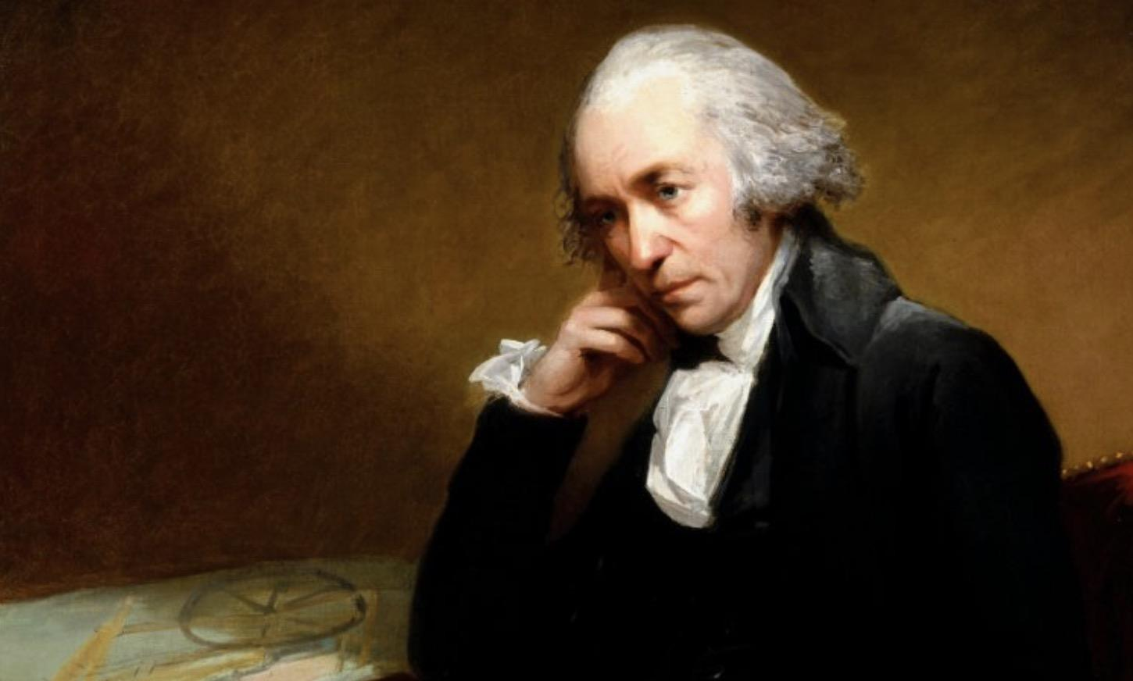
MEET JAMES WATT
The supplier of the equipment
Lecture 1 · Unit Economics

Slide 54
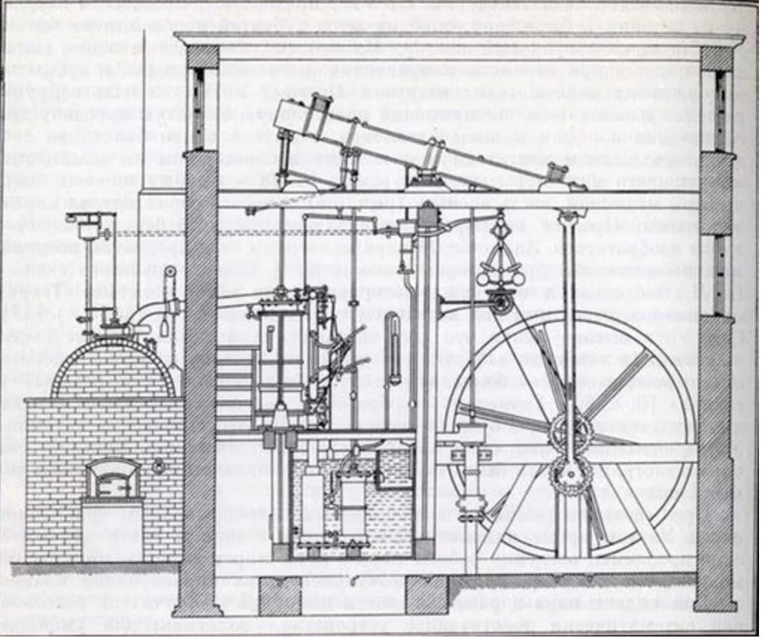
THE TECHNOLOGY
The spinning machinery of the age
Lecture 1 · Unit Economics

Slide 55

INDUSTRIAL BRITAIN
Britain at the dawn of the factory era
Lecture 1 · Unit Economics

Slide 56
19TH-CENTURY UE
Earn £100 / month from a textile factory
John Peel's goal
Same question as any SaaS model, 200 years early: how much must he produce and sell to cover his costs and hit his target profit?
Lecture 1 · Unit Economics

Slide 57

19TH-CENTURY UE
What goes in, what comes out
Costs
Revenue
Loan repayment
Sales of cloth
Wages
Energy (coal)
Just one line — but it has to cover everything on the left.
Raw material
Machinery
Advertising
Warehouse
Lecture 1 · Unit Economics

Slide 58
19TH-CENTURY UE
Sorting the costs
Fixed / month
One-time
£1,750
£7,500
Loan repayment — £450
Machinery — 5 × £1,000
Wages — 25 × £50
Warehouse — £2,500
Advertising — £50
…and on top, a variable cost on every roll produced →
Lecture 1 · Unit Economics

Slide 59
19TH-CENTURY UE
Sold for
£10
The economics of one roll
Raw material
−£2
Energy
−£1
Contribution per roll = £7
Lecture 1 · Unit Economics

Slide 60
TASK 3
How many rolls a month must John Peel sell to earn £100?
Hint: cover the fixed £1,750, then the £100 profit, at £7 a roll.

Slide 61
19TH-CENTURY UE
“
How the story ends
Having run the numbers, Peel was convinced the idea would pay off and opened his factory in 1801. Years later he had built a fortune — and passed it on to his children, along with factories running in several English cities.
Lecture 1 · Unit Economics

Slide 62
FOR TWO CENTURIES, UNIT ECONOMICS ANSWERED ONE QUESTION
How much must we produce and sell to cover our fixed costs — and earn the profit we need?
That's how it looked until the end of the 20th century. The units changed — subscribers, API calls — the question didn't.

Slide 63
01
CALZEN CASE
CalZen: Data Driven Approach vs Intuitive
01
Customer flow quiz
02
Custdev results
03
Funnel numbers
04
Unit economics problems

Slide 64
02
CALZEN CASE
CalZen
01
Customer flow
02
Custdev results
03
Funnel numbers
04
Unit economics problems

Slide 65
01
CUSTDEV SETUP
Customer development parameters
How the interviews were conducted.

Slide 66
CUSTDEV SETUP
Interview parameters
01
Zoom
02
Screen sharing
Audio or video call
User shows the product flow
03
Open format
04
UX interview
Conversation, not a questionnaire
Audio and video recorded
Lecture 1 · Unit Economics

Slide 67
CUSTDEV SETUP
Interview flow
1
2
3
4
Open the app
Go through onboarding
React aloud
Discuss objections
Lecture 1 · Unit Economics

Slide 68
AUDIENCE
Custdev audience
Men
8/10
Out of 10 custdev interviews
Lecture 1 · Unit Economics

Slide 69
AUDIENCE
Custdev audience
Tracked calories in the past
9/10
Out of 10 custdev interviews
Lecture 1 · Unit Economics

Slide 70
AUDIENCE
Custdev audience
Track calories now
6/10
Out of 10 custdev interviews
Lecture 1 · Unit Economics

Slide 71
AUDIENCE
Custdev audience
Fitness trainers
4/10
Out of 10 custdev interviews
Lecture 1 · Unit Economics

Slide 72
AUDIENCE
Custdev audience
Fitness-trainer clients
4/10
Out of 10 custdev interviews
Lecture 1 · Unit Economics

Slide 73
AUDIENCE
Custdev audience
Used FatSecret
8/10
Out of 10 custdev interviews
Lecture 1 · Unit Economics

Slide 74
02
CUSTDEV RESULTS
Onboarding findings
What users noticed during the onboarding flow.

Slide 75
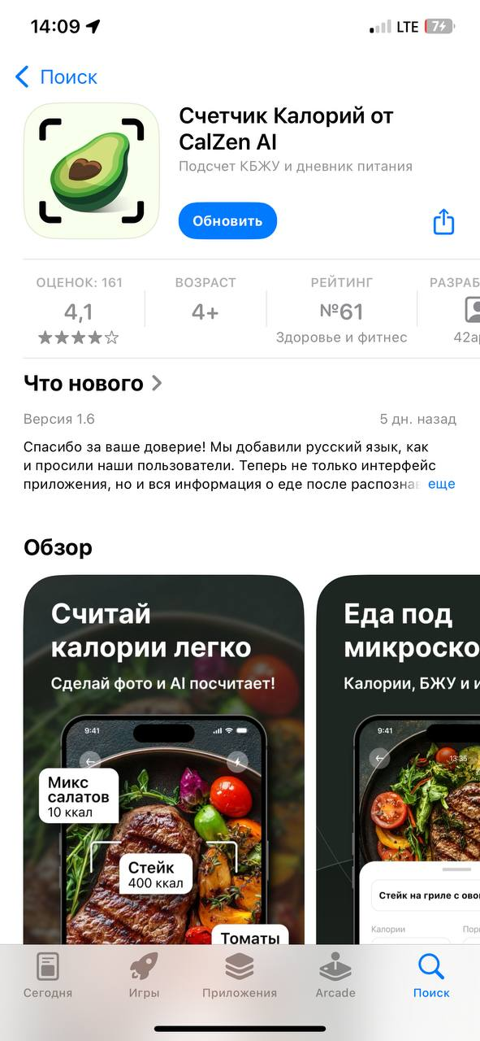
APP STORE
Store presence
The first touchpoint frames expectations before onboarding starts.
Lecture 1 · Unit Economics

Slide 76
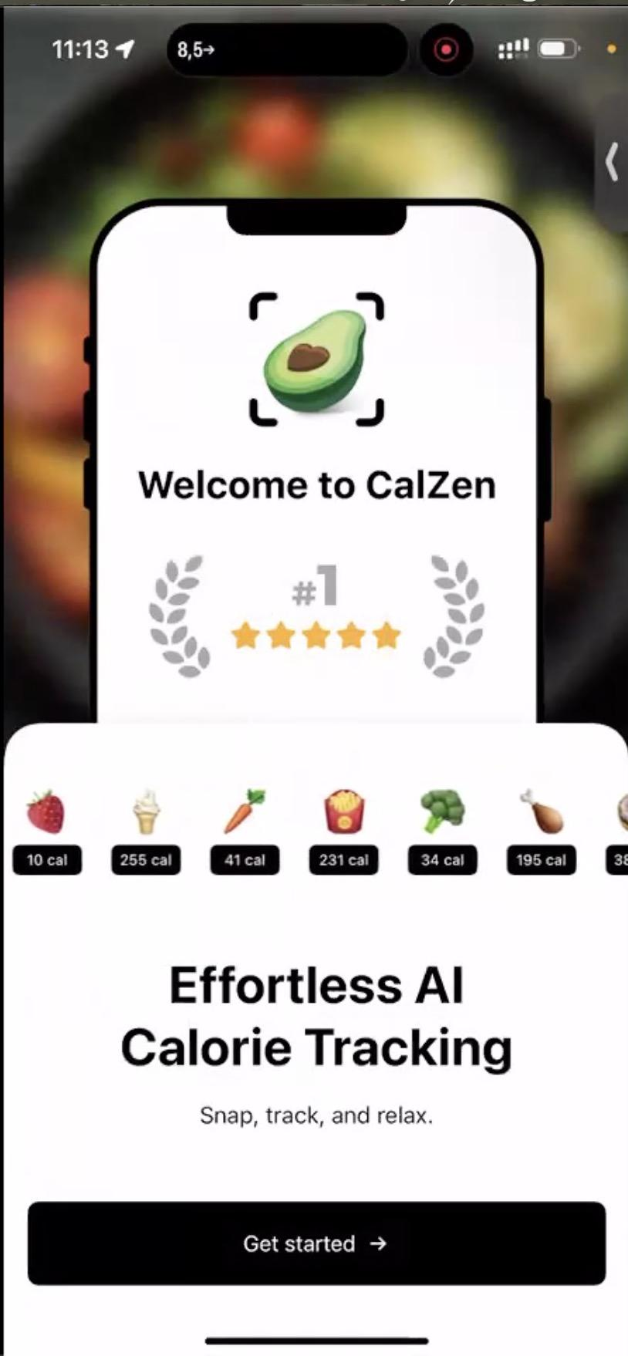
ONBOARDING
1. Welcome page
“The app has no App Store award. Why are you lying?”
1/10
Lecture 1 · Unit Economics

Slide 77
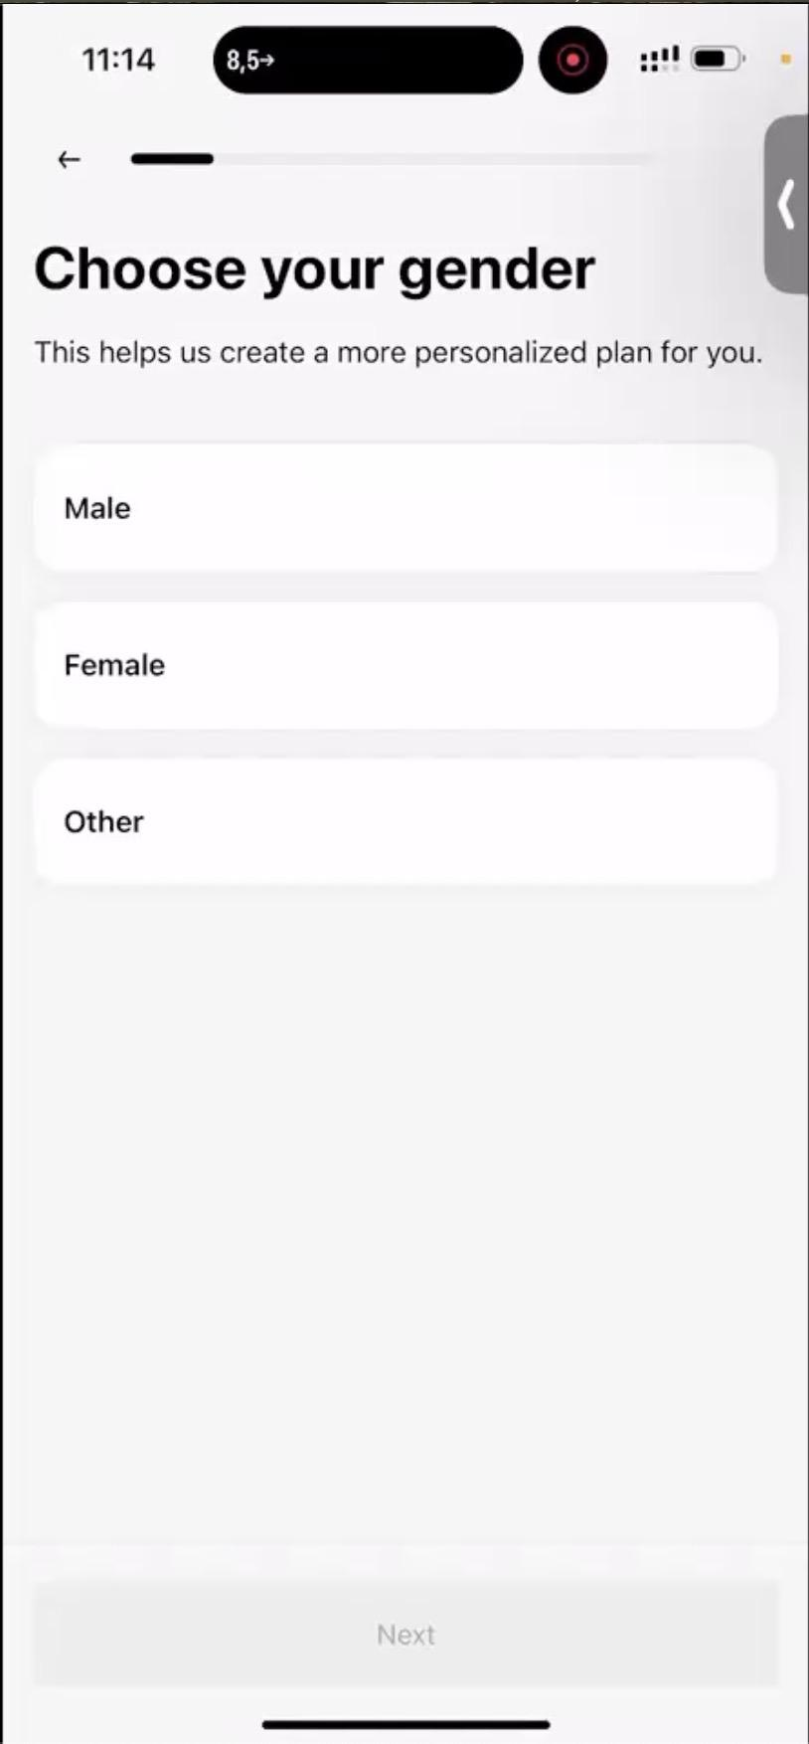
ONBOARDING
2. Gender
No major objection captured on this step.
Lecture 1 · Unit Economics

Slide 78
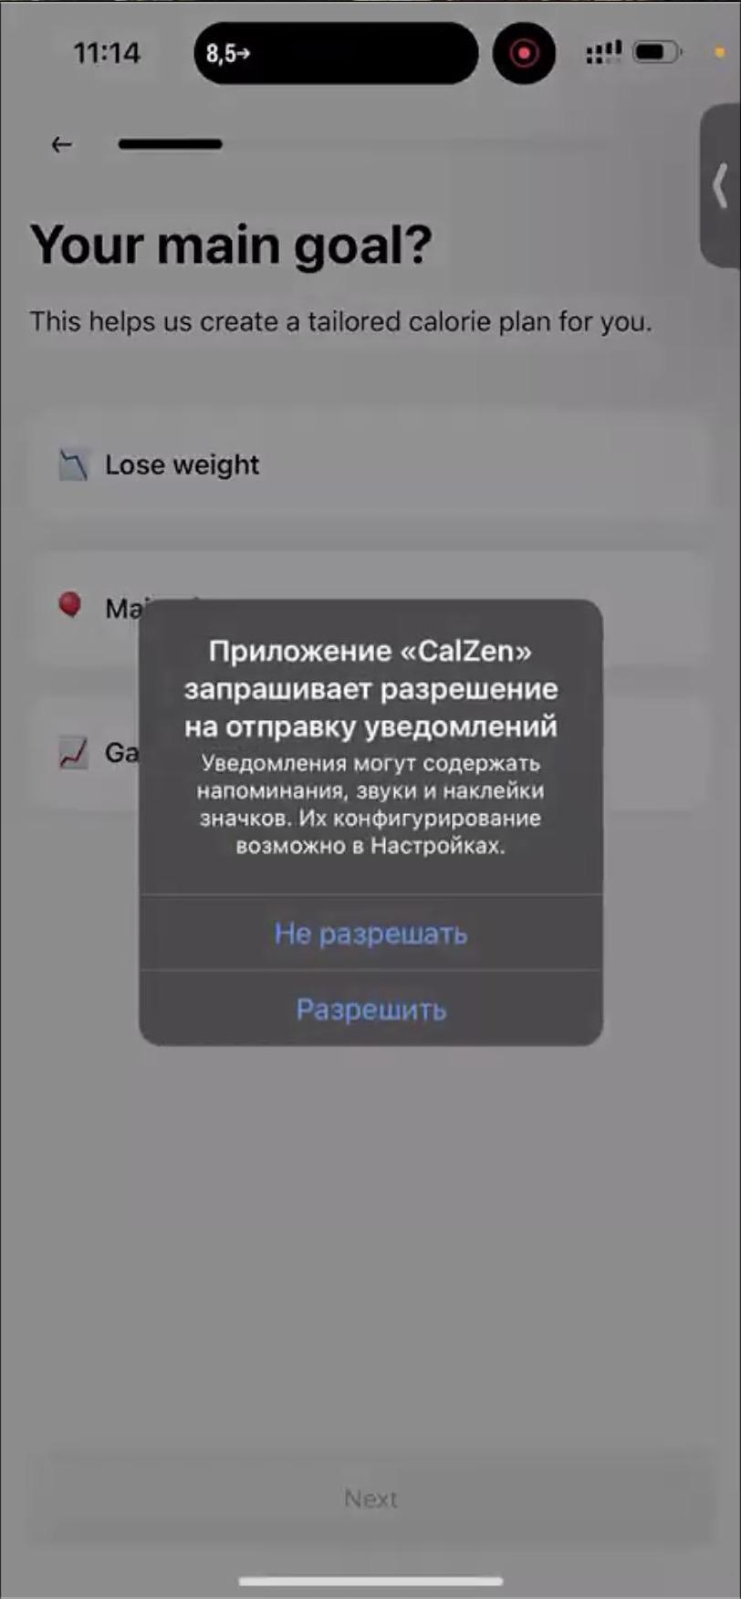
Onboarding notifications
ONBOARDING
Notifications
“Bad timing.”
1/10
Lecture 1 · Unit Economics

Slide 79
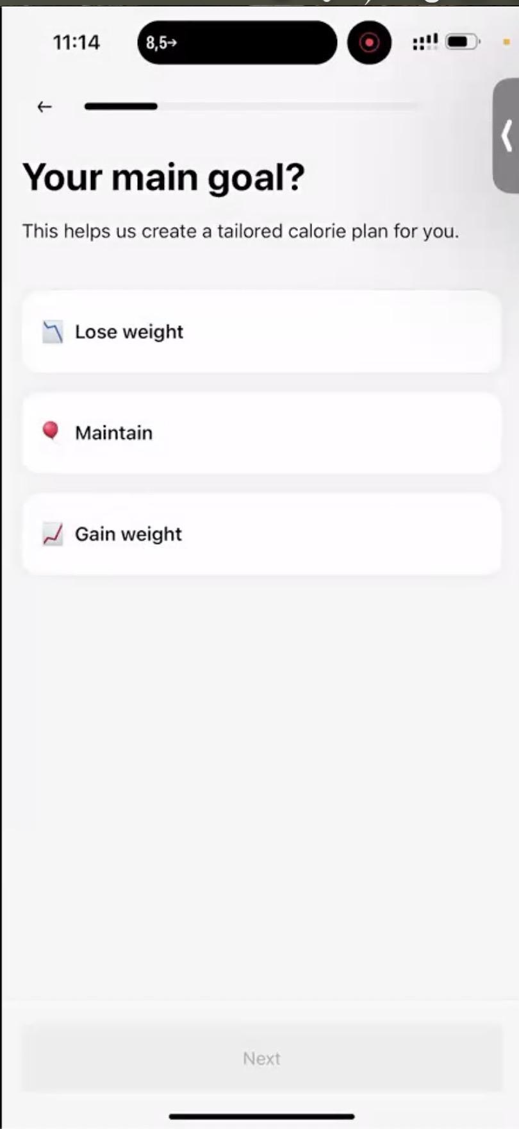
ONBOARDING
3. Goal
No major objection captured on this step.
Lecture 1 · Unit Economics

Slide 80
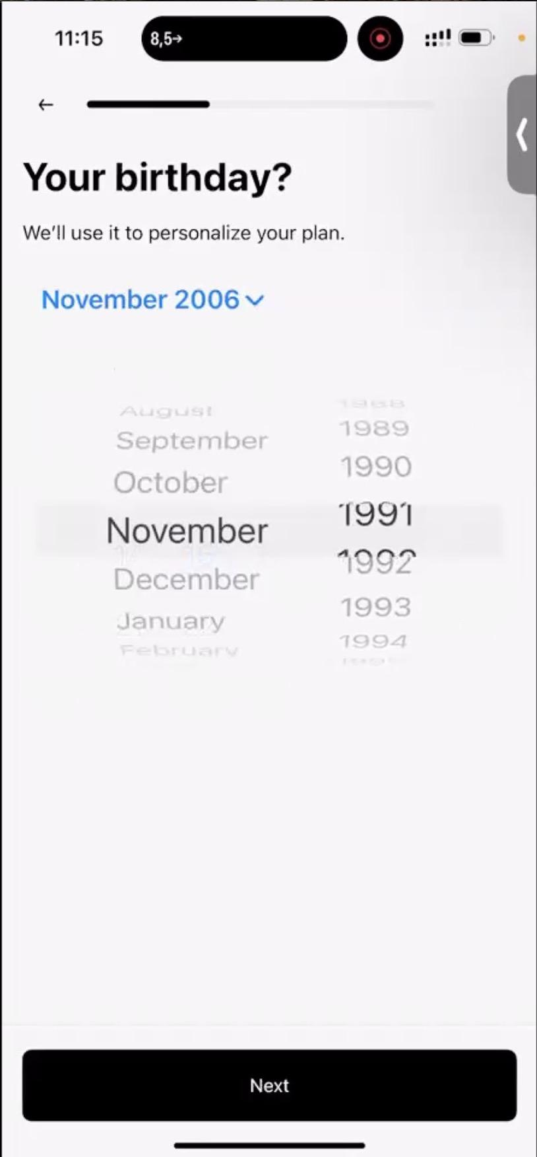
ONBOARDING
4. Birthday
“Why make me scroll from 2006 to my year?”
1/10
Lecture 1 · Unit Economics

Slide 81
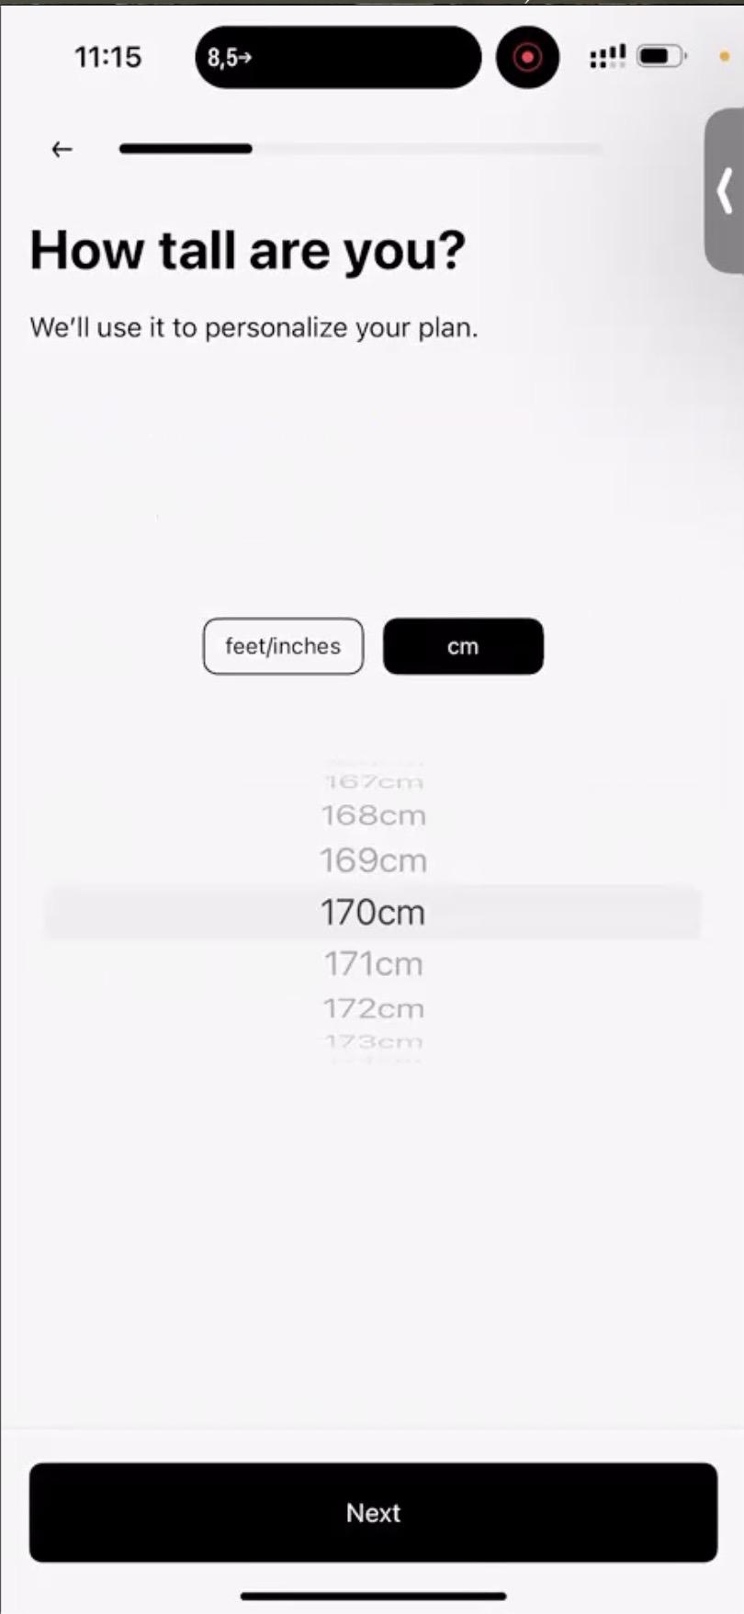
ONBOARDING
5. Height
No major objection captured on this step.
Lecture 1 · Unit Economics

Slide 82
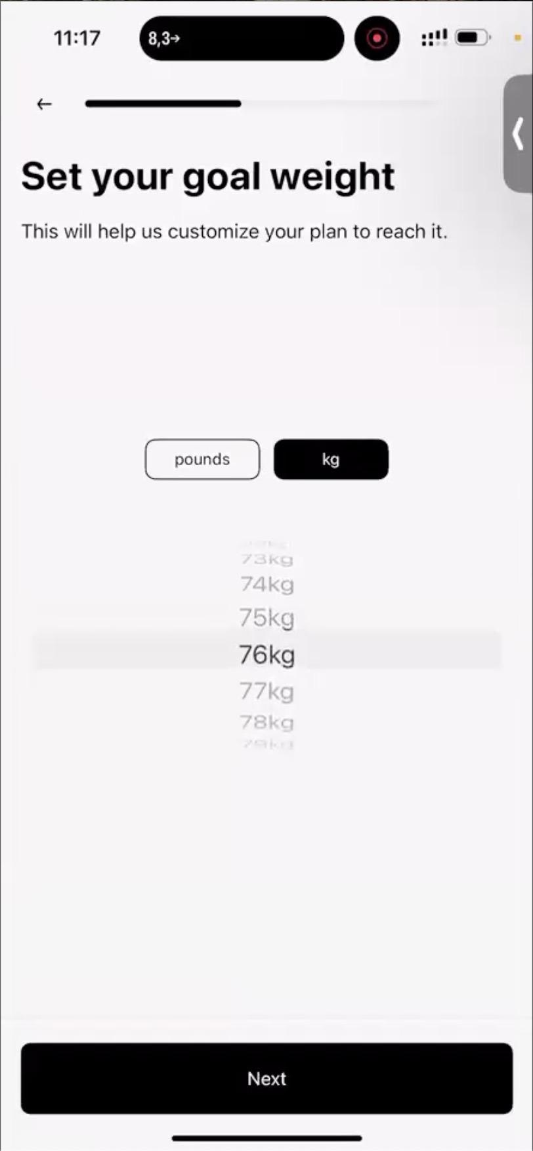
ONBOARDING
6. Weight
No major objection captured on this step.
Lecture 1 · Unit Economics

Slide 83
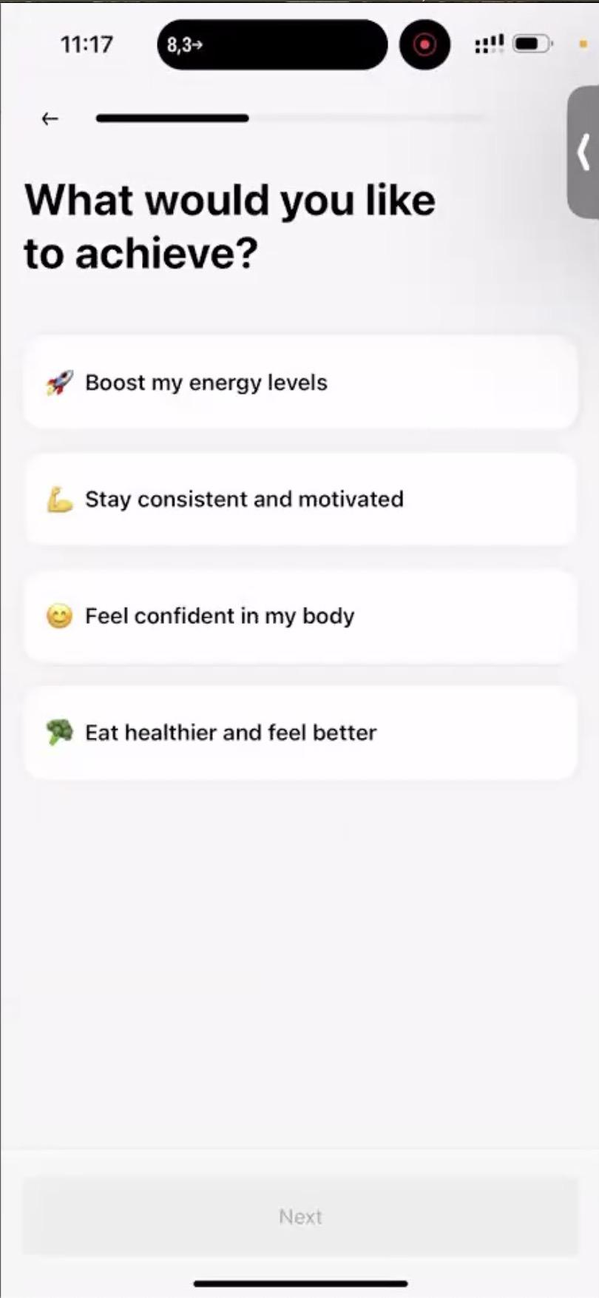
ONBOARDING
7. Motivation
“What am I supposed to choose?”
3/10
Lecture 1 · Unit Economics

Slide 84
ONBOARDING
8. Goal weight
“Why ask kg/lb again? I already answered.”
1/10
Lecture 1 · Unit Economics

Slide 85
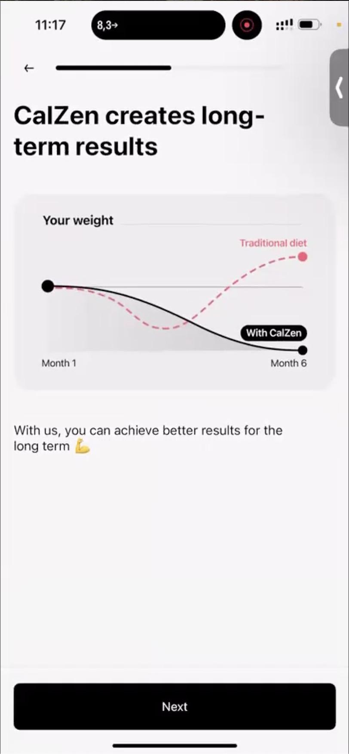
ONBOARDING
9. Long-term results
“So classic diets have negative efficiency? Hmm...”
3/10
Lecture 1 · Unit Economics

Slide 86
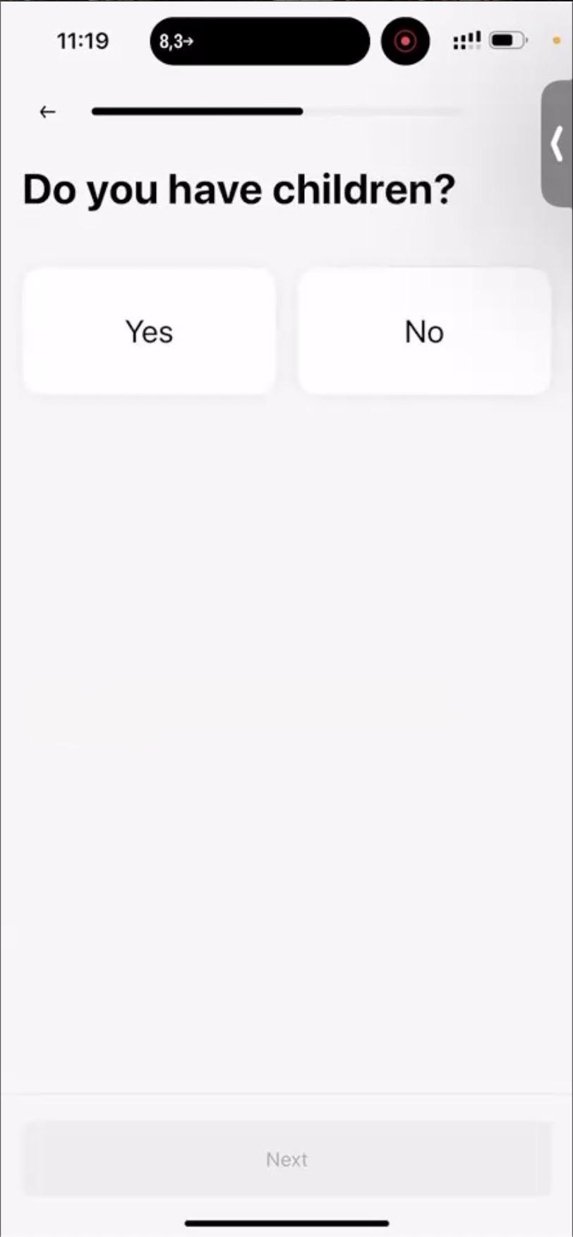
ONBOARDING
10. Kids
“Why does it matter?”
3/10
Lecture 1 · Unit Economics

Slide 87
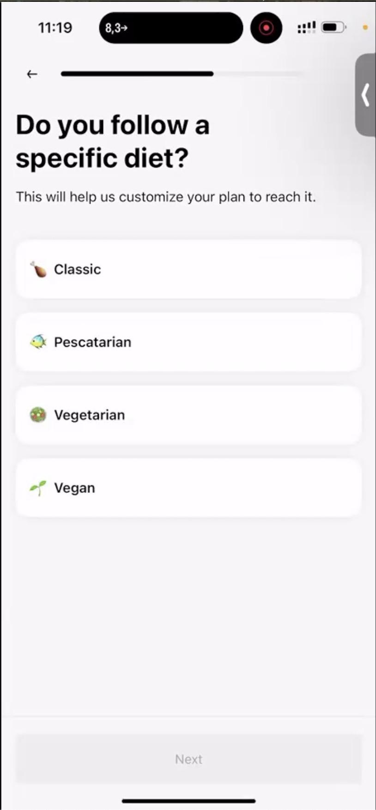
ONBOARDING
11. Diet
“Where is 'I do not follow a diet'? Is that 'classic'?”
8/10
Lecture 1 · Unit Economics

Slide 88
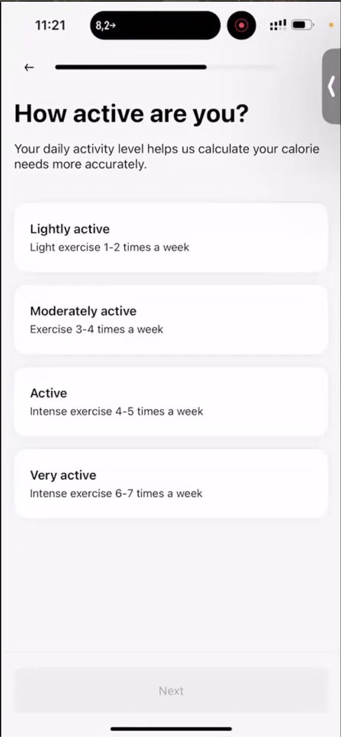
ONBOARDING
12. Activity
“I train hard 3 times a week. Which option is mine?”
2/10
Lecture 1 · Unit Economics

Slide 89
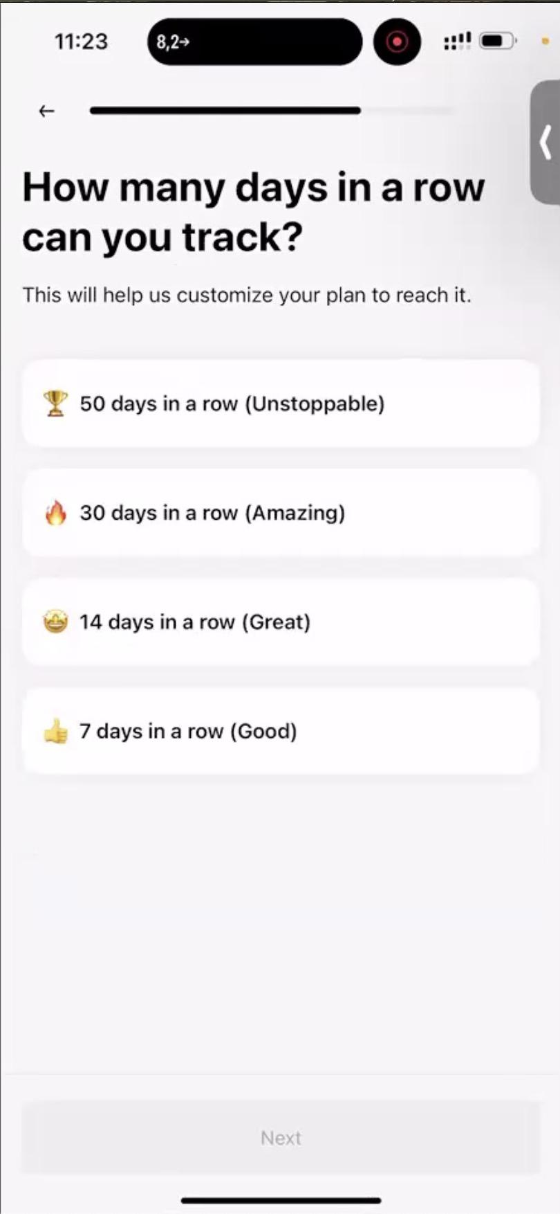
ONBOARDING
10. Tracking
“How would I know? Maybe ask if I tracked before.”
2/10
Lecture 1 · Unit Economics

Slide 90
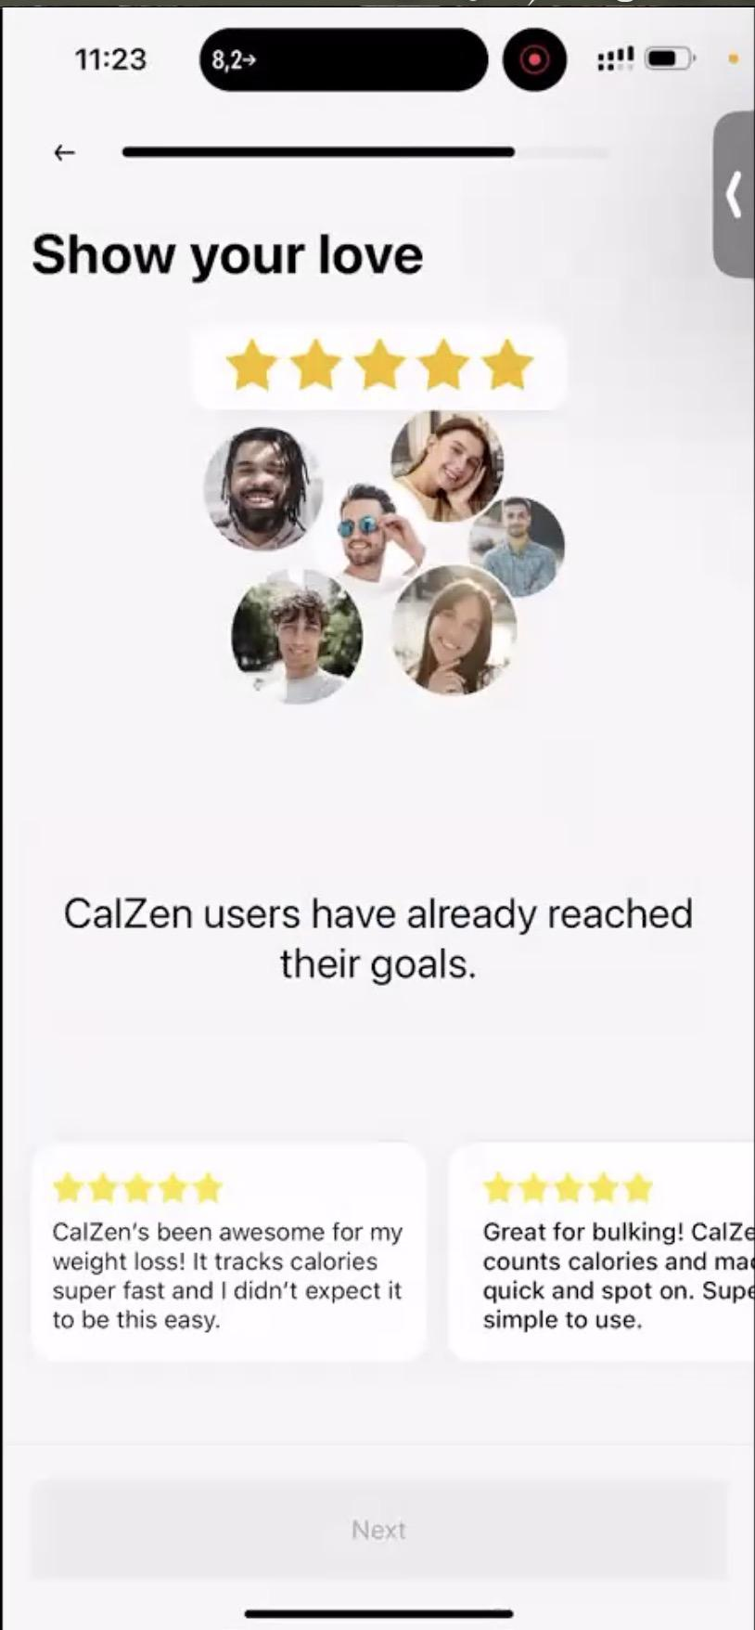
ONBOARDING
11. Reviews
“Isn't it too early?”
4/10
Lecture 1 · Unit Economics

Slide 91
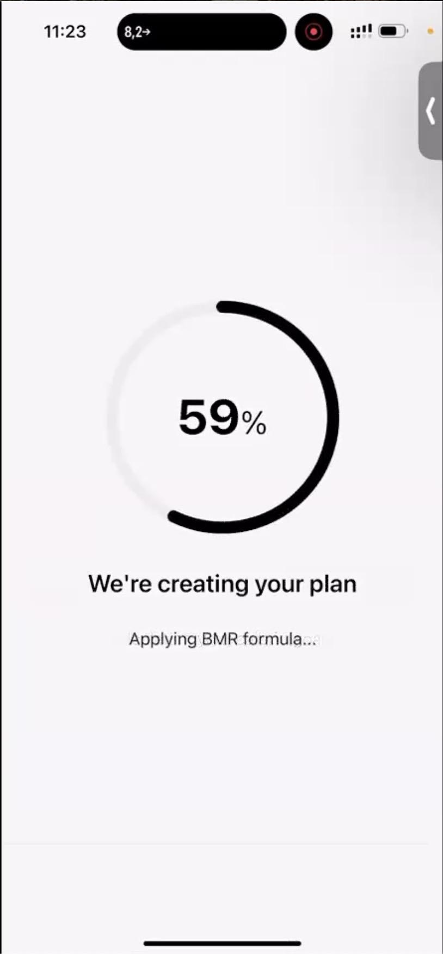
ONBOARDING
Progress screen
Onboarding in progress
No major objection captured on this step.
Lecture 1 · Unit Economics

Slide 92
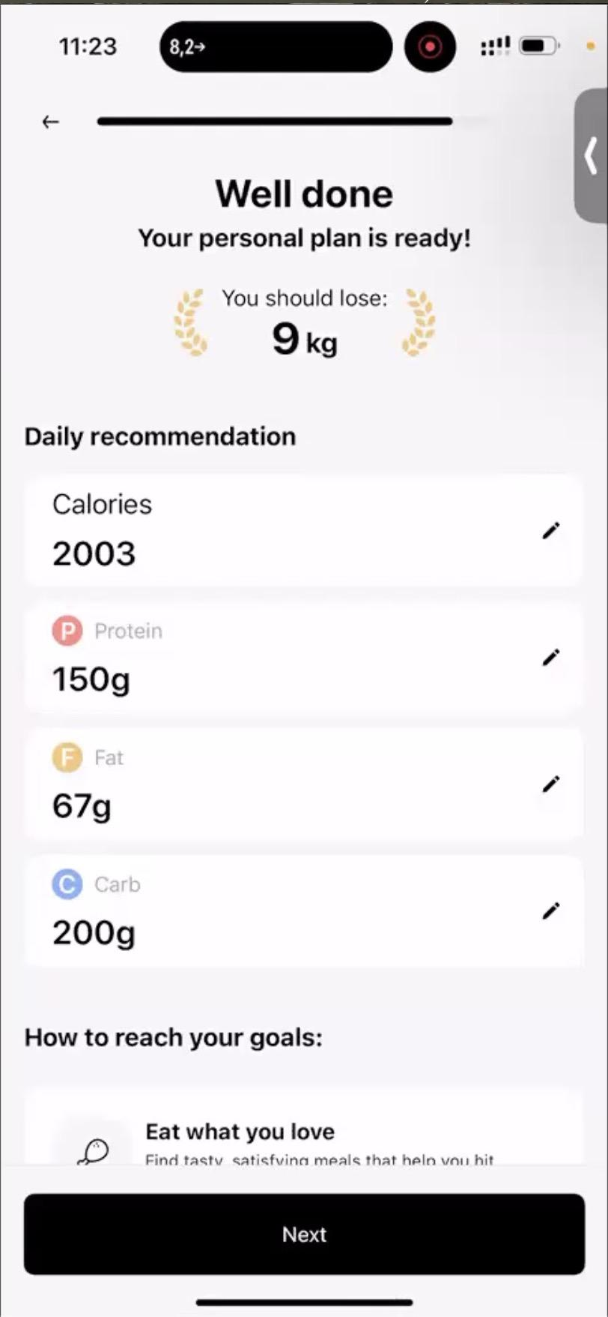
ONBOARDING
12. Plan
“Too much protein. Too few calories. When will I lose 9 kg?”
6/10
Lecture 1 · Unit Economics

Slide 93
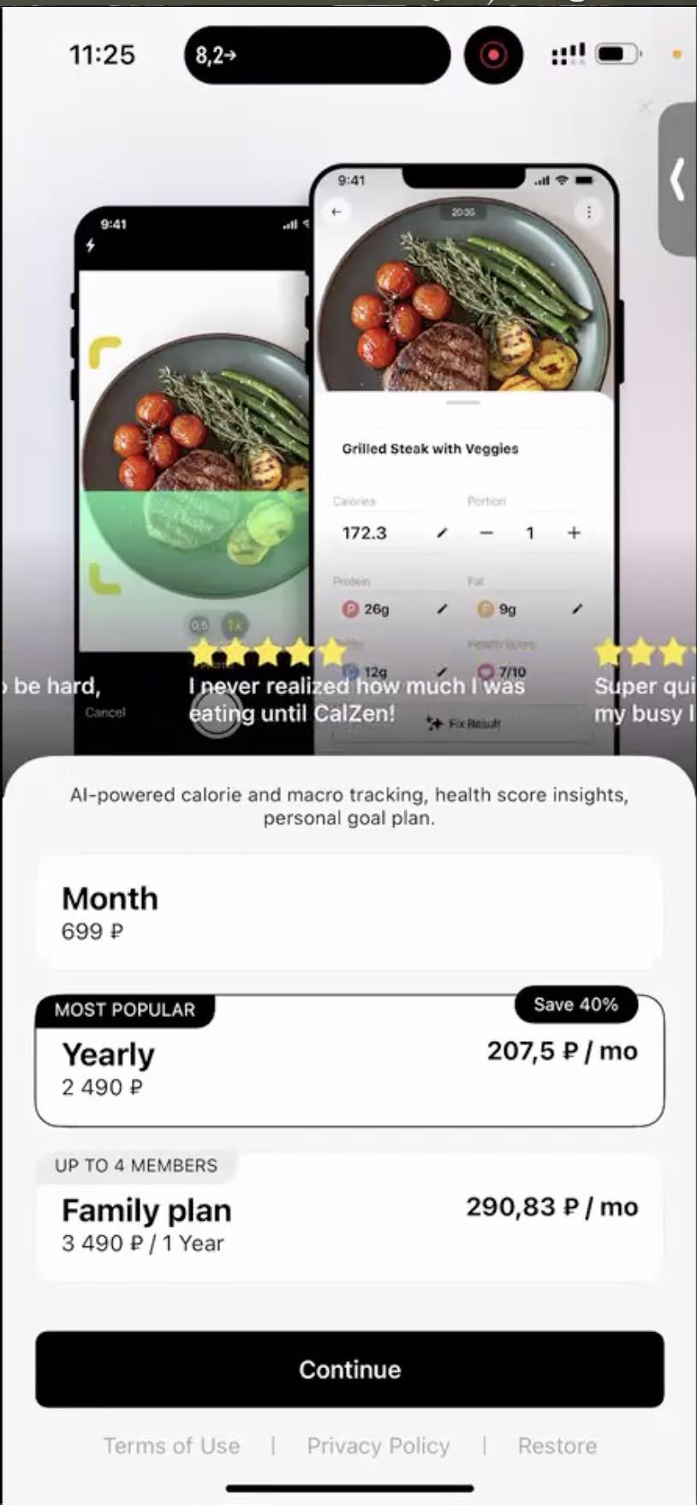
ONBOARDING
13. Subscription discount
“Can't close it? No trial? Paid only?”
6/10
Lecture 1 · Unit Economics

Slide 94
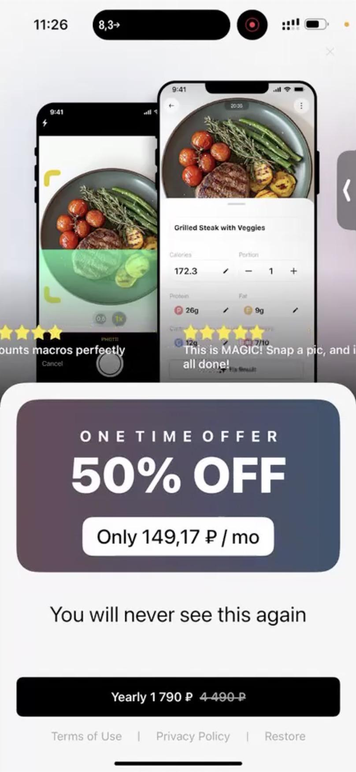
ONBOARDING
13. Subscription discount
“Why are they lying? They will show this screen again anyway.”
2/10
Lecture 1 · Unit Economics

Slide 95
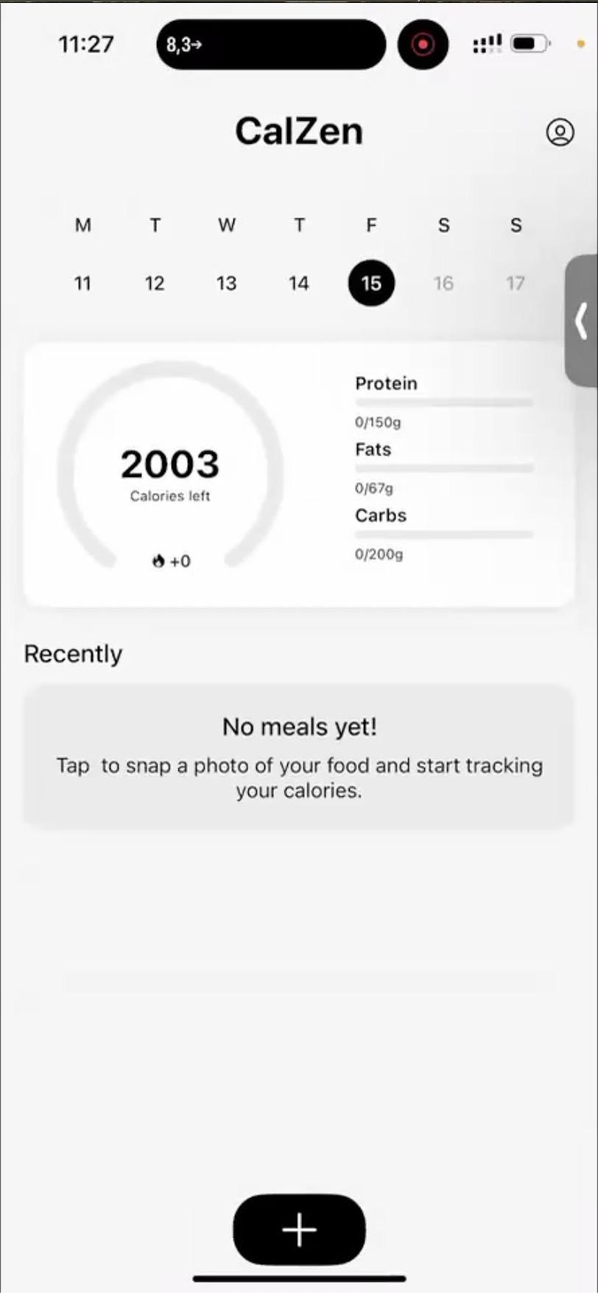
ONBOARDING
14. Main screen
No major objection captured on this step.
Lecture 1 · Unit Economics

Slide 96
03
CALZEN CASE
CalZen
01
Customer flow
02
Custdev results
03
Funnel numbers
04
Unit economics problems

Slide 97
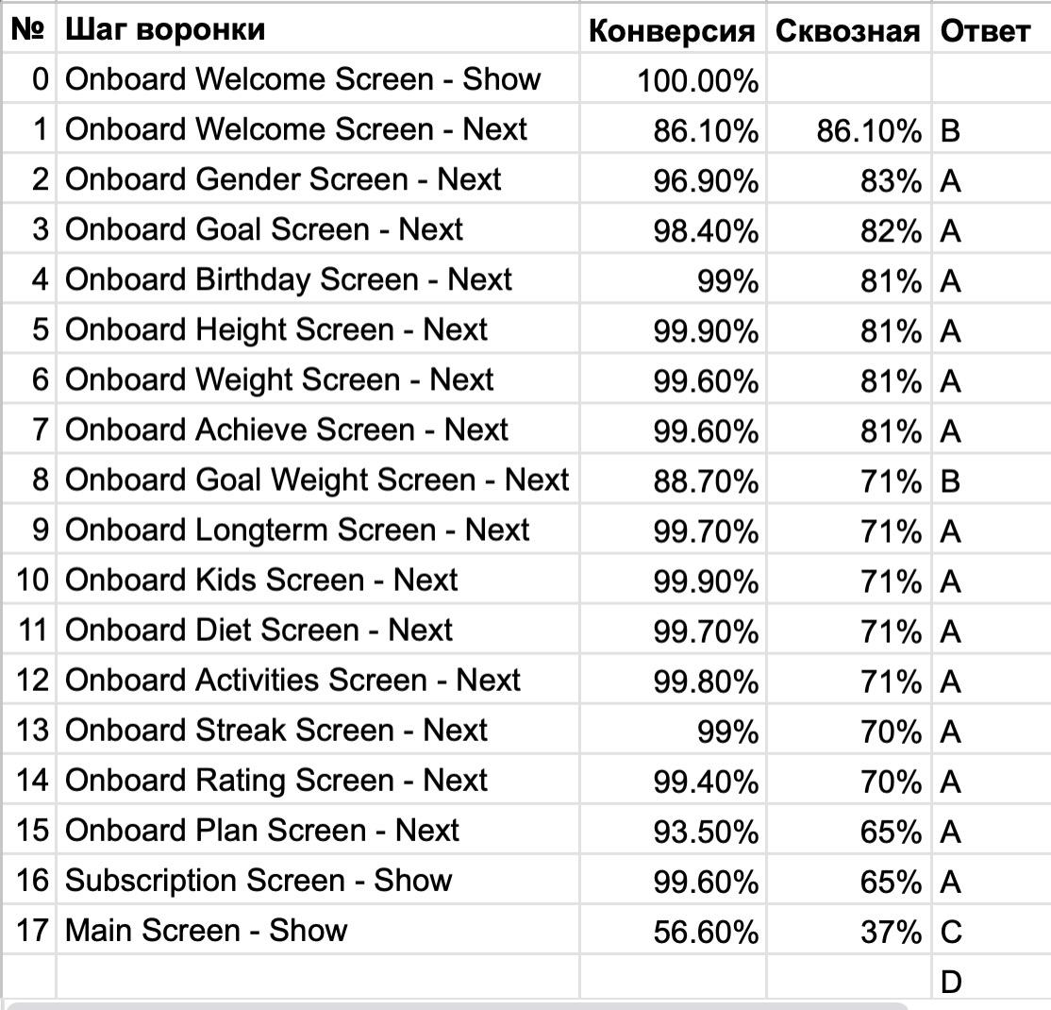
FUNNEL
Through conversion
The analytics export shows how users move through the flow.
Lecture 1 · Unit Economics

Slide 98
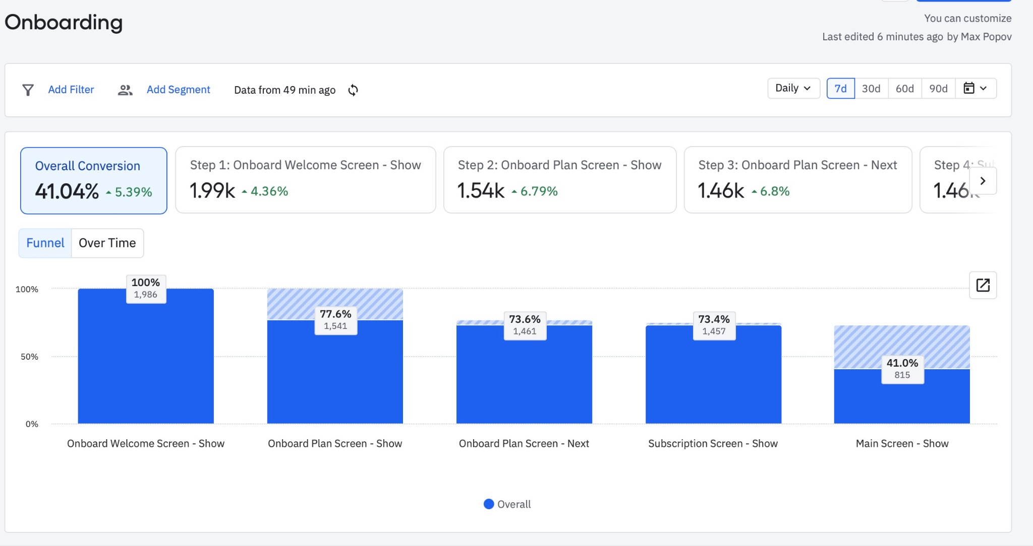
FUNNEL
With onboarding
Baseline funnel: onboarding preserves quality but loses users before payment.
Lecture 1 · Unit Economics

Slide 99
?
FUNNEL EXPERIMENT
What if we remove onboarding?
Same product, shorter path to the paywall.

Slide 100
FUNNEL
Through conversion
Step
Value
Conversion
Welcome Screen
1000
Onboarding
Main Page
410
41.0%
Subscription Screen Show
370
90.24%
Subscription Successful
33
8.92%
The onboarding itself converts well. The revenue problem appears later.
Lecture 1 · Unit Economics

Slide 101
FUNNEL
Without onboarding
Step
Value
Conversion
Welcome Screen
1000
Main Page
950
95.00%
Subscription Screen Show
857
90.24%
Subscription Successful
43
5.00%
Removing onboarding increases reach, but the final subscription conversion is still low.
Lecture 1 · Unit Economics

Slide 102
04
CALZEN CASE
CalZen
01
Customer flow
02
Custdev results
03
Funnel numbers
04
Unit economics problems

Slide 103
03
REPEAT SALES
Repeat-sales economics
The user keeps generating value and costs after the first payment.

Slide 104
Metric
Value
REPEAT SALES
CAC
$8.62
CPI
$0.50
LTV problem
Install conversion
17
End-to-end conversion
5.80%
Subscription
$17.00
Retention rate, 1y
50%
The long-term model depends on repeat use, but repeat use adds AI costs.
Repeat sale 1
$8.50
Repeat sale 2
$0.13
Repeat sale 3
$0.08
Repeat sale 4
$0.02
Repeat sale 5
$0.00
LTV, 5y
$25.71
Lecture 1 · Unit Economics

Slide 105
AI COST
Serving one user
Photo recognition
$0.02
Text recognition
$0.01
Lecture 1 · Unit Economics

Slide 106
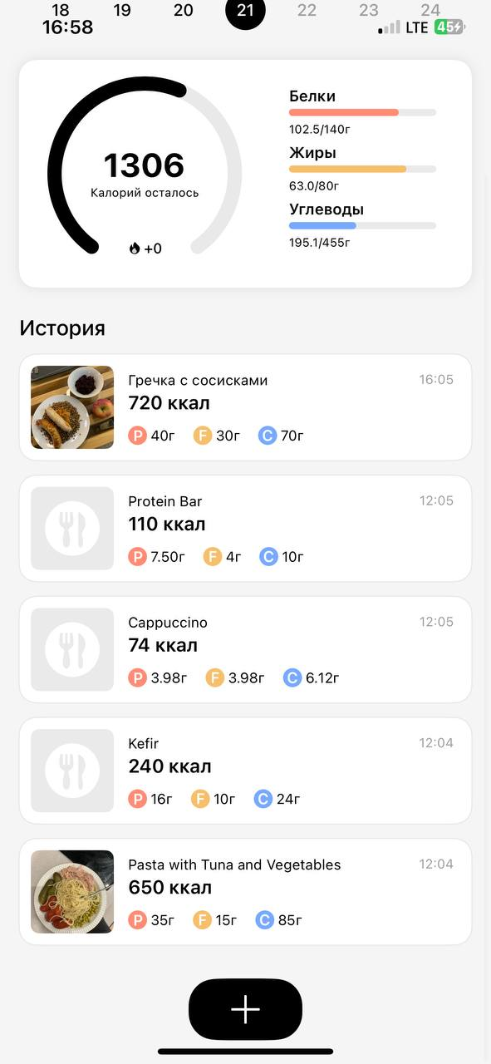
AI COST
A day of usage
Daily usage
3 photo recognitions
3 text recognitions
$0.09 per active day
Lecture 1 · Unit Economics

Slide 107
$
AI COST
100 days of service usage = $9
A cheap-looking request becomes expensive when repeated every day.

Slide 108
OPTIONS
Ways to fix it
1
Wait for the next GPT cost drop
2
Build a dish database to call the API less often
3
Maximise first sales and minimise retention
Lecture 1 · Unit Economics

Slide 109
PS
P.S.
Two additional product risks
The economics problem is not only in the funnel.

Slide 110
P.S.
Users from FatSecret
Users who used FatSecret think calorie tracking is free.
?
Question: how do you change willingness to pay when the reference product is free?
Lecture 1 · Unit Economics

Slide 111
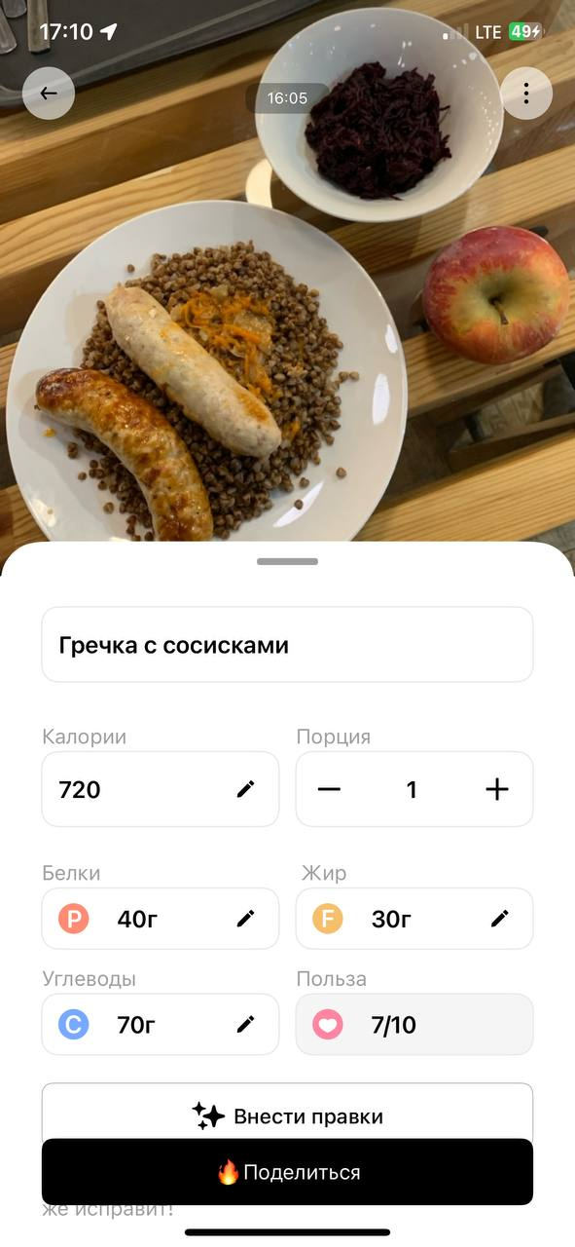
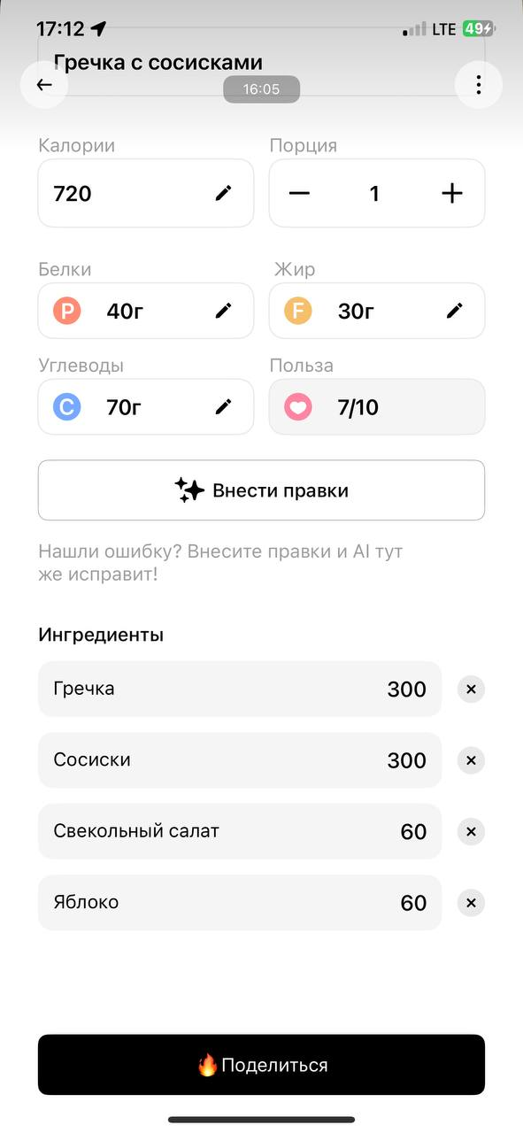
P.S.
Trust and accuracy
When tracking is automated, trust becomes part of the product.
Lecture 1 · Unit Economics

Slide 112
TAKEAWAY
16-step tiring onboarding with very high conversion (around 99%).
CalZen case
Custdev feedback contradicts the real sales funnel.
Repeat-sales paradox: it may be better if the customer leaves.
During development, remember where your main unit economics problems actually are.
Lecture 1 · Unit Economics

Slide 113
SUMMARY
John Peel: The UE in the 19th century
Lecture 2:
Done so far
John Peel: The goal UE answers
CalZen Case: The Sales Funnel Quiz
CalZen Case: The CustDev Result
CalZen Case: The Repeat-Sale Paradox
CalZen Case: The Key Insights
7
Lecture 1 · Unit Economics

Slide 114
BEFORE WE WRAP UP
Questions?
On the topics discussed and not only

Slide 115
?
Thank you
Telegram: @max_popov
Max Popov · Financial Management in Digital Products · Innopolis University

