Slide 1
11
INNOPOLIS UNIVERSITY · SUMMER 2026
Financial Management
in Digital Products
Unit Economics · Financial Modelling · Business Valuation
Lecture 11-12 — Kazan Express, Magnit Market, Uzum
Max Popov · Course Instructor

Slide 2
BEFORE WE START
Turn on Meeting
Recording
Make sure the recording is running, and only then begin.
Lecture 11-12 — Kazan Express, Magnit Market, Uzum

Slide 3
TODAY
1
Kazan Express Story & Unit Economics
What we'll cover
2
Magnit Market – Acquisition by Magnit
3
Uzum – Team transfer
4
Additional scores before exam
5
Exam date & format, Exam Q&A
6
The Course Recap
Lecture 11-12 — Kazan Express, Magnit Market, Uzum

Slide 4
CASE · PART 1
KazanExpress
→ Magnit Market
How Tatarstan's marketplace was built — and sold.

Slide 5
CONCEPT
A marketplace is a platform that does not own the inventory. It matches independent sellers with buyers, and monetises the transaction — the match itself — rather than the product.
What is a
marketplace?
1
2
3
Two sides
No inventory
Take rate
The platform sells the transaction, not the goods.
Sellers and buyers, each with its own funnel, CAC and retention.
The platform never buys the goods — no stock on the balance sheet.
Revenue is a cut of GMV: commission, ads, services, delivery.
EXAMPLES
Magnit Market (ex-KazanExpress) · Uzum · Ozon · Wildberries · Amazon
Lecture 11-12 — Kazan Express, Magnit Market, Uzum
A retailer buys and resells. A marketplace never owns what it sells — that is the whole difference.

Slide 6
UNIT ECONOMICS
CONTRIBUTION PROFIT PER ORDER
One client,
end to end
+ Platform earns
− Platform pays
+ Commission
− Payment
+ Ads
− Fulfillment
+ Seller Services
− Last Mile
+ Delivery Fee
− Pickup Point
− Returns
Unit = one client. Everything the platform earns and pays on that single order.
− Support
− Promo
Buyer LTV = Contribution Profit per Order × Repeat Orders
THE TWO QUESTIONS THAT DECIDE EVERYTHING
1
Contribution Profit per Order > 0 ?
2
Buyer LTV > Buyer CAC ?
Lecture 11-12 — Kazan Express, Magnit Market, Uzum

Slide 7
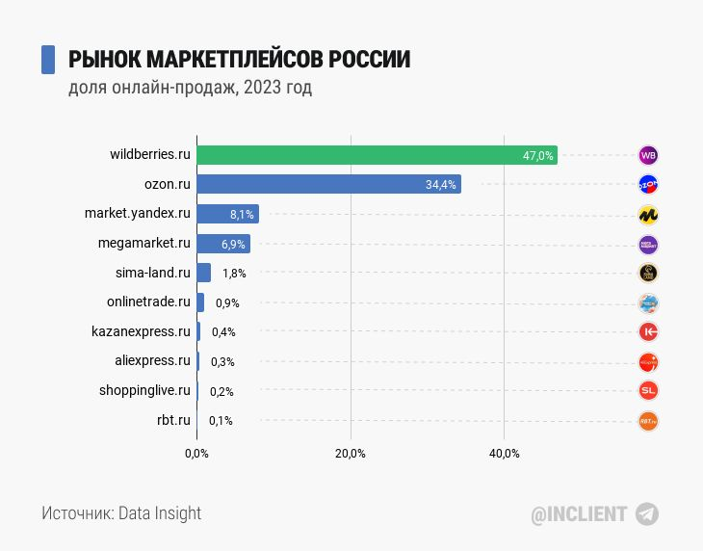

Slide 8
2017
A Tatarstan marketplace, betting on speed.
Born in Kazan
Founded by Linar Khusnullin & Kevin Khanda
The gap: no Russian marketplace; AliExpress shipped slowly from China
The bet: delivery in one day
First pickup points in Kazan — Innopolis among the first cities

Slide 9
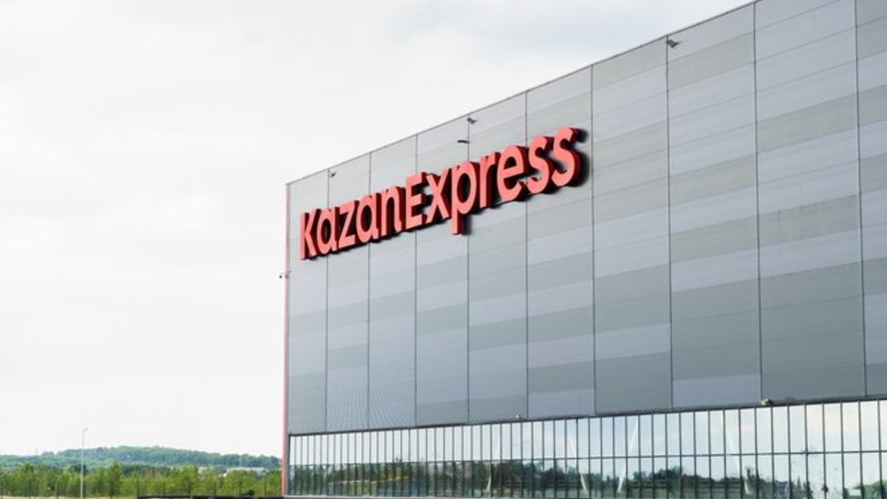

KazanExpress won early not through assortment or scale, but through delivery speed achieved by concentrating logistics locally.

Slide 10
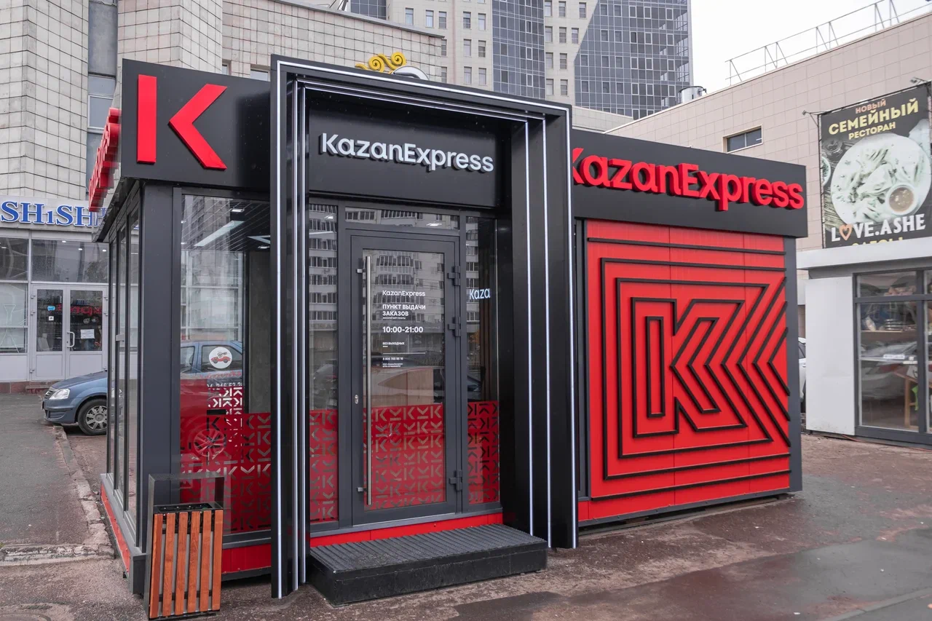

Slide 11
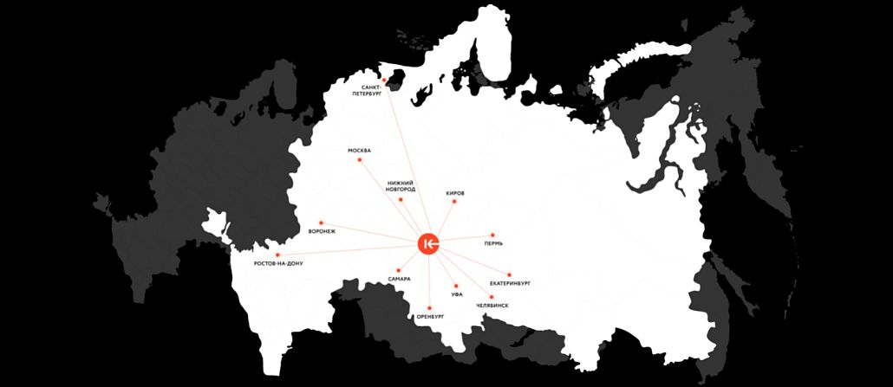

Slide 12
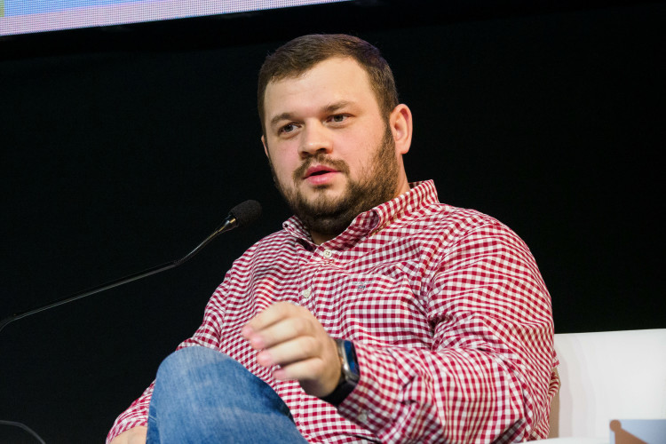
FOUNDER · 1
FROM OFFLINE RETAIL TO ONE-DAY DELIVERY
He had already built a retail chain before the marketplace.
Linar
Khusnullin
1
Before KazanExpress he came from offline retail: he grew the fixed-price store chain “Vsyo po 99 rubley” (Everything for 99 roubles).
Founder & CEO of KazanExpress — the business frontman
2
The chain reached roughly 140 stores across 80 cities. He then sold his stake to his partner and started looking for a new model — online retail with fast delivery.
3
The idea behind KazanExpress: a “Russian AliExpress”, but with next-day delivery — cheap assortment combined with local speed.
PHOTO
Linar Khusnullin · portrait
At KazanExpress he was CEO and the business frontman: strategy, scaling, partnerships, investor negotiations and the logistics model.
4
5
After the Magnit deal he stayed involved, arguing that the real value of KazanExpress was never just the warehouses and pickup points — it was the team, the competences and a working fast local delivery model.
Lecture 11-12 — KazanExpress → Magnit Market, Uzum

Slide 13
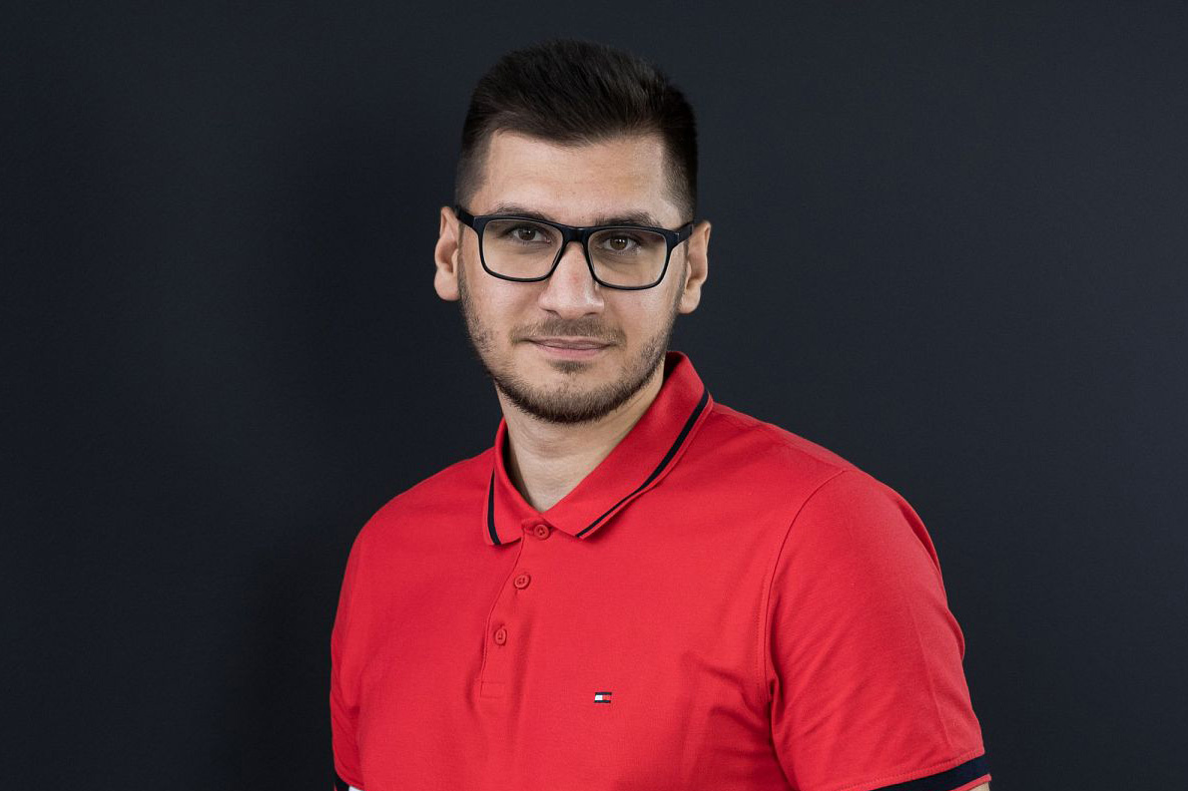
FOUNDER · 2
THE TECHNOLOGY SIDE OF THE MARKETPLACE
The platform, the warehouse and the logistics ran on his code.
Kevin
Handa
1
A graduate of Innopolis University who moved to Tatarstan from Moscow — he became the technology co-founder of KazanExpress.
Innopolis graduate · co-founder & CTO of KazanExpress
2
At KazanExpress he was the technical leader / CTO: he was responsible for building the IT platform that ran the marketplace, the warehouse and the logistics.
3
His contribution was not “just a website” but the technological infrastructure of a marketplace: an in-house warehouse and logistics management system was what made one-day delivery possible.
PHOTO
Kevin Handa · portrait
He made the Forbes “30 Under 30” list in the Entrepreneurs category, as one of the young tech founders behind the growth of KazanExpress.
4
5
After KazanExpress he stayed in e-commerce and moved to Uzum — Innopolis lists him as co-founder of KazanExpress and CTO / CPO of Uzum.
Lecture 11-12 — KazanExpress → Magnit Market, Uzum

Slide 14
2018–2020
From local pilot to a multi-city marketplace.
Growth &
first capital
First investor: GK Fix
Registered as OOO KazanExpress (2019)
Expansion across cities; own logistics & pickup network
“Made in Russia” program for local sellers
Later: turnover, daily orders, sellers, Inc. Russia valuation

Slide 15

https://fix.ru

Slide 16
2021
The pivotal change in ownership.
AliExpress
takes control
AliExpress Russia raises its stake to a controlling one
Founders become minority shareholders
Enters Forbes' top-20 Russian internet companies

Slide 17
2022–2023
Scale without profit.
Big reach,
thin economics
Top-5 Russian marketplace by daily orders
Still loss-making
Tiny market share next to Wildberries & Ozon
Later: unit economics, market share, GMV

Slide 18
CAP TABLE
KEY INVESTORS AND PARTICIPANTS
Who backed
KazanExpress
INVESTOR / PARTICIPANT
WHAT IS KNOWN
Fix Group /
Dmitry Eremeev /
Sergey Eremeev
In 2018 KazanExpress raised about $2M from the Fix group. Sergey Eremeev later became a major co-owner of the KazanExpress structure.
Two rounds and one takeover. The founders kept the operating roles; the money came from outside.
AliExpress Russia
Invested in 2021: the talk was initially about roughly 30%, then AliExpress raised its stake to a controlling 50.1%+.
Linar Khusnullin
Founder and CEO; the entrepreneurial side of the project.
Kevin Handa
Co-founder and CTO; the technology side of the project.
Magnit
Not an investor in the classic sense but a buyer: in 2023 it bought 100% of KazanExpress and began turning it into Magnit Market.
Fix, 2018 → AliExpress Russia, 2021 → Magnit, 2023 — 100% exit
Lecture 11-12 — KazanExpress → Magnit Market, Uzum

Slide 19
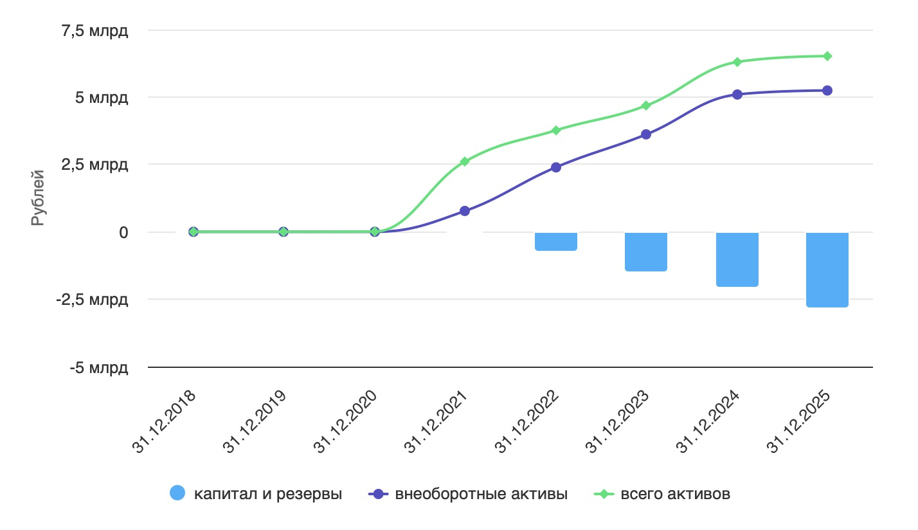
https://www.audit-it.ru/buh_otchet/1648052064_ooo-kazanekspress-fulfilment

Slide 20
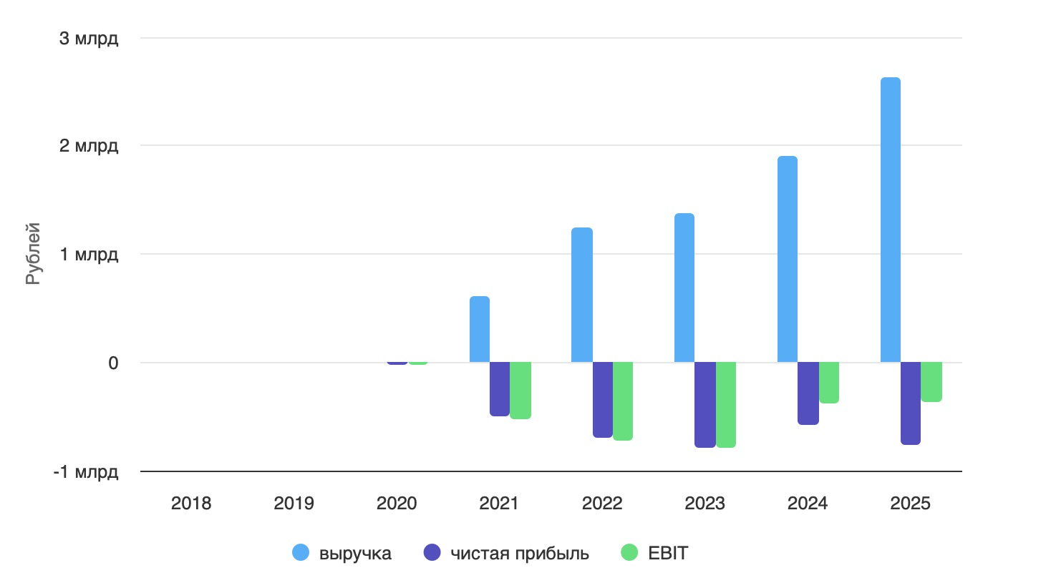
https://www.audit-it.ru/buh_otchet/1648052064_ooo-kazanekspress-fulfilment

Slide 21
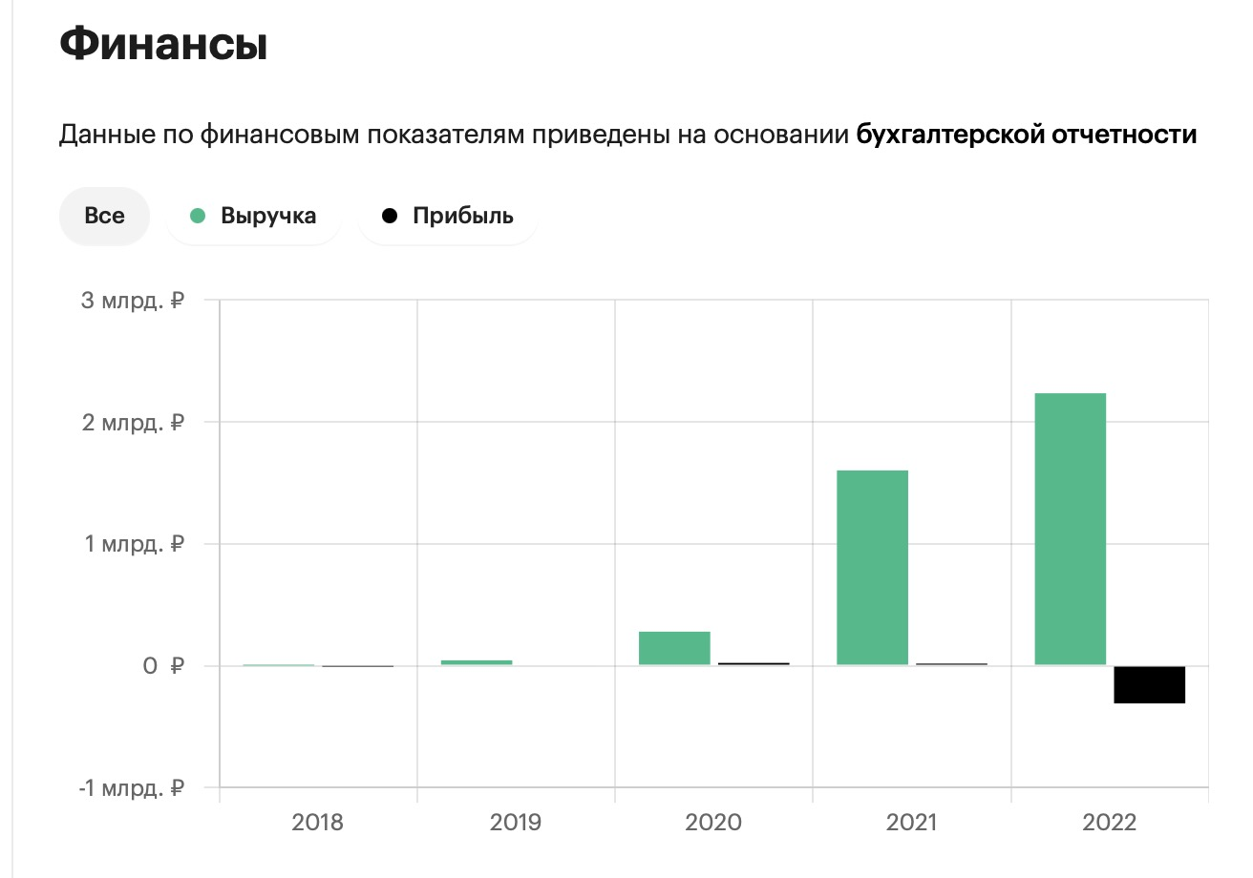
https://companies.rbc.ru/id/1181690055557-ooo-logisticheskaya-kompaniya-zadenru/

Slide 22
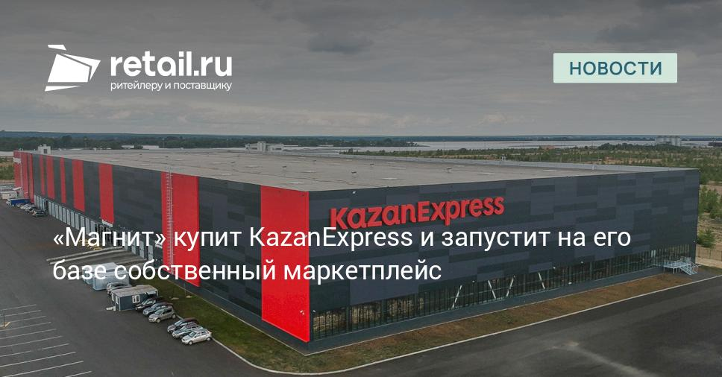

Slide 23
2023
The exit — via acquisition.
Sold to Magnit
Magnit buys 100% of KazanExpress
Sber had also wanted the company
A condition of the deal: rebrand the marketplace
Later: deal size, $180M Forbes valuation

Slide 24
MOTIVATION
WHY MAGNIT BOUGHT KAZANEXPRESS
Four reasons, in the retailer's own words.
Buy,
don't build
1
Speed over building
2
Not a shell — a machine
Magnit said it plainly: buying lets it enter the marketplace segment fast, with fewer resources than a build from scratch.
The deal included the tech platform, pickup points, warehouses, the vehicle fleet, the IP — and 12,000 ready sellers.
Magnit wanted to be a marketplace. Building one from zero was slower and dearer than buying one that already worked.
3
Pickup points synergy
4
A cheap entry ticket
500 pickup points in 120 cities, to be multiplied inside 28,300 Magnit stores. Up to 4,000 new ones were planned.
≈ 10 bn ₽ by expert estimates — about 6% of Magnit's expected 2023 EBITDA for a whole new segment.
The strategy: make the shelf infinite, turn 28,300 stores into the last mile.
Lecture 11-12 — KazanExpress → Magnit Market, Uzum

Slide 25
DEAL PARAMETERS
THE PRICE
What was
it priced at?
OFFICIAL
EXPERT ESTIMATE
FORBES VALUATION
Not disclosed
≈ 10 bn ₽
$180M
THE MULTIPLES
MULTIPLE
VALUE
WHY
P / S
3.6x – 5.7x
Price ÷ revenue of 2.8 bn ₽ (2022). The one multiple that actually computes.
The price was never disclosed. Everything below is built on estimates — and on FY2022 reporting.
P / GMV
0.5x – 0.8x
Price ÷ GMV of 19.3 bn ₽. What buyers of loss-making marketplaces really look at.
P / E
n / m
The 2022 net result was a loss of − 1.6 bn ₽. A negative denominator makes the ratio meaningless.
P / B
n / m
Accumulated losses had eaten the equity. Book value near zero or negative — the ratio breaks.
Two of the four multiples do not exist here. That is the lesson: a loss-making platform cannot be priced on earnings or on book.
Lecture 11-12 — KazanExpress → Magnit Market, Uzum
Price range: 10 bn ₽ (expert estimate) to ≈ 16 bn ₽ ($180M at ≈ 90 ₽/$). All ratios on FY2022 figures.

Slide 26
AFTERMATH
MAGNIT MARKET, FY2024
They bought
the assets
ORDERS, YoY
GMV, YoY
NET LOSS
DATA INSIGHT
− 34%
− 25%
3.2 bn ₽
#57
WHAT ACTUALLY BROKE
1
One-day delivery — the whole reason KazanExpress existed — stretched to 3–7 days.
… and lost the model. Two years on, the marketplace is smaller than the one Magnit paid for.
2
A category-based commission arrived, so sellers had to raise their prices.
3
Sellers report collapsing traffic; net loss more than doubled, 1.47 → 3.22 bn ₽.
THE TAKEAWAY
Khusnullin said the value was never the warehouses and the pickup points — it was the team and a working model. Magnit bought the first and lost the second.
In M&A you buy a unit economics, not a balance sheet — and someone has to keep it running.
Lecture 11-12 — KazanExpress → Magnit Market, Uzum

Slide 27
CASE · PART 2
The Kazan code
moves to Tashkent
Uzum Market — built on a KazanExpress-licensed platform, by a 15-person Innopolis dev team that moved to Tashkent in 2022.

Slide 28
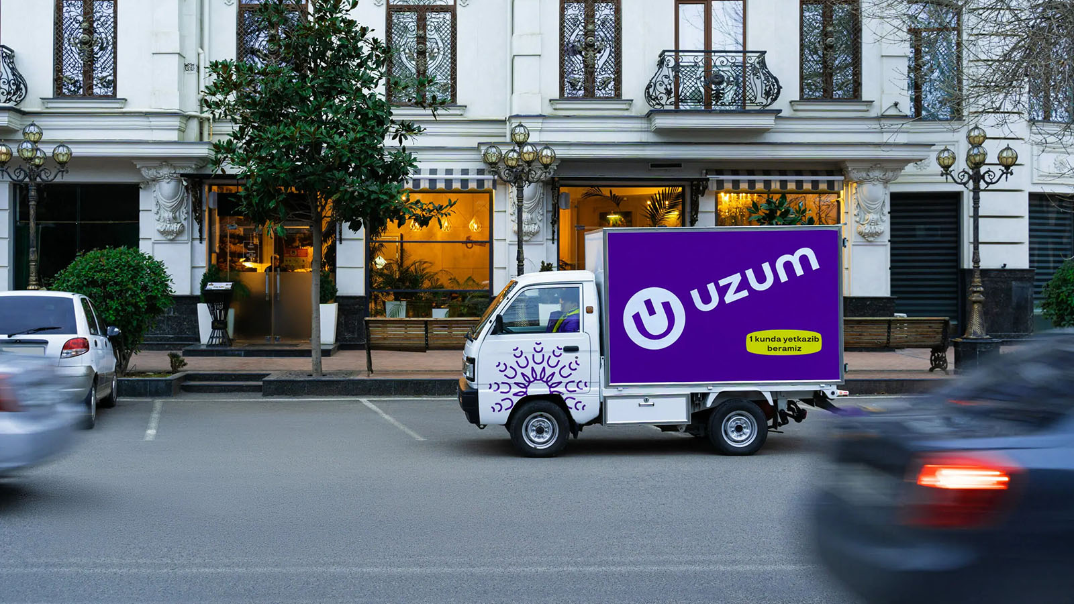

Slide 29
UZUM
“Uzum” = grape: a cluster of services on one stem.
The grape
ecosystem
Uzum Market — marketplace, one-day delivery
Uzum Bank — neobank (from Apelsin)
Uzum Nasiya — BNPL / installments (from Paymart)
Uzum Tezkor — express food & grocery delivery
Uzum Avto — automotive marketplace

Slide 30
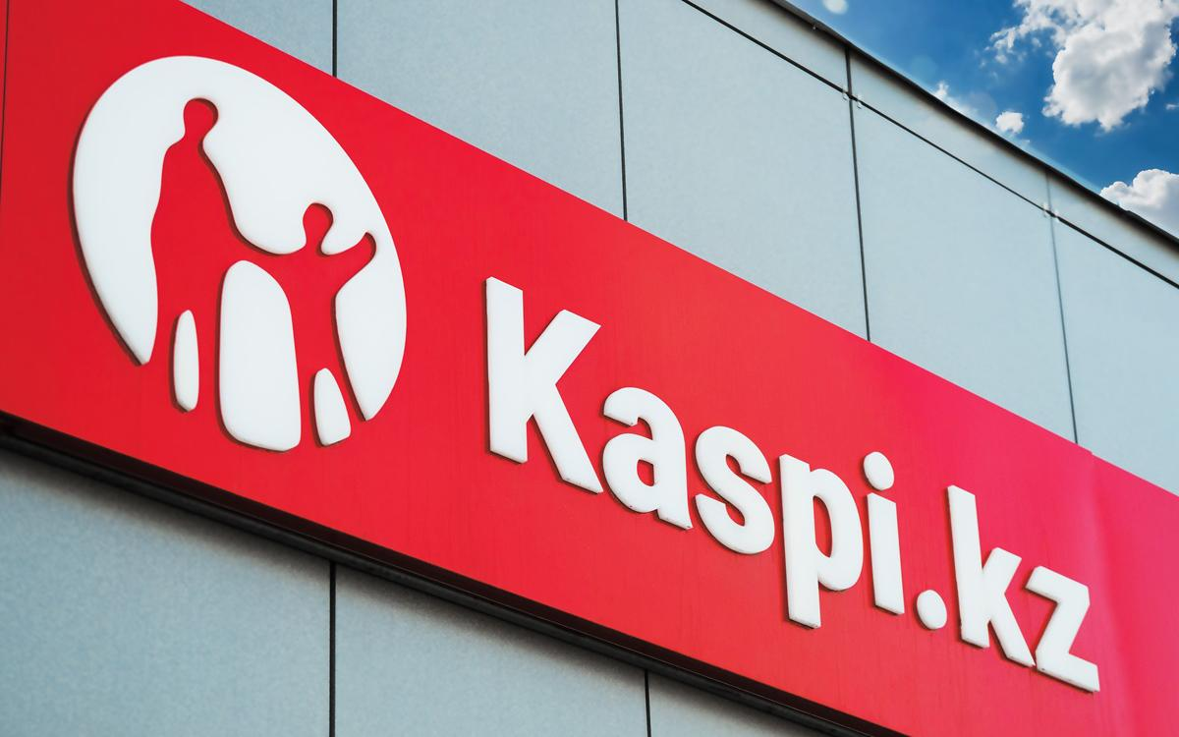

Slide 31
2022
Leapfrog the bazaar.
Founding
& thesis
Founded by Djasur Djumaev (CEO)
A young market with almost no e-commerce yet
Thesis: skip offline retail — go straight from bazaar to digital, Amazon-style

Slide 32
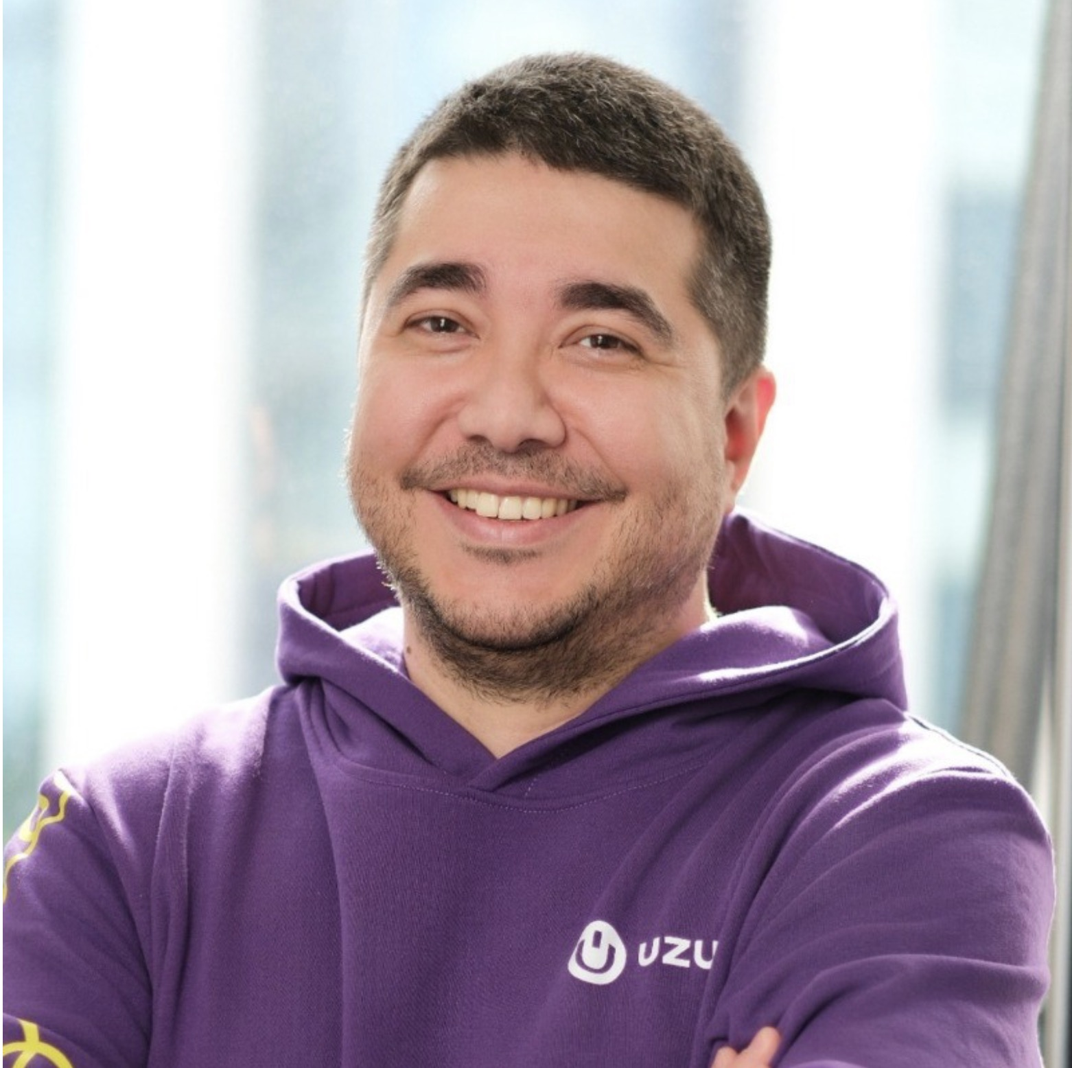
FOUNDER · UZUM
HE BUILT THE PROFITABLE ONE
Same region, same playbook — a very different outcome.
Djasur
Djumaev
1
An Uzbek entrepreneur with a BBA from Westminster International University in Tashkent. Before Uzum he was a serial founder, venture investor and business angel — among other things a co-founder and board member of KupiKupon.
Founder & CEO of the Uzum ecosystem
2
He founded Uzum in Tashkent in 2022. “Uzum” means grape in Uzbek: many berries on one stem — which is precisely the thesis. Marketplace, bank, lending and delivery hang off a single platform.
3
He hired operators, not just coders. Nikolay Seleznev (ex-JP Morgan) runs strategy — and Kevin Handa, the CTO of KazanExpress, is now CTO & CPO of Uzum.
PHOTO
Djasur Djumaev · portrait
His bet: Uzbekistan skips a step. Retail will leapfrog straight from bazaars and informal trade into digital commerce, without the traditional-retail phase in between.
4
5
The result: the country's first unicorn, valued at $2.3bn by March 2026, with 20M users — and, unusually for a marketplace, actually profitable ($176M net income in 2025).
Lecture 11-12 — KazanExpress → Magnit Market, Uzum

Slide 33
OCT 2022
Infrastructure first, then the ecosystem.
Launch &
the cluster
Built logistics, fleet & pickup points for one-day delivery
Launched Uzum Market
Apelsin bank & Paymart (BNPL) folded into the “grape”

Slide 34
2024
Uzbekistan's first tech unicorn.
First unicorn
Series A led by FinSight Ventures
Valuation crosses $1 billion
Ambition: to become the Uzbek Kaspi.kz
Later: $114M raise, round structure, $1.1B valuation

Slide 35
2025–2026
Scaling capital and users.
Rise toward
an IPO
New rounds: Tencent / VR Capital, then sovereign Oman
17M+ monthly users — over half the country
On course for a 2027 IPO
Later: $1.5B → $2.3B valuation, revenue & GMV

Slide 36
SYNTHESIS
One Kazan code, three trajectories.
One DNA,
three exits
KazanExpress
Teez
Uzum
sold to Magnit
sold to a fintech
heading for an IPO
M&A
M&A
IPO
Two ways out for a tech company: sell to a strategic buyer, or go public — the bridge to Digital Habits' pre-IPO story.

Slide 37
EXAM · ADDITIONAL SCORES
The List of
Practical Tasks
All the tasks to complete along the course

Slide 38
RESUBMISSION
DEADLINE
21 July
Nothing is accepted after this date.
Second
chance
1
Unit Economics Tasks
2
Unit Economics Test — Lectures 1–2
Six tasks are open again. Resubmit any of them to raise your score.
3
Lectures 3–4 Test
4
Rental Apartment Case / Financial Ratios
5
Digital Habits Valuation Task
6
Final Takeaway
Financial Management in Digital Products — Resubmissions
Each resubmission earns extra credit. It replaces your previous attempt only if it scores higher.

Slide 39
TASK · LECTURES 3–4
SmenaPro
UE Case
Build the unit-economics model for a small SaaS in Google Sheets — then submit the link.
25 minutes, in class.
Open the task
max-ppv.ru
WHAT YOU SUBMIT
A shared Google Sheets link — make sure access is open.
Lecture 11-12 — Kazan Express, Magnit Market, Uzum

Slide 40
EXAM · FINAL DAY
Exam
Date & Format
The format and requirements

Slide 41
EXAM
Choose one — one slot per person.
Pick your
exam slot
WEEK 1
WEEK 2
Wednesday
Wednesday
22 July
29 July
09:00
09:00
Four options across two weeks. Each slot runs the same exam.
Thursday
Thursday
23 July
30 July
17:40
17:40
Lecture 11-12 — Kazan Express, Magnit Market, Uzum
Same format, same difficulty — the date is the only difference.

Slide 42
EXAM
FORMAT
WHERE
DEFENCE
Online
Yandex Telemost
10 minutes
How the
exam works
WHAT YOU DO
Pick a time slot
A short oral defence of your own case solution — online, one on one.
1
Choose one slot in the shared file. One per person, first come first served.
Examine the case
2
Have your own case solution open and ready to share your screen.
Defend it live
3
We go through your model together — numbers, assumptions, logic.
Financial Management in Digital Products — Exam
No slides, no report — just your model and a conversation about it.

Slide 43
?
WRAP-UP
Questions?
On the exam format — and not only.
Lecture 11-12 — Kazan Express, Magnit Market, Uzum

Slide 44
COURSE RECAP
The whole course,
in one pass
Σ
L 1–2
Unit Economics foundations
L 3–4
Prioritization & Constraints
L 5–6
Financial modelling & ratios
L 7–8
Valuation
L 9–10
Services → product
L 11
Marketplaces

Slide 45
RECAP · 1 / 6
WHAT WE COVERED
Unit Economics
foundations
1
Where UE came from — John Peel pricing single customers back in the 19th century.
2
The core metrics: CAC and LTV, and how to calculate each one.
LECTURES 1–2
1
CalZen case: the funnel quiz, the CustDev result, the repeat-sale paradox.
3
REMEMBER
The whole game plays out on one customer: LTV has to beat CAC.
Financial Management in Digital Products — Course Recap

Slide 46
RECAP · 2 / 6
WHAT WE COVERED
Prioritization
& constraints
1
Why LTV = 3 × CAC can still be bad — the cash gap between spending and earning.
2
Diving into the UE model and prioritising features by their UE impact.
LECTURES 3–4
2
Theory of Constraints (Goldratt): find the bottleneck in the funnel first.
3
REMEMBER
Fix the constraint, not the loudest problem.
Financial Management in Digital Products — Course Recap

Slide 47
RECAP · 3 / 6
WHAT WE COVERED
Financial
modelling
1
The safe-growth threshold g_safe — how fast you can grow before you run out of cash.
2
Building a financial model of a digital product from the ground up.
LECTURES 5–6
3
The financial ratios that tell you whether that model is actually healthy.
3
REMEMBER
Grow faster than g_safe and growth itself burns your cash.
Financial Management in Digital Products — Course Recap

Slide 48
RECAP · 4 / 6
WHAT WE COVERED
Modelling case
& valuation
1
GPU Compute Rent case — a full model built around the central bank key rate.
2
Business valuation: how a company is actually put to a price.
LECTURES 7–8
4
A real-life valuation case to anchor the method in something concrete.
3
REMEMBER
Value is discounted future cash flow — the key rate is the lens you discount through.
Financial Management in Digital Products — Course Recap

Slide 49
RECAP · 5 / 6
WHAT WE COVERED
Services
to product
1
Digital Habits and the unit economics of outsourced / custom development.
2
The unit economics of a B2B product — the opposite shape to services.
LECTURES 9–10
5
The Pre-IPO valuation of the group, plus the practical assignment.
3
REMEMBER
Services and product have opposite economics; the move between them is the value story.
Financial Management in Digital Products — Course Recap

Slide 50
RECAP · 6 / 6
WHAT WE COVERED
KazanExpress
& marketplaces
1
KazanExpress: the story and the unit economics of a fast-delivery marketplace.
2
The Magnit acquisition — buy vs build, and why the assets are not the model.
LECTURE 11
6
The Uzum team transfer — competences move on, infrastructure stays behind.
3
REMEMBER
In M&A you buy a unit economics, not a balance sheet.
Financial Management in Digital Products — Course Recap

Slide 51
THE THROUGH-LINES
Four ideas
under all of it
1
2
It all reduces to one unit
Cash is not profit
One customer, one order. If the unit doesn't work, scale only makes the loss bigger.
The cash gap and g_safe both come from timing, not from margin. You can be profitable and still run dry.
Every case in this course was really one of these four in disguise.
3
4
A number needs a perimeter
Model first, opinion second
The same trap in valuation and in M&A: a multiple is meaningless until you know what it is measured over.
Every case here was a model before it was a judgement. The number comes first; the story explains it.
That is the course: read the unit, respect the cash, mind the perimeter, and model before you decide.
Financial Management in Digital Products — Course Recap

Slide 52
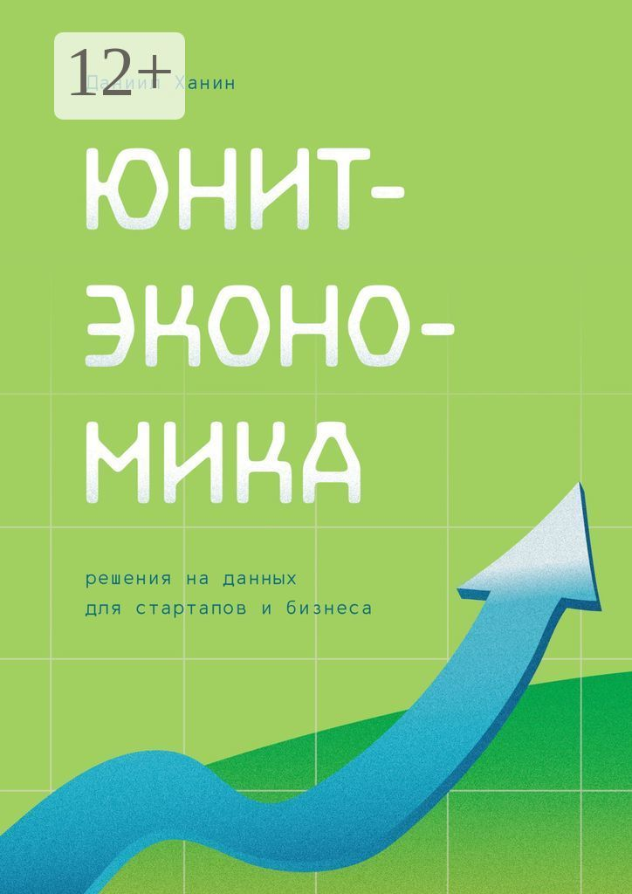




Slide 53

TODAY
Kazan Express Story & Unit Economics
Done During the Course
Magnit Market – Acquisition by Magnit
Uzum – Team transfer
Additional scores before exam
Exam date & format, Exam Q&A
The Course Recap
7
Lecture 9-10 — Digital Habits, Outsource Development, From Services to Products

Slide 54
?
Thank you
Telegram: @max_popov
Max Popov · Financial Management in Digital Products · Innopolis University

