Slide 1
BEFORE WE START
Turn on Meeting Recording
Make sure the recording is running, and only then begin.
R E C
Financial Management in Digital Products

Slide 2
0
INNOPOLIS UNIVERSITY · SUMMER 2026
Financial Management
in Digital Products
Unit Economics · Financial Modelling · Business Valuation
Lecture 3 — Unit Economics
Max Popov · Course Instructor

Slide 3

PREVIOUS LECTURE
Course Structure, Grading, Schedule
Lecture 1:
Done so far
Introduction + Product Manager Lens
Unit Economics Foundations
Where UE Came From
Calculating the core metrics — CAC & LTV
The key question of unit economics
7
Lecture 3 · Unit Economics + Prioritization

Slide 4
PREVIOUS LECTURE
John Peel: The UE in the 19th century
Lecture 2:
Done so far
John Peel: The goal UE answers
CalZen Case: The Sales Funnel Quiz
CalZen Case: The CustDev Result
CalZen Case: The Repeat-Sale Paradox
CalZen Case: The Key Insights
7
Lecture 3 · Unit Economics + Prioritization

Slide 5
PREVIOUS LECTURE
Two activities,
Link
Lecture 1: Survey
Rate topics from the most interesting to the least interesting
Lecture 1: Test
Answer the questions depending on the material
Lecture 3 · Unit Economics + Prioritization

Slide 6
TODAY
1
When LTV = 3*CAC is bad, Cash Gap
Lecture 3:
What we’ll cover today
2
Unit Economics Model Dive In
3
UE Model Practical Task
4
Priorities
5
Prioritization based on UE
6
Discussion: What Feature Impacts What
Lecture 3 · Unit Economics + Prioritization

Slide 7
3×
UNIT ECONOMICS
When LTV = 3 × CAC isn't enough, Cash Gap
A healthy ratio can still burn cash.

Slide 8
BENCHMARK
What LTV / CAC is healthy?
< 1×
1×
3×
> 5×
Losing money
Break-even
Healthy
Under-investing
LTV $80 vs CAC $100 — you pay more than you earn.
LTV $100 = CAC $100 — nothing left to grow.
LTV $300 vs CAC $100 — the common target.
Great margins — but maybe you could grow faster.
Rule of thumb: aim for LTV / CAC ≈ 3×. But the ratio alone doesn't tell you if you can afford to grow.
Lecture 3 · Unit Economics + Prioritization

Slide 9
COHORT VIEW
One customer looks profitable
Month
Cash flow
Cumulative
Month 0 — CAC paid
−$100
−$100
Month 1
+$50
−$50
Month 2
+$50
$0 (payback)
Month 3
+$50
+$50
Month 4
+$50
+$100
Month 6
+$50
+$200
CAC $100, then +$50 every month. Payback in month 2, +$200 over six months. On its own, LTV = 3 × CAC looks great.
Lecture 3 · Unit Economics + Prioritization

Slide 10
COMPANY VIEW
Month
New cust.
CAC paid
LTV collected
Net cash
But growth burns cash
1
100
−$10,000
$0
−$10,000
2
150
−$15,000
+$5,000
−$10,000
3
225
−$22,500
+$12,500
−$10,000
4
338
−$33,800
+$23,750
−$10,050
5
506
−$50,600
+$40,650
−$9,950
6
759
−$75,900
+$65,950
−$9,950
+50% customers every month. LTV / CAC = 3.0×, every cohort profitable — yet the company burns ~$10k each month.
Lecture 3 · Unit Economics + Prioritization

Slide 11
CASH GAP
Why the gap appears
MONEY OUT — now
CAC is paid up front, in full, the moment you acquire a customer.
MONEY IN — later
LTV trickles back over months. The faster you grow, the more CAC you pay before old cohorts repay.
That timing mismatch is the cash gap — and growth makes it wider.
Lecture 3 · Unit Economics + Prioritization

Slide 12
DEFINITIONS
Cash flow ≠ revenue
Revenue
Cash flow
Counted when it is earned — the contract, the sale, the promise.
Shows whether the business model works. Can look healthy while the bank account drains.
Counted when money actually moves.
Pays salaries and ad bills. It is what keeps the company alive — or not.
You can be profitable on paper and still run out of cash.
Lecture 3 · Unit Economics + Prioritization

Slide 13
SELF-FUNDED GROWTH
Scaling without outside money
Scenario
CAC
1st-mo profit
Ratio
Result
Bad UE
$100
$50
0.5×
Needs outside cash
Break-even
$100
$100
1.0×
Replaces spend only
Self-funded
$100
$120
1.2×
Reinvests surplus
A SaaS can self-fund growth only when first-month contribution > CAC — not just when total LTV / CAC looks good.
Lecture 3 · Unit Economics + Prioritization

Slide 14
RETENTION → LIFETIME
Customer lifetime (LT)
LT = 1 / (1 − RR)
LT — average number of purchases per customer · RR — retention rate per period
RR = 80% → LT = 1 / (1 − 0.8) = 1 / 0.2 = 5 purchases
RR 50%
RR 67%
RR 75%
RR 80%
RR 90%
LT 2
LT 3
LT 4
LT 5
LT 10
Higher retention → a longer lifetime, and LT × gross profit per purchase is the revenue side of LTV.
Lecture 3 · Unit Economics + Prioritization

Slide 15
HERO TASK · OPTIONAL
Homework
The Safe
Pace of Scaling
YOUR MISSION
Derive, from first principles, the maximum monthly growth rate g_safe a business can sustain with no ever-deepening cash gap — written using only r = LTV / CAC and LT = 1 / (1 − RR).
Optional. Invent the formula yourself — don't look it up. Bring your derivation to the consultation.
THE MODEL
WHAT TO DELIVER
CAC paid upfront, at acquisition
Margin m collected from the next month
LT = 1 / (1 − RR), LTV = m × LT
New customers compound at rate g / month
No cash gap = steady-state net cash ≥ 0
Rebuild the slide: CAC $100, m $50, LTV/CAC 3 — find LT
Derive — then box g_safe ( r, LT )
Validate: does it flag +50% growth as unsafe?
Hero twist: does retention really matter, or is it "just 1 / payback"?
g_safe ( r, LT ) = ?
Lecture 3 · Unit Economics + Prioritization

Slide 16
%
SIMPLE UE MODEL
Unit Economics Model Dive In
From one impression to the last sale.

Slide 17
THE FUNNEL
Impressions
100,000
From impression to sale
↓ CTR 2%
Clicks
2,000
↓ CR₁ 25%
Leads / Installs / Subs
500
↓ CR₂ 40%
Regs
200
↓ CR 50%
Trials
100
↓ CR 20%
Purchases
20
CTR = click-through rate · CR = conversion rate of each step. Multiply them to size any stage.
Lecture 3 · Unit Economics + Prioritization

Slide 18
RETENTION
1st purchase
1,000
From first to last purchase
↓ × RR 80%
2nd purchase
800
↓ × RR 80%
3rd purchase
640
↓ × RR 80%
4th purchase
512
↓ × RR 80%
5th purchase
410
↓ × RR 80%
… last purchase
→ 0
Each period a share RR = 80% buys again, so the cohort decays by RR until the last purchase. How many purchases on average? → next slide.
Lecture 3 · Unit Economics + Prioritization

Slide 19
FORECASTING
OK
Where the numbers come from
1
Ask an AI
A quick first guess — OK to start.
BETTER
2
Find a benchmark
Reports: AppsFlyer, Unbounce, ChartMogul.
EVEN BETTER
3
Call a friend / agency
People who run these funnels daily.
BEST
4
Verify in reality
Your own funnel data or a live test.
Benchmarks are starting assumptions, not answers — replace them with your real funnel data.
Lecture 3 · Unit Economics + Prioritization

Slide 20
THE CASE
UNIT ECONOMICS TASK
SmenaPro helps small cafés, bakeries, and barbershops build staff shift schedules, notify employees in Telegram, and export hours for payroll.
SmenaPro:
build the UE model
Owners now coordinate shifts in spreadsheets and chats. Acquisition comes only from Yandex Direct search ads. Visitors start a 14-day free trial with no card, then become monthly subscribers or churn.
25 minutes · Google Sheets
PLAN
TARGET
1,490 ₽ / month / location
Small service businesses · 1–5 locations
CHANNEL
TRIAL
Yandex Direct search ads
14 days · no card
Deliverable
Create a Google Spreadsheet with assumptions, formulas, and a final conclusion. Submit only the shared spreadsheet link on ue.html.
Lecture 3 · Unit Economics + Prioritization
No written answers on this slide — the model lives in the spreadsheet.

Slide 21
RICE
PRIORITIZATION
Priorities: Choosing what to build next
Frameworks, a worked example, and the UE lens.
Lecture 3 · Unit Economics + Prioritization

Slide 22
FRAMEWORKS
Popular prioritization systems
RICE
ICE
Reach × Impact × Confidence ÷ Effort
Impact × Confidence × Ease
MoSCoW
Kano
Must · Should · Could · Won't
Basic · Performance · Delight
Value / Effort
WSJF
Quick 2×2 win-finder
Cost of Delay ÷ Job Size (SAFe)
Lecture 3 · Unit Economics + Prioritization

Slide 23
WORKED EXAMPLE
RICE in practice
Feature
Reach
Impact
Conf.
Effort
RICE
#
Onboarding revamp
5,000
2.0
80%
3
2,667
1
Referral program
3,000
1.5
70%
2
1,575
2
Dark mode
8,000
0.5
90%
4
900
3
RICE = (Reach × Impact × Confidence) ÷ Effort. Higher score = build first. One formula turns opinions into a ranked list.
Lecture 3 · Unit Economics + Prioritization

Slide 24
PRIORITIZATION BY UE
Does the feature pay off?
Forecast horizon: 1 year
Feature X · 1 year
Long enough to capture the adoption ramp and retention.
Added gross profit
+$60,000
Build cost
−$30,000
Short enough that the market and assumptions stay trustworthy.
Run cost (12 mo)
−$12,000
Net
Matches annual planning and budgets.
+$18,000
Beyond ~12 months a feature forecast is mostly a guess.
Build a feature when its expected 1-year gross profit > cost to build and run it.
Lecture 3 · Unit Economics + Prioritization

Slide 25
UE
PRIORITIZATION
Priorities: Based on UE of a Feature
What metric feature impacts? How much does it impact?
Lecture 3 · Unit Economics + Prioritization

Slide 26
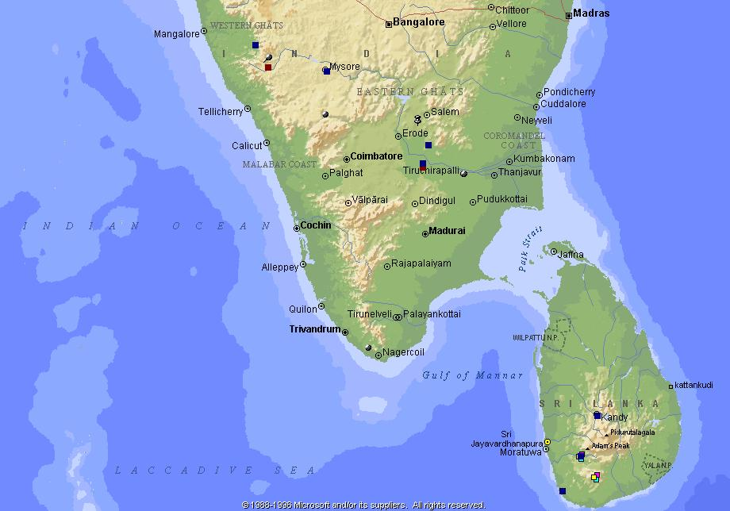

Slide 27


Slide 28


Slide 29
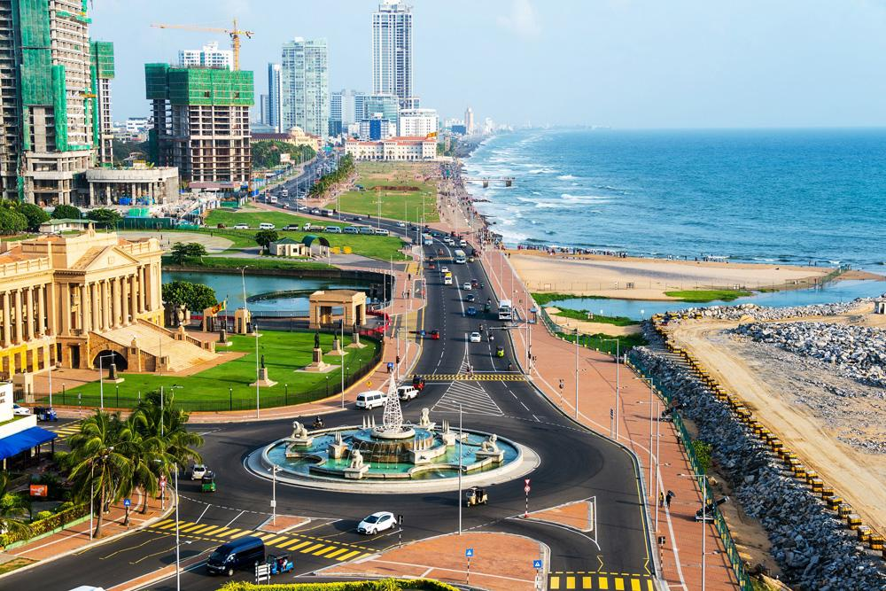

Slide 30
UE
UNIT ECONOMICS CASE
UE for Credit Organization
Lecture 3 · Unit Economics + Prioritization

Slide 31
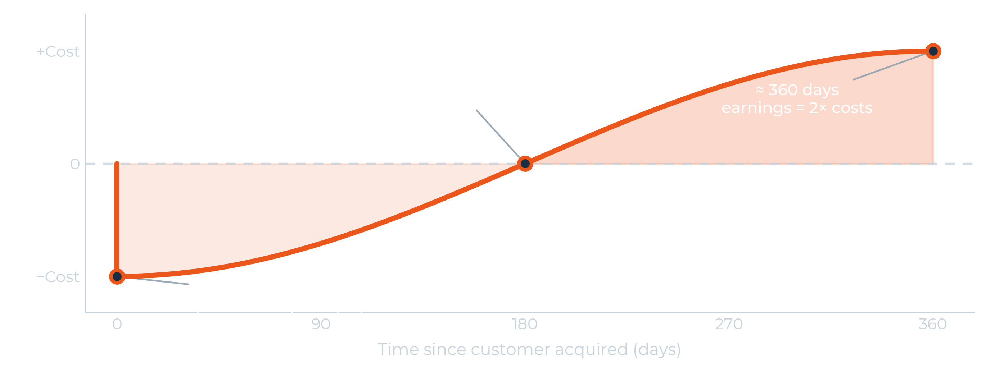
PAYBACK CURVE
Costs now, profit over time
Lecture 3–4 · Unit Economics

Slide 32
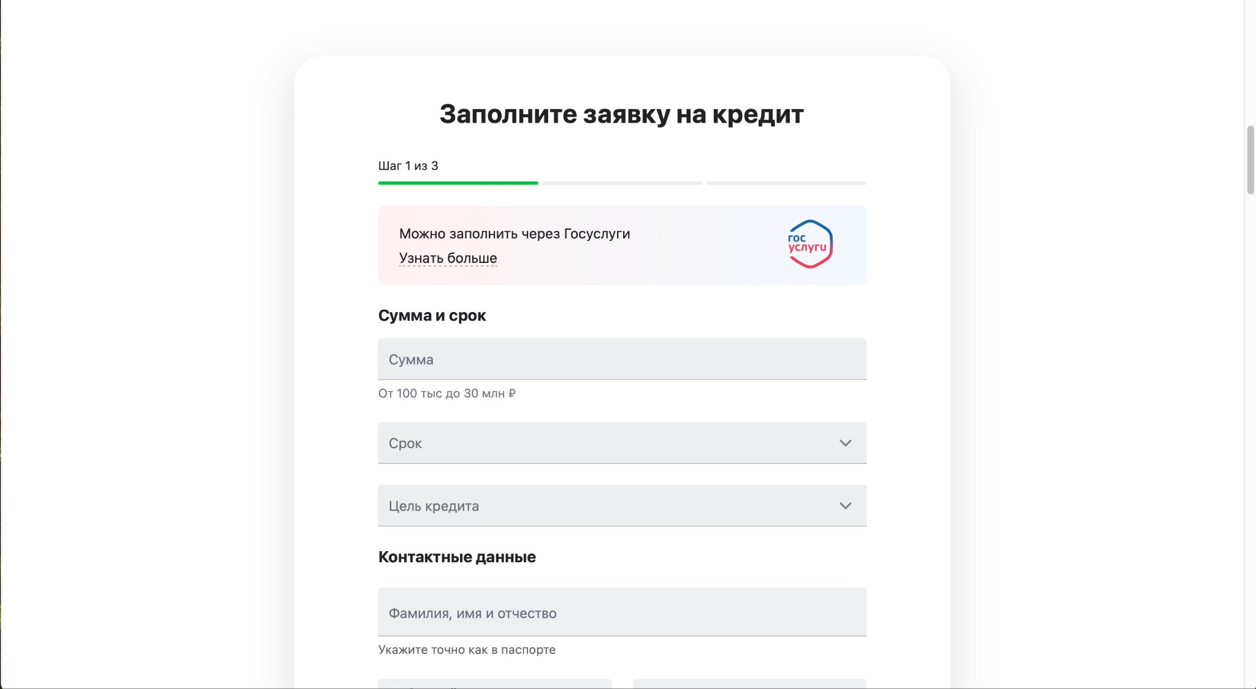

Slide 33
REAL-LIFE ISSUES
Real-life problems
→ For all acquisition channels together, or separately?
→ What cohort lifetime should we use?
→ Based on which months?
→ What to do with abnormal months?
→ What exactly goes into CAC?
Solution: measure what differs materially
Lecture 3 · Unit Economics + Prioritization

Slide 34
KEY SEGMENTS
Two key segments
"Paid traffic"
CAC $9.51 · Total Profit (LTV) −$10.28
"Partner base"
CAC $2.85 · Total Profit (LTV) $36.83
Lecture 3 · Unit Economics + Prioritization

Slide 35
FIX
PROBLEM SOLVING
Fixing the problem
Lecture 3 · Unit Economics + Prioritization

Slide 36
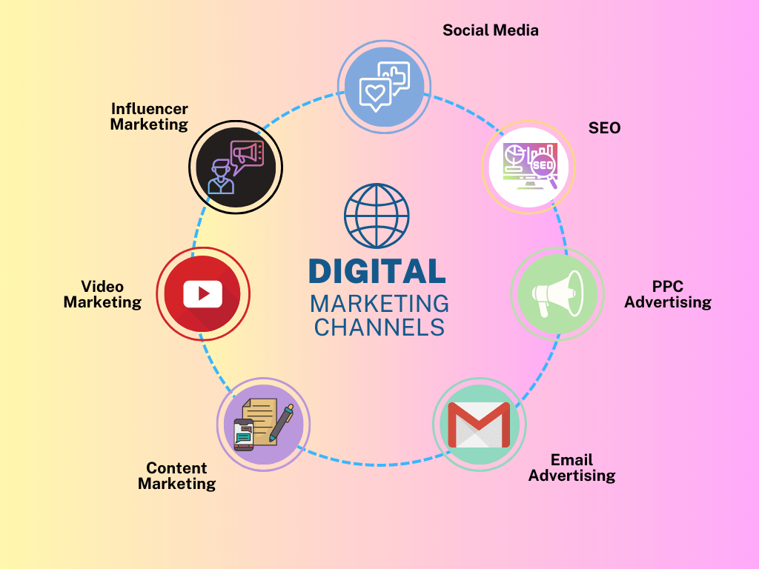
IDEA 1
Idea 1
Features to solve the problem
Let’s optimize traffic!
Cost: 10 team-hours
Payoff: ?
Lecture 3 · Unit Economics + Prioritization

Slide 37

IDEA 2
Idea 2
Features to solve the problem
Add Tamil and Sinhala languages
Cost: 10 team-hours
Payoff: ?
Lecture 3 · Unit Economics + Prioritization

Slide 38
IDEA 3
Idea 3
Features to solve the problem
Remove extra fields the risk team doesn’t use
Cost: 10 team-hours
Payoff: ?
Lecture 3 · Unit Economics + Prioritization

Slide 39
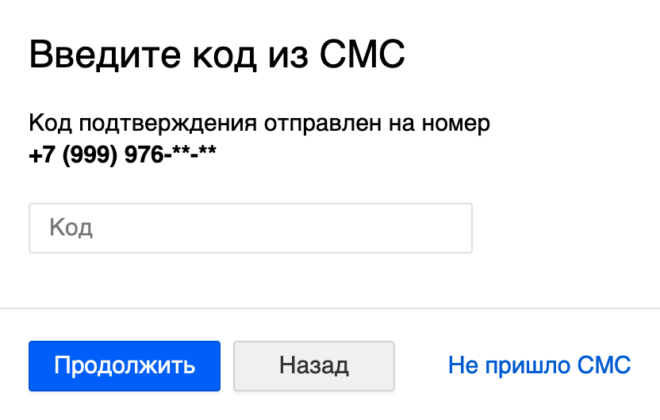
IDEA 4
Idea 4
Features to solve the problem
Improve SMS deliverability – add a backup provider
Steps: phone confirmed, terms signed
Cost: 15 team-hours
Payoff: ?
Lecture 3 · Unit Economics + Prioritization

Slide 40
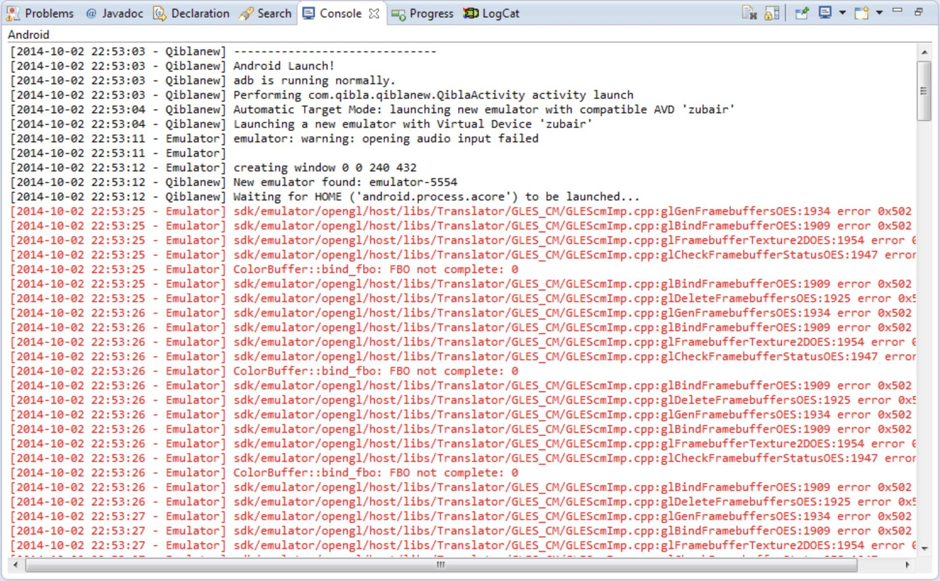
IDEA 5
Idea 5
Features to solve the problem
Improve payout deliverability – review bank error logs
Steps: Money received
Cost: 10 team-hours
Payoff: ?
Lecture 3 · Unit Economics + Prioritization

Slide 41
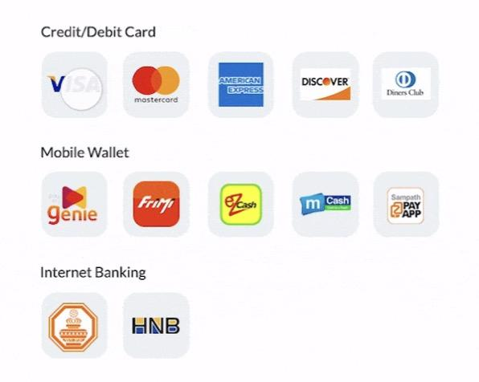
IDEA 6
Idea 6
Features to solve the problem
Add more payout methods
Steps: Bank details
Cost: 20 team-hours
Payoff: ?
Lecture 3 · Unit Economics + Prioritization

Slide 42
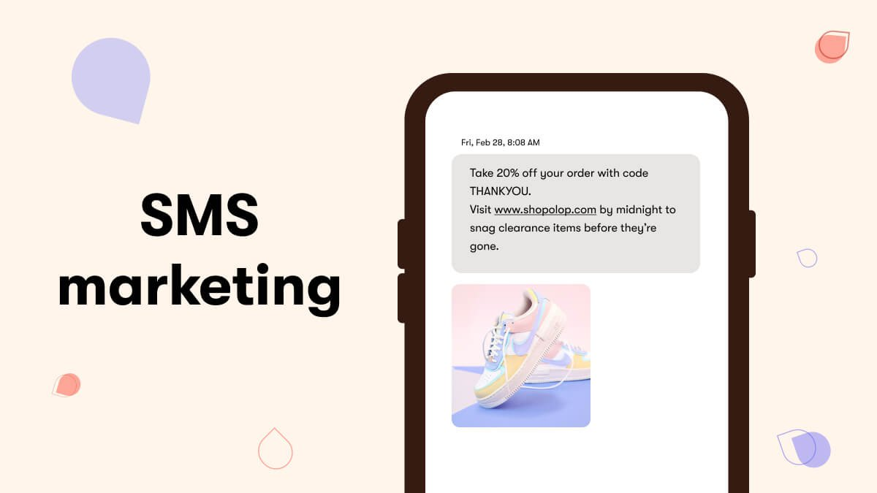
IDEA 7
Idea 7
Features to solve the problem
Roll out triggered CRM marketing
Steps: Retention Rate
Cost: 20 team-hours
Payoff: ?
Lecture 3 · Unit Economics + Prioritization

Slide 43
IDEA 8
Idea 8
Features to solve the problem
How about raising the loan approval rate?
Steps: Loan approved
Cost: 5 team-hours
Payoff: ?
Lecture 3 · Unit Economics + Prioritization

Slide 44
IDEA 9
Idea 9
Features to solve the problem
How about lowering the average check?
Cost: 5 team-hours
Payoff: ?
Lecture 3 · Unit Economics + Prioritization

Slide 45
SUMMARY TABLE
Action | Cost | Effect
Optimize traffic | 10h / $1K | +$0.5 Profit / unit
Add languages | 10h / $1K | +$0.2 Profit / unit
Remove extra fields | 5h / $0.5K | +$0.1 Profit / unit
SMS deliverability | 15h / $1.5K | +$0.25 Profit / unit
Payout deliverability | 10h / $1K | +$0.1 Profit / unit
Payout methods | 20h / $2K | +$0.05 Profit / unit
CRM marketing | 20h / $2K | +$0.1 Profit / unit
Raise approval rate | 5h / $0.5K | +$5 Profit / unit
All combined | 95h / $9.5K | +$6.3 Profit / unit
Summary of ideas
Lecture 3 · Unit Economics + Prioritization

Slide 46
KEY TAKEAWAY
Key takeaway
1
It pays to compute the unit economics of an individual feature;
2
Compare the cost against the forecasted profit;
3
Direct your key efforts at widening the main constraint (the bottleneck).
Lecture 3 · Unit Economics + Prioritization

Slide 47
BEFORE WE WRAP UP
What is your takeaway today?
On the topics discussed and not only

Slide 48
SUMMARY
When LTV = 3*CAC is bad, Cash Gap
Lecture 3:
Done so far
Unit Economics Model Dive In
UE Model Practical Task
Priorities
Prioritization based on UE
Discussion: What Feature Impacts What
7
Lecture 3 · Unit Economics + Prioritization

Slide 49
BEFORE WE WRAP UP
Questions?
On the topics discussed and not only

Slide 50
?
Thank you
Telegram: @max_popov
Max Popov · Financial Management in Digital Products · Innopolis University

Slide 51
BEFORE WE START
Turn on Meeting Recording
Make sure the recording is running, and only then begin.
R E C
Financial Management in Digital Products

Slide 52
0
INNOPOLIS UNIVERSITY · SUMMER 2026
Financial Management
in Digital Products
Unit Economics · Financial Modelling · Business Valuation
Lecture 4 — Theory of Constraints, Channel Variability
Max Popov · Course Instructor

Slide 53
TODAY
1
Theory of Constraints by Goldratt
Lecture 4:
What we’ll cover today
2
Looking for bottlenecks in Job search funnel
3
Job Search Quiz
4
Digital Product Sales Funnel Variability
5
Digital Product Monetization Variability
6
The Most Useful Skill + Homework
Lecture 4 · Theory of Constraints

Slide 54
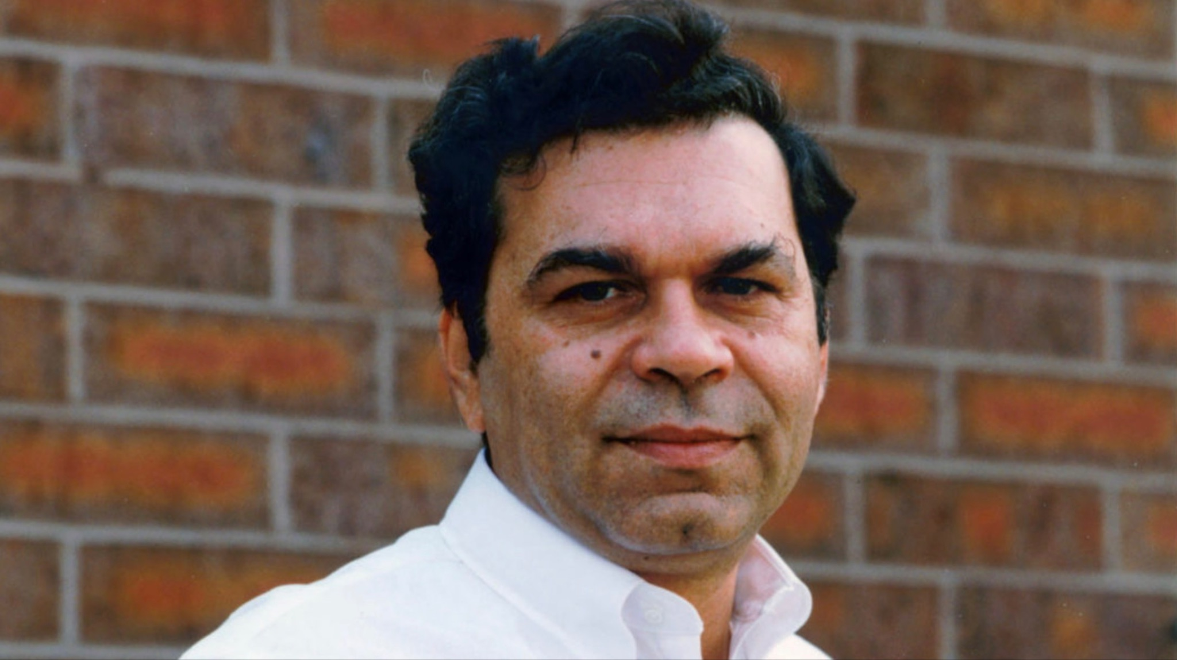

Slide 55
BOTT
BOTTLENECK
Job search as a funnel
A practical case for finding and widening constraints
Lecture 4 · Theory of Constraints, Channels Variability

Slide 56
THEORY OF CONSTRAINTS
Work with the bottleneck
1
Find the narrowest point in the system.
2
Subordinate the rest of the process to that constraint.
3
Widen the bottleneck.
4
Find the next bottleneck and repeat.
Lecture 4 · Theory of Constraints

Slide 57
CASE
CASE
Finding a 500K+ IT job
The same logic works outside product funnels
Lecture 4 · Theory of Constraints

Slide 58
GIVEN
The target outcome
500K+
12M+
₽ / month — target salary
₽ personal LTV over two years
Assumption
Relevant experience and a portfolio are already in place.
Lecture 4 · Theory of Constraints

Slide 59
QUES
QUESTION
How did he act?
Lecture 4 · Theory of Constraints

Slide 60
STEP
STEP 1
Customer development with HRs
Lecture 4 · Theory of Constraints

Slide 61
INSIGHTS
What HR interviews revealed
Around 90% of hiring starts on HH.ru.
Frequent job changes or industry switches raise questions.
The higher the grade, the more hiring happens through referrals.
Recruiters scan for keywords, not line-by-line reading.
Applications without cover letters are often ignored.
A non-standard CV format is inconvenient for screening.
A CV without a photo can look suspicious.
Lecture 4 · Theory of Constraints

Slide 62
STEP
STEP 2
Choose the key sales channel
HH.ru became the main acquisition channel
Lecture 4 · Theory of Constraints

Slide 63
CHANNEL FOCUS
Why HH.ru first?
Highest volume
It is the highest-volume channel for the target market.
Measurable
It gives clear, measurable funnel stages.
Fast to test
It allows quick experiments with profile visibility and applications.
Lecture 4 · Theory of Constraints

Slide 64
STEP 3
Funnel step | Value | Benchmark
Impressions
CR 1
Profile views
CR 2
Responses
CR 3
Invitations
CR 4
First interview (HR)
Second interview (Manager)
Third interview (Final)
Security check
Offer
Build the HH funnel
Lecture 4 · Theory of Constraints

Slide 65
STEP
STEP 4
Publish the CV and take the first measurement
Lecture 4 · Theory of Constraints

Slide 66
DAY 1
Funnel step | Value | Benchmark
Impressions | 10
CR 1 | 0.00%
Profile views | 0
Responses
Invitations
Offer
First measurement
Lecture 4 · Theory of Constraints
The first bottleneck is at the very top: too few people see the CV.

Slide 67
DECISION
What should we do?
A
Enroll in rhetoric courses to perform better in interviews.
B
Build a portfolio website.
C
Manually raise the CV in search results.
D
Buy automatic CV promotion on HH.ru for 799 RUB.
Lecture 4 · Theory of Constraints

Slide 68
DECISION
What should we do?
A
Enroll in rhetoric courses to perform better in interviews.
B
Build a portfolio website.
C
Manually raise the CV in search results.
D
Buy automatic CV promotion on HH.ru for 799 RUB.
Lecture 4 · Theory of Constraints

Slide 69
STEP
STEP 5
Buy automatic CV promotion
Lecture 4 · Theory of Constraints

Slide 70
DAY 2
Funnel step | Value | Benchmark
Impressions | 49
CR 1 | 2.04%
Profile views | 1
Responses
Invitations
Offer
After promotion
Lecture 4 · Theory of Constraints
Visibility improved, but we still need a benchmark.

Slide 71
DECISION
What should we do?
A
Find out whether 49 impressions/day and 2.04% CR are high or low.
B
Create additional CVs.
C
Publish the CV on LinkedIn, H.Careers, Getmatch, and other sites.
D
Prepare for interviews.
Lecture 4 · Theory of Constraints

Slide 72
DECISION
What should we do?
A
Find out whether 49 impressions/day and 2.04% CR are high or low.
B
Create additional CVs.
C
Publish the CV on LinkedIn, H.Careers, Getmatch, and other sites.
D
Prepare for interviews.
Lecture 4 · Theory of Constraints

Slide 73
HOW?
HOW?
How do we benchmark it?
Lecture 4 · Theory of Constraints

Slide 74
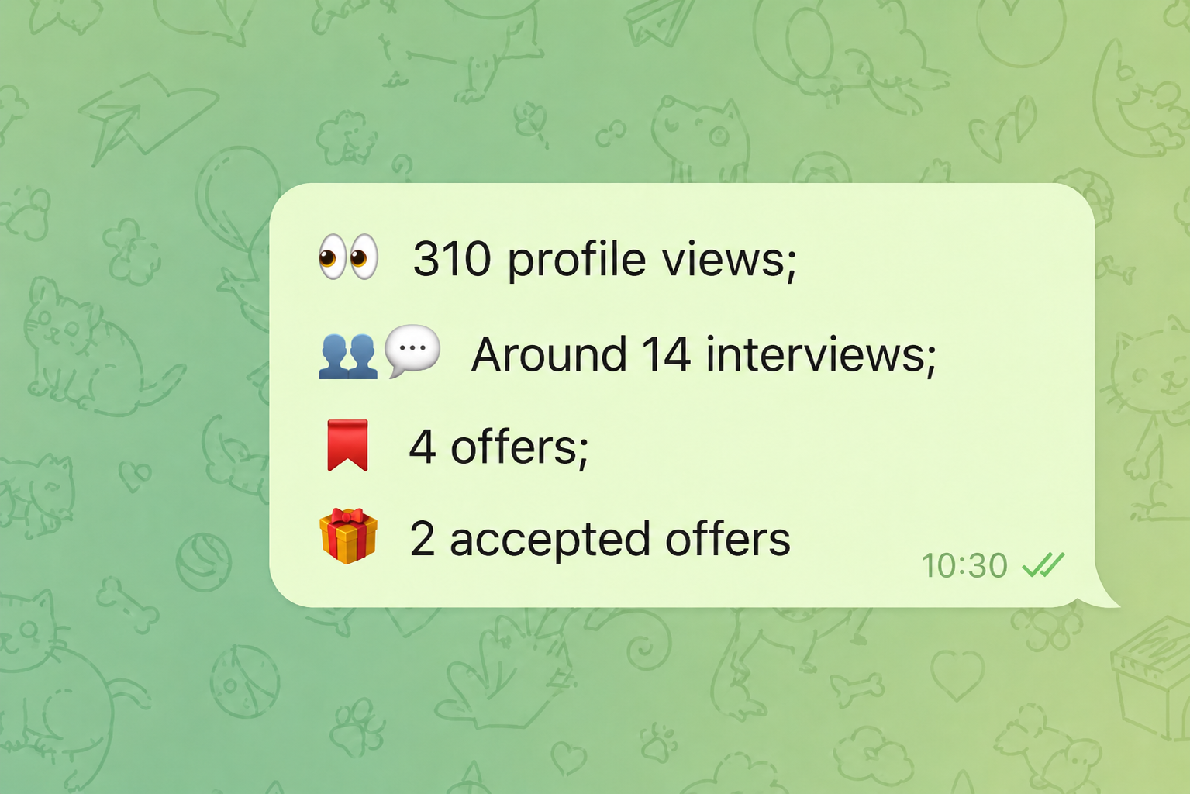
BENCHMARK
Call a friend
Lecture 4 · Theory of Constraints

Slide 75
DAY 2
Funnel step | Value | Benchmark
Impressions | 49
CR 1 | 2.04%
Profile views | 1 | 310
CR 2 |  | 11.94%
Responses |  | 37
CR 3 |  | 37.84%
Invitations |  | 14
CR 4 |  | 100.00%
First interview (HR) |  | 14
Offer |  | 4
Current funnel vs benchmark
Lecture 4 · Theory of Constraints
The first measurable gap is profile views and response conversion.

Slide 76
DECI
DECISION
What do we do next?
Lecture 4 · Theory of Constraints

Slide 77
DECISION
What should we do?
A
Strengthen the CV title, short summary, and photo.
B
Start applying to 10 vacancies per day and write cover letters.
C
Change the location to Moscow.
Lecture 4 · Theory of Constraints

Slide 78
DECISION
What should we do?
A
Strengthen the CV title, short summary, and photo.
B
Start applying to 10 vacancies per day and write cover letters.
C
Change the location to Moscow.
Lecture 4 · Theory of Constraints

Slide 79
DAY 3
Funnel step | Value | Benchmark
Impressions | 102
CR 1 | 23.53%
Profile views | 24 | 310
CR 2 | 16.67% | 11.94%
Responses | 4 | 37
CR 3 | 25.00% | 37.84%
Invitations | 1 | 14
CR 4 |  | 100.00%
First interview (HR) |  | 14
Offer |  | 4
After improving the CV, starting applying and changing location to Moscow
Lecture 4 · Theory of Constraints
The top conversion improved sharply; now the funnel is moving.

Slide 80
DECI
DECISION
What do we do now?
Lecture 4 · Theory of Constraints

Slide 81
DECISION
What should we do?
A
Apply even more to increase impressions and views.
B
Build a cover-letter generator.
C
Prepare for the first interview with reusable answer scripts.
Lecture 4 · Theory of Constraints

Slide 82
DECISION
What should we do?
A
Apply even more to increase impressions and views.
B
Build a cover-letter generator.
C
Prepare for the interview with reusable answer scripts.
Lecture 4 · Theory of Constraints

Slide 83
EXERCISE
Map actions to funnel steps
Visibility actions — promotion and profile activity.
Impressions
Profile views
CV title, summary, photo, and keywords.
Responses
Cover letters and relevant applications.
Interview stages
Interview preparation and reusable answer scripts.
Target the current bottleneck — not the loudest anxiety.
Lecture 4 · Theory of Constraints

Slide 84
HH FUNNEL
Step | Value
Impressions | 475
CR 1 | 22.11%
Profile views | 105
CR 2 | 16.19%
Responses | 17
CR 3 | 35.29%
Invitations | 6
CR 4 | 83.33%
First interview (HR) | 5
CR 5 | 60.00%
Second interview (Manager) | 3
CR 6 | 66.67%
Third interview (Final) | 2
CR 7 | 50.00%
Security check | 1
CR 8 | 100.00%
Offer | 1
From impressions to offer
Lecture 4 · Theory of Constraints

Slide 85
SUMMARY
What the case teaches
✓
A personal career search can be modeled as unit economics (+ sales funnel)
✓
Don’t optimize late-stage conversion before the top of the funnel exists.
✓
Benchmarks turn vague anxiety into a measurable, fixable gap.
✓
After each improvement, measure again and move to the next constraint.
Lecture 4 · Theory of Constraints

Slide 86
RESULT
Offer: 550K
3 weeks from funnel measurement to outcome
Key idea
Treat a job search as a growth funnel.
Method
Measure, compare, improve the bottleneck.
Outcome
A better offer, faster.

Slide 87
CHAN
CHANNELS
Marketing Channels
Turn channel mechanics into measurable sales funnels and CAC
Lecture 4 - Marketing Channels

Slide 88
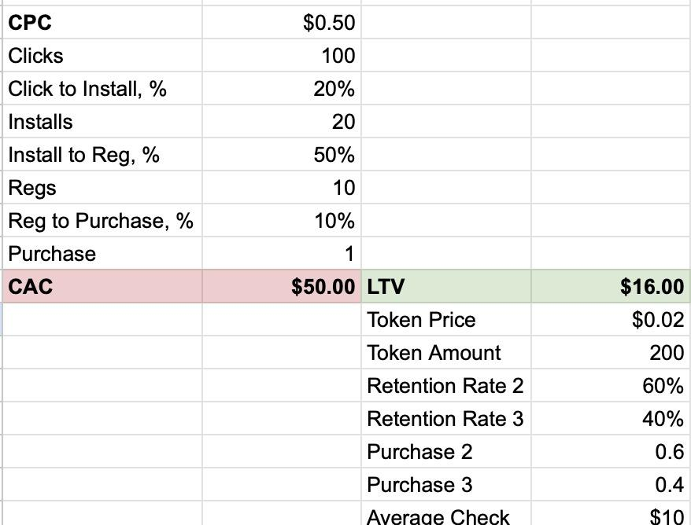
CALCULATION IN TABLE
CAC & LTV
UE Model
Lecture 4 · Unit Economics

Slide 89
CHANNEL
Description
Paid search captures active demand from users already looking for a solution.
Search Ads
Monthly cost
Sales
CAC
$10,000
60
$167
Funnel step
Volume
CR
Impressions
100,000
Clicks
5,000
5.0%
Leads / trials
400
8.0%
Sales
60
15.0%
Lecture 4 - Marketing Channels
CAC = channel cost / sales. Compare channels only after checking lead quality and downstream LTV.

Slide 90
CHANNEL
Description
Social ads create demand through targeting, creative, and repeated exposure.
Paid Social Ads
Monthly cost
Sales
CAC
$10,000
36
$278
Funnel step
Volume
CR
Impressions
500,000
Clicks
6,000
1.2%
Registrations
360
6.0%
Sales
36
10.0%
Lecture 4 - Marketing Channels
CAC = channel cost / sales. Compare channels only after checking lead quality and downstream LTV.

Slide 91
CHANNEL
Description
Video ads explain the offer visually, then move viewers to a landing page.
YouTube / Video Ads
Monthly cost
Sales
CAC
$10,000
4
$2499
Funnel step
Volume
CR
Views
200,000
Site visits
1,000
0.5%
Registrations
40
4.0%
Sales
4
10.0%
Lecture 4 - Marketing Channels
CAC = channel cost / sales. Compare channels only after checking lead quality and downstream LTV.

Slide 92
CHANNEL
Description
Display ads buy broad reach and retargeting inventory across websites and apps.
Display / Banner Ads
Monthly cost
Sales
CAC
$10,000
14
$714
Funnel step
Volume
CR
Impressions
2,000,000
Clicks
6,000
0.3%
Leads
180
3.0%
Sales
14
7.8%
Lecture 4 - Marketing Channels
CAC = channel cost / sales. Compare channels only after checking lead quality and downstream LTV.

Slide 93
CHANNEL
Description
Creators lend attention and trust; the product converts through a tracked link or code.
Influencer Ads
Monthly cost
Sales
CAC
$10,000
36
$278
Funnel step
Volume
CR
Views
100,000
Link clicks
3,000
3.0%
Registrations
300
10.0%
Sales
36
12.0%
Lecture 4 - Marketing Channels
CAC = channel cost / sales. Compare channels only after checking lead quality and downstream LTV.

Slide 94
CHANNEL
Description
Partners promote the product and are paid for qualified sales or conversions.
Affiliate Marketing
Monthly cost
Sales
CAC
$5,000
100
$50
Funnel step
Volume
CR
Affiliate impressions
100,000
Clicks
5,000
5.0%
Registrations
500
10.0%
Sales
100
20.0%
Lecture 4 - Marketing Channels
CAC = channel cost / sales. Compare channels only after checking lead quality and downstream LTV.

Slide 95
CHANNEL
Description
Store ads place the product in front of users searching or browsing for apps.
App Store Ads
Monthly cost
Sales
CAC
$10,000
60
$167
Funnel step
Volume
CR
Impressions
200,000
App page visits
10,000
5.0%
Installs
3,000
30.0%
Purchases
60
2.0%
Lecture 4 - Marketing Channels
CAC = channel cost / sales. Compare channels only after checking lead quality and downstream LTV.

Slide 96
CHANNEL
Description
Sponsored emails reach a known audience through someone else's mailing list.
Newsletter Ads
Monthly cost
Sales
CAC
$5,000
18
$278
Funnel step
Volume
CR
Subscribers reached
50,000
Clicks
1,000
2.0%
Registrations
120
12.0%
Sales
18
15.0%
Lecture 4 - Marketing Channels
CAC = channel cost / sales. Compare channels only after checking lead quality and downstream LTV.

Slide 97
CHANNEL
Description
Audio sponsorships rely on host trust and memorable calls to action.
Podcast Ads
Monthly cost
Sales
CAC
$8,000
17
$471
Funnel step
Volume
CR
Listens
80,000
Site visits
560
0.7%
Registrations
84
15.0%
Sales
17
20.2%
Lecture 4 - Marketing Channels
CAC = channel cost / sales. Compare channels only after checking lead quality and downstream LTV.

Slide 98
CHANNEL
Description
Native placements look like editorial content and convert through article engagement.
Native Ads
Monthly cost
Sales
CAC
$10,000
28
$357
Funnel step
Volume
CR
Impressions
1,000,000
Article visits
8,000
0.8%
Leads
400
5.0%
Sales
28
7.0%
Lecture 4 - Marketing Channels
CAC = channel cost / sales. Compare channels only after checking lead quality and downstream LTV.

Slide 99
CHANNEL
Description
Sales teams proactively contact prospects and qualify them into meetings.
Cold Calls / Outbound
Monthly cost
Sales
CAC
$8,000
16
$500
Funnel step
Volume
CR
Prospects called
2,000
Conversations
400
20.0%
Meetings
80
20.0%
Sales
16
20.0%
Lecture 4 - Marketing Channels
CAC = channel cost / sales. Compare channels only after checking lead quality and downstream LTV.

Slide 100
CHANNEL
Description
Events concentrate attention in a niche audience but add booth, travel, and team costs.
Conferences / Events
Monthly cost
Sales
CAC
$20,000
24
$833
Funnel step
Volume
CR
Booth visitors
1,000
Leads
400
40.0%
Qualified leads
120
30.0%
Sales
24
20.0%
Lecture 4 - Marketing Channels
CAC = channel cost / sales. Compare channels only after checking lead quality and downstream LTV.

Slide 101
MONE
MONETIZATION
Types of Monetization
How products turn usage, access, and transactions into revenue
Lecture 4 - Types of Monetization

Slide 102
CALCULATION IN TABLE
CAC & LTV
UE Model
Lecture 4 · Unit Economics

Slide 103
Apple
MONETIZATION
Description
The customer pays once to own a product or receive a finished service.
Direct Sale
Why it works
Revenue is simple to model: units sold multiplied by price, minus delivery and support costs.
Example
Apple sells devices directly through stores, partners, and online channels.
Product
->
One-time price
->
Customer pays
->
Revenue
Lecture 4 - Types of Monetization

Slide 104
Netflix
MONETIZATION
Description
The customer pays recurring fees for continuous access to a product or service.
Subscription
Why it works
Recurring revenue makes retention, churn, and lifetime value the core economics.
Example
Netflix charges monthly for access to its streaming catalog.
Access
->
Monthly fee
->
Retention
->
LTV
Lecture 4 - Types of Monetization

Slide 105
Spotify
MONETIZATION
Description
A free tier attracts users; a paid tier unlocks limits, features, or convenience.
Freemium
Why it works
The model depends on low free-user servicing cost and strong paid conversion.
Example
Spotify offers free listening with limits and monetizes upgrades to Premium.
Free users
->
Activation
->
Upgrade
->
Paid users
Lecture 4 - Types of Monetization

Slide 106
Google
MONETIZATION
Description
Users get free or subsidized access while advertisers pay for attention or actions.
Advertising
Why it works
The product must create high-quality inventory and measurable advertiser ROI.
Example
Google Search monetizes intent through paid search ads.
Audience
->
Ad inventory
->
Advertiser pays
->
Revenue
Lecture 4 - Types of Monetization

Slide 107
Airbnb
MONETIZATION
Description
The platform takes a percentage or fee from transactions between buyers and sellers.
Marketplace Commission
Why it works
The key metric is gross merchandise value multiplied by take rate.
Example
Airbnb earns service fees when guests book stays from hosts.
Buyer
->
Transaction
->
Take rate
->
Platform fee
Lecture 4 - Types of Monetization

Slide 108
AWS
MONETIZATION
Description
Customers pay according to consumption: requests, storage, seats, minutes, or compute.
Usage-Based Pricing
Why it works
Revenue expands with customer usage, but cost-to-serve must be tightly controlled.
Example
AWS charges for cloud resources such as compute, storage, and data transfer.
Usage
->
Metering
->
Unit price
->
Revenue
Lecture 4 - Types of Monetization

Slide 109
Microsoft
MONETIZATION
Description
Another company or user pays for the right to use intellectual property or software.
Licensing
Why it works
Licensing scales well when marginal delivery cost is lower than the license fee.
Example
Microsoft licenses Windows, Office, and enterprise software rights.
IP / software
->
License terms
->
License fee
->
Renewal
Lecture 4 - Types of Monetization

Slide 110
Gillette
MONETIZATION
Description
A durable base product drives repeat purchases of proprietary consumables.
Razor-and-Blades
Why it works
The first purchase creates a system; profit often comes from repeat consumables.
Example
Gillette sells razors and monetizes repeat purchases of replacement blades.
Handle
->
Lock-in
->
Refills
->
Repeat margin
Lecture 4 - Types of Monetization

Slide 111
Amazon
MONETIZATION
Description
The business earns a referral fee for sending customers to another seller.
Affiliate Commission
Why it works
This works when distribution or trust is valuable but fulfillment sits elsewhere.
Example
Amazon Associates pays publishers commissions for qualified referred purchases.
Traffic
->
Referral link
->
Purchase
->
Commission
Lecture 4 - Types of Monetization

Slide 112
Stripe
MONETIZATION
Description
The platform charges a small fee for enabling, routing, or securing payments.
Payment Processing Fee
Why it works
Revenue is tied to transaction volume, approval rates, fraud, and payment mix.
Example
Stripe earns fees on card payments and other financial infrastructure services.
Payment
->
Processing
->
Fee per transaction
->
Net revenue
Lecture 4 - Types of Monetization

Slide 113
PREVIOUS LECTURE
Excel Activity
The link
UE Funnel: build and calculate the unit economics funnel.
Bottleneck: identify the weakest point in the funnel.
RICE: prioritize improvements using reach, impact, confidence, and effort.
Feature ROI: estimate whether the selected feature pays off.
Lecture 3 · Unit Economics + Prioritization

Slide 114
BEFORE WE WRAP UP
What is your takeaway today?
On the topics discussed and not only

Slide 115
SUMMARY
When LTV = 3*CAC is bad, Cash Gap
Lecture 3:
Done so far
Unit Economics Model Dive In
UE Model Practical Task
Priorities
Prioritization based on UE
Discussion: What Feature Impacts What
7
Lecture 3 · Unit Economics + Prioritization

Slide 116
SUMMARY
Theory of Constraints by Goldratt
Lecture 4:
Done so far
Looking for bottlenecks in Job search funnel
Job Search Quiz
Digital Product Sales Funnel Variability
Digital Product Monetization Variability
The Most Useful Skill + Homework
7
Lecture 3 · Unit Economics + Prioritization

Slide 117
BEFORE WE WRAP UP
Questions?
On the topics discussed and not only

Slide 118
?
Thank you
Telegram: @max_popov
Max Popov · Financial Management in Digital Products · Innopolis University

