Slide 1
BEFORE WE START
Turn on Meeting Recording
Make sure the recording is running, and only then begin.
Lectures 5–6 · Recap, Test Review, Financial Statements

Slide 2
5
INNOPOLIS UNIVERSITY · SUMMER 2026
Financial Management
in Digital Products
Unit Economics · Financial Modelling · Business Valuation
Lecture 5–6 — Recap · Test Review · Safe-Growth Homework · Financial Statements
Max Popov · Course Instructor

Slide 3
TODAY
1
Recap — what you should already know (Lectures 1–4)
Lectures 5–6:
what we'll cover
2
Test review — correct vs. wrong answers
3
Homework: the safe-growth threshold (g_safe)
4
Financial Modelling of Digital Products
5
Financial Ratios
Lectures 5–6 · Recap, Test Review, Financial Statements

Slide 4
R
RECAP · LECTURES 1–4
What you should already know
Twelve ideas that carry the whole course so far — course recap by Hermes using Codex 5.5 medium.
Lectures 5–6 · Recap, Test Review, Financial Statements

Slide 5
RECAP · LECTURES 1–4
Idea
01 / 12
A product manager doesn't just ship features — they create value for users and profit for the business.
Lectures 5–6 · Recap, Test Review, Financial Statements

Slide 6
SEQUENCE
First I check whether the product can make money.
What I do first
First
Then
1
Build unit economics
Customer development
2
Build a financial model
Backlog prioritisation
3
Estimate product valuation
Development roadmap
A beautiful roadmap cannot save a broken unit.
Lecture 1 · Introduction

Slide 7
RECAP · LECTURES 1–4
Idea
02 / 12
Before building or scaling anything, ask the first question: does one unit actually make money?
Lectures 5–6 · Recap, Test Review, Financial Statements

Slide 8
RECAP · LECTURES 1–4
Idea
03 / 12
Unit economics answers how many units you should have to earn X.
Unit economics answers how much each unit brings and takes from your company.
Lectures 5–6 · Recap, Test Review, Financial Statements

Slide 9



Slide 10
RECAP · LECTURES 1–4
Idea
04 / 12
CAC is what it costs to acquire one paying customer. LTV is what that customer is worth over their lifetime.
Lectures 5–6 · Recap, Test Review, Financial Statements

Slide 11
RECAP · LECTURES 1–4
Idea
05 / 12
If LTV < CAC, you lose money on every customer — and growth only scales the loss.
Whether LTV > CAC is the key question of Unit Economics. is key question of Unit Economics
Lectures 5–6 · Recap, Test Review, Financial Statements

Slide 12
RECAP · LECTURES 1–4
Idea
06 / 12
Fixed costs don't move with volume. Variable costs grow with users, transactions, and requests.
Lectures 5–6 · Recap, Test Review, Financial Statements

Slide 13
RECAP · LECTURES 1–4
Idea
07 / 12
The dot-com crash showed that users and growth mislead when the economics of one unit are broken.
Lectures 5–6 · Recap, Test Review, Financial Statements

Slide 14

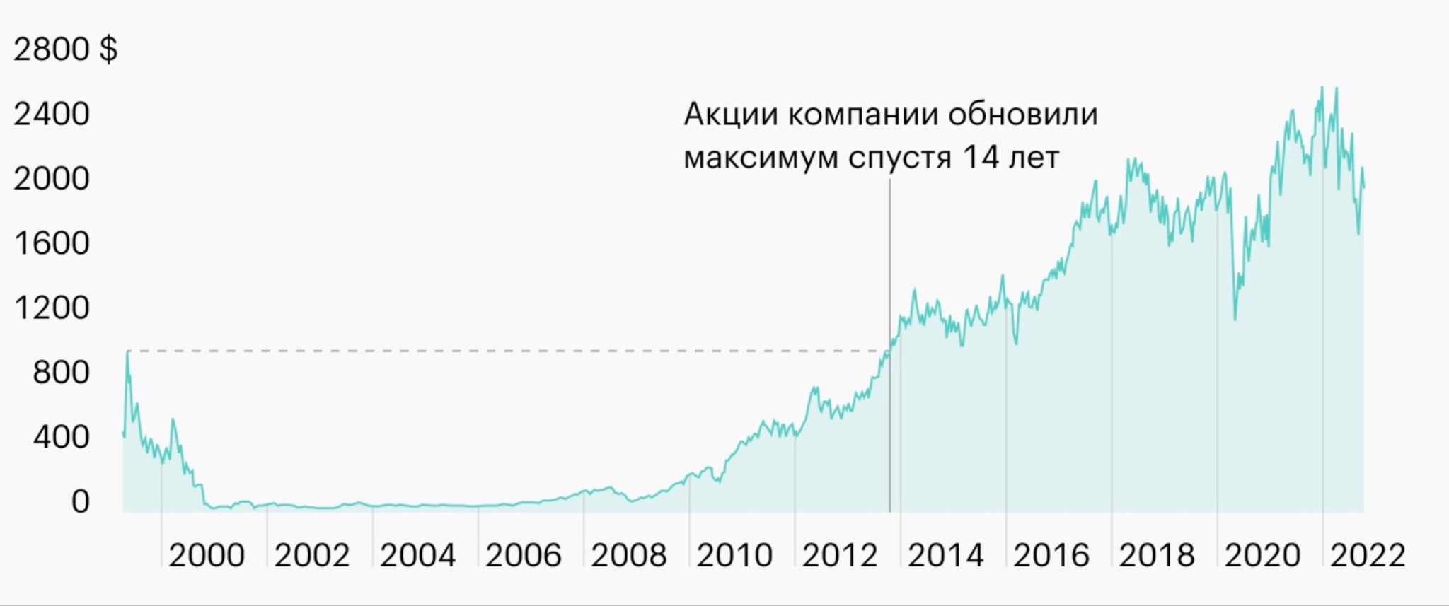


Slide 15
RECAP · LECTURES 1–4
Idea
08 / 12
A "healthy" LTV/CAC ≈ 3× can still be dangerous if payback is slow and growth opens a cash gap.
Lectures 5–6 · Recap, Test Review, Financial Statements

Slide 16
RECAP · LECTURES 1–4
Idea
09 / 12
Cash flow matters: CAC is paid upfront, while LTV returns gradually over time.
Lectures 5–6 · Recap, Test Review, Financial Statements

Slide 17
RECAP · LECTURES 1–4
Idea
10 / 12
Compare features by their expected economic impact — not by request count or development effort.
Lectures 5–6 · Recap, Test Review, Financial Statements

Slide 18
RECAP · LECTURES 1–4
Idea
11 / 12
Theory of Constraints: improving anything except the current bottleneck rarely improves the whole system.
Lectures 5–6 · Recap, Test Review, Financial Statements

Slide 19
RECAP · LECTURES 1–4
Idea
12 / 12
When you project numbers in a Unit Economics model use benchmarks, if you lack real-life data.
Lectures 5–6 · Recap, Test Review, Financial Statements

Slide 20
T
TEST REVIEW · LECTURES 3–4
Correct vs. wrong answers
One question per slide: the benchmark answer, a real wrong answer, and why.
Lectures 5–6 · Recap, Test Review, Financial Statements

Slide 21
TEST DISCUSSION · 01 / 09
THE QUESTION
Q1
Product-manager lens
How does a product manager's view of a product differ from a purely feature-focused view? Name one financial question a PM should ask before shipping or scaling a feature.
✗ A STUDENT ANSWERED
“LTV > CAC or not.”
Let them reason it out before revealing the answer.
ASK THE CLASS Why is this answer wrong — or incomplete?
Lectures 5–6 · Test Review · Lectures 3–4

Slide 22
TEST REVIEW
Q1
The product-
manager lens
✓ CORRECT ANSWER
Feature view asks “can we build it?” A PM view asks “should we — and does it improve the economics?” A good answer connects user value, business value, revenue, retention, conversion, and cost — not a single ratio.
✗ WRONG / INCOMPLETE
WHY IT'S WRONG
“LTV > CAC or not.”
One narrow check. The question is about PM thinking vs. feature thinking — not just comparing two abbreviations.
Lectures 5–6 · Recap, Test Review, Financial Statements

Slide 23
TEST DISCUSSION · 02 / 09
THE QUESTION
Q2
Fixed vs. variable costs
For an AI calorie tracker, classify each cost as fixed or variable and explain the logic: base cloud hosting · LLM/API tokens per request · App-Store ad spend · designer salary · payment processing fee · support that grows with users.
✗ A STUDENT ANSWERED
“Base cloud hosting is variable because the developer chooses it. Tokens are fixed. Payment processing fee is fixed. Support cost is variable.”
Let them reason it out before revealing the answer.
ASK THE CLASS Why is this answer wrong — or incomplete?
Lectures 5–6 · Test Review · Lectures 3–4

Slide 24
TEST REVIEW
Q2
Fixed vs.
variable costs
✓ CORRECT ANSWER
Cost item (AI calorie tracker) | Classification
Base cloud hosting fee | Fixed (short run)
LLM / API tokens per request | Variable
App Store advertising spend | Acquisition (≈ variable)
Designer salary | Fixed
Payment processing fee | Variable
Support that grows with users | Variable / semi-variable
✗ WRONG / INCOMPLETE
WHY IT'S WRONG
“Hosting is variable, tokens are fixed, payment fee is fixed, support is variable.”
Confuses “chosen by us” with “fixed.” A cost is variable if it moves with usage, requests, or transactions.
Lectures 5–6 · Recap, Test Review, Financial Statements

Slide 25
TEST DISCUSSION · 03 / 09
THE QUESTION
Q3
Unit-economics vocabulary
Define unit economics in your own words. What is a unit? Briefly explain CAC, LTV, contribution margin, and payback period.
✗ A STUDENT ANSWERED
“Contribution margin is LTV − CAC. Payback period is the time when the business starts to cover costs / becomes profitable.”
Let them reason it out before revealing the answer.
ASK THE CLASS Why is this answer wrong — or incomplete?
Lectures 5–6 · Test Review · Lectures 3–4

Slide 26
TEST REVIEW
Q3
Unit-economics
vocabulary
✓ CORRECT ANSWER
Unit economics = revenue & cost per one unit. CAC = cost to acquire one paying customer. LTV = total contribution over the lifetime. Contribution margin = unit revenue − variable cost. Payback = time to recover CAC from contribution.
✗ WRONG / INCOMPLETE
WHY IT'S WRONG
“Contribution margin = LTV − CAC; payback = when the business becomes profitable.”
Mixes levels. CM is per-unit (revenue − variable cost); payback recovers CAC for one customer, not the whole company.
Lectures 5–6 · Recap, Test Review, Financial Statements

Slide 27
TEST DISCUSSION · 04 / 09
THE QUESTION
Q4
Why unit economics matters
Why did unit economics become especially important after the dot-com crash? Explain why growth, revenue, or active users can mislead if the economics of one unit are broken.
✗ A STUDENT ANSWERED
“Because .com was cheap. Business was economically healthy. After the crash margin became negative, so many businesses closed.”
Let them reason it out before revealing the answer.
ASK THE CLASS Why is this answer wrong — or incomplete?
Lectures 5–6 · Test Review · Lectures 3–4

Slide 28
TEST REVIEW
Q4
Why it matters
after dot-com
✓ CORRECT ANSWER
Growth alone isn't enough. After the crash, unit economics answered “does one unit make money?” On a broken unit, more users, more revenue, and impressive activity simply produce more loss.
✗ WRONG / INCOMPLETE
WHY IT'S WRONG
“.com was cheap, the business was healthy, then margins went negative and firms closed.”
Reverses the logic. The crash revealed economics were already broken — not healthy first and broken later.
Lectures 5–6 · Recap, Test Review, Financial Statements

Slide 29
TEST DISCUSSION · 05 / 09
THE QUESTION
Q5
Calculate CAC
Paid acquisition — CPC $0.60 · click→install 25% · install→registration 40% · registration→paid 8%. Calculate the CAC of one paying customer; show the funnel conversion and the final CAC.
✗ A STUDENT ANSWERED
“CAC = 0.60 × 0.25 × 0.40 × 0.08 = 0.0048.”
Let them reason it out before revealing the answer.
ASK THE CLASS Why is this answer wrong — or incomplete?
Lectures 5–6 · Test Review · Lectures 3–4

Slide 30
TEST REVIEW
Q5
Calculate CAC
through a funnel
✓ CORRECT ANSWER
Total conversion = 25% × 40% × 8% = 0.8%.
CAC = CPC ÷ conversion = $0.60 ÷ 0.008 =
$75 per paying customer.
✗ WRONG / INCOMPLETE
WHY IT'S WRONG
“CAC = 0.60 × 0.25 × 0.40 × 0.08 = 0.0048.”
Multiplies instead of dividing. Low conversion → many clicks per customer → higher CAC. CAC = CPC ÷ conversion.
Lectures 5–6 · Recap, Test Review, Financial Statements

Slide 31
TEST DISCUSSION · 06 / 09
THE QUESTION
Q6
Calculate net LTV
Subscription $12/month. Retention: M1 100%, M2 50%, M3 30%, then users stop. AI: token $0.015, an active user uses 150 tokens/month. Calculate net LTV — show revenue, AI cost, and final LTV.
✗ A STUDENT ANSWERED
“Monthly net value = 12 − 0.015 × 150 = 11.775; then 11.775 + 11.775×0.5 + 11.775×0.3 = 21.195; divide by 3 → LTV = 7.065.”
Let them reason it out before revealing the answer.
ASK THE CLASS Why is this answer wrong — or incomplete?
Lectures 5–6 · Test Review · Lectures 3–4

Slide 32
TEST REVIEW
Q6
Calculate
net LTV
✓ CORRECT ANSWER
Active months = 1.0 + 0.5 + 0.3 = 1.8. Revenue = $12 × 1.8 = $21.60.
AI cost = 150 × $0.015 = $2.25/mo → × 1.8 = $4.05.
Net LTV = $21.60 − $4.05 =
$17.55.
✗ WRONG / INCOMPLETE
WHY IT'S WRONG
“net/mo = 12 − 0.015 × 150 = 11.775 … then ÷ 3 = 7.065.”
Two errors: 0.015 × 150 = 2.25 (so net/mo = $9.75), and LTV is the lifetime total — don't divide by 3.
Lectures 5–6 · Recap, Test Review, Financial Statements

Slide 33
TEST DISCUSSION · 07 / 09
THE QUESTION
Q7
Does the unit work?
Using your CAC and LTV from the previous questions, decide whether paid acquisition is economically healthy. Explain, and name two levers that could improve the unit economics.
✗ A STUDENT ANSWERED
“Yes, it works, I calculated it.”
Let them reason it out before revealing the answer.
ASK THE CLASS Why is this answer wrong — or incomplete?
Lectures 5–6 · Test Review · Lectures 3–4

Slide 34
TEST REVIEW
Q7
Does the
unit work?
✓ CORRECT ANSWER
CAC $75 vs. Net LTV $17.55 → LTV/CAC ≈ 0.23×. Not healthy — scaling paid acquisition scales the loss. Levers: cut CAC (conversion/CPC), raise retention, raise price, cut token cost.
✗ WRONG / INCOMPLETE
WHY IT'S WRONG
“Yes, it works, I calculated it.”
No comparison and wrong conclusion: $17.55 < $75. Needs the ratio plus at least two improvement levers.
Lectures 5–6 · Recap, Test Review, Financial Statements

Slide 35
TEST DISCUSSION · 08 / 09
THE QUESTION
Q8
Break-even & target profit
John Peel has fixed monthly costs of £1,750. Each roll contributes £7 after variable costs. How many rolls to break even? How many to earn £100 profit in a month?
✗ A STUDENT ANSWERED
“1850 / 7 = 265.”
Let them reason it out before revealing the answer.
ASK THE CLASS Why is this answer wrong — or incomplete?
Lectures 5–6 · Test Review · Lectures 3–4

Slide 36
TEST REVIEW
Q8
Break-even &
target profit
✓ CORRECT ANSWER
Break-even = £1,750 ÷ £7 = 250 rolls.
For £100 profit = (£1,750 + £100) ÷ £7 ≈ 264.3 → round up to
265 rolls.
✗ WRONG / INCOMPLETE
WHY IT'S WRONG
“1850 / 7 = 265.”
Gives target-profit only and omits break-even (1750 ÷ 7 = 250). The question asks for two outputs.
Lectures 5–6 · Recap, Test Review, Financial Statements

Slide 37
TEST DISCUSSION · 09 / 09
THE QUESTION
Q9
CalZen insights
In the CalZen case, what did the sales-funnel quiz, the CustDev result, and the repeat-sale paradox show? Name one metric or experiment you would use next to check whether CalZen's unit economics can become healthy.
✗ A STUDENT ANSWERED
“Retention was not as low as expected, but still low. To make unit economics healthy, give a trial period and free features so more people buy premium.”
Let them reason it out before revealing the answer.
ASK THE CLASS Why is this answer wrong — or incomplete?
Lectures 5–6 · Test Review · Lectures 3–4

Slide 38
TEST REVIEW
Q9
CalZen
insights
✓ CORRECT ANSWER
Funnel quiz: interest ≠ paid conversion. CustDev: explains why users do/don't pay. Repeat-sale paradox: more usage can lift LTV but also AI cost. Next: measure net LTV after AI cost, paid conversion, or willingness to pay.
✗ WRONG / INCOMPLETE
WHY IT'S WRONG
“Retention was low; give a trial + free features so more people buy premium.”
Too vague and misses the case. In CalZen more usage raises AI cost — measure net LTV, not just usage.
Lectures 5–6 · Recap, Test Review, Financial Statements

Slide 39
g
HOMEWORK · LECTURES 5–6
The safe-growth threshold
When does fast growth stop being safe? A cohort-model deep dive into g_safe.
The formula suggested by the Opus 4.8 (High) by Anthropic.
Lectures 5–6 · Recap, Test Review, Financial Statements

Slide 40
HOMEWORK · STEP 1
The model
and inputs
LTV
200
SIMPLE FORMULA
CAC
100
g_safe =
(r − 1) / LT
r = LTV / CAC
2
RR (monthly retention)
80%
= (2 − 1) / 5
=
20%
LT = 1 / (1 − RR)
5
m = LTV / LT (monthly contribution)
40
CAC is paid upfront; each active customer returns 40/month, so a faster-growing cohort opens an early cash gap.
Lectures 5–6 · Recap, Test Review, Financial Statements

Slide 41
HOMEWORK · KEY POINT
The simplified formula is a safe rule of thumb — not the exact threshold for the full cohort model.
20% is
conservative
SIMPLE FORMULA SAYS
TRUE DYNAMIC THRESHOLD
20%
33.3%
conservative boundary
where retained cohorts exactly fund new CAC
Lectures 5–6 · Recap, Test Review, Financial Statements

Slide 42
HOMEWORK · STEP 2
At 20% growth
At 25% growth
20% and 25%
both recover
Month 1
−60.0
Month 1
−60.0
Month 2
−40.0
Month 2
−43.0
Month 3
−22.4
Month 3
−28.2
Month 4
−6.4
Month 4
−14.7
Month 5
+8.7
Month 5
−2.0
Month 6
+23.6
Month 6
+10.6
Burns early, then turns positive.
Deeper early gap — still recovers.
Both have negative early months and then recover, so 25% is not structurally unsafe in this model.
Lectures 5–6 · Recap, Test Review, Financial Statements

Slide 43
HOMEWORK · STEP 3
Revenue per current cohort, summing all retained past cohorts (a geometric series):
The real
threshold
m / (1 − RR/(1+g)) ≥ CAC
40 / (1 − 0.8/(1+g)) ≥ 100
1 − 0.8/(1+g) ≤ 0.4
0.8/(1+g) ≥ 0.6 → 1+g ≤ 1.333…
g ≤ 0.333… → g_safe ≈ 33.3%
Lectures 5–6 · Recap, Test Review, Financial Statements

Slide 44
HOMEWORK · STEP 4
Monthly net cash flow at 34%
Why 34%
is unsafe
Month 1
−60.0
After bottoming out around month 9, the gap starts widening again — new CAC grows faster than old cohorts can finance it.
Month 4
−32.1
Month 7
−19.8
Month 9
−17.6
Month 10
−18.3
Month 11
−20.2
Month 12
−23.6
Unsafe ≠ negative first months. Unsafe = the cash gap keeps expanding instead of stabilizing.
Lectures 5–6 · Recap, Test Review, Financial Statements

Slide 45
HOMEWORK · SUMMARY
GROWTH RATE
RESULT
What to
record
20%
Safe / conservative
25%
Still safe in the cohort model
33.3%
Approximate true boundary
34%+
Unsafe — gap keeps worsening
Better formula: g_safe = ((r − 1)/LT) / (1 − r/LT) = (0.2)/(0.6) = 33.3%
Feedback: the model is right that 25% is still viable; 20% is just a conservative rule of thumb.
Lectures 5–6 · Recap, Test Review, Financial Statements

Slide 46
S
FINANCIAL STATEMENTS · GERASIMENKO
Financial Modelling
12 ideas from Alexey Gerasimenko bridging unit economics → financial modelling.
Lectures 5–6 · Recap, Test Review, Financial Statements

Slide 47
FINANCIAL STATEMENTS · WHAT WE MEAN
Three different things called “finance”
Accounting
Financial reporting
Management finance
BOOKKEEPING
REGULATED · IFRS / GAAP / RAS
INTERNAL · FOR DECISIONS
Recording every transaction by the rules.
Standardized statements built for outsiders.
Whatever helps you decide — no mandated format.
For tax office, the law
For investors, banks, auditors
For founders, PMs, tech leads
Asks “Is it recorded correctly?”
Asks “Can outsiders trust it?”
Asks “What decision does this drive?”
Horizon backward-looking
Horizon backward, comparable
Horizon forward-looking
This course is about the third. Unit economics, LTV/CAC, and cohort models are management finance — built to drive decisions, not to satisfy compliance.
OUR COURSE LIVES HERE
Lectures 5–6 · Financial Statements

Slide 48



Slide 49


Slide 50


Slide 51

https://www.youtube.com/watch?v=NvslpOUDaHo

Slide 52
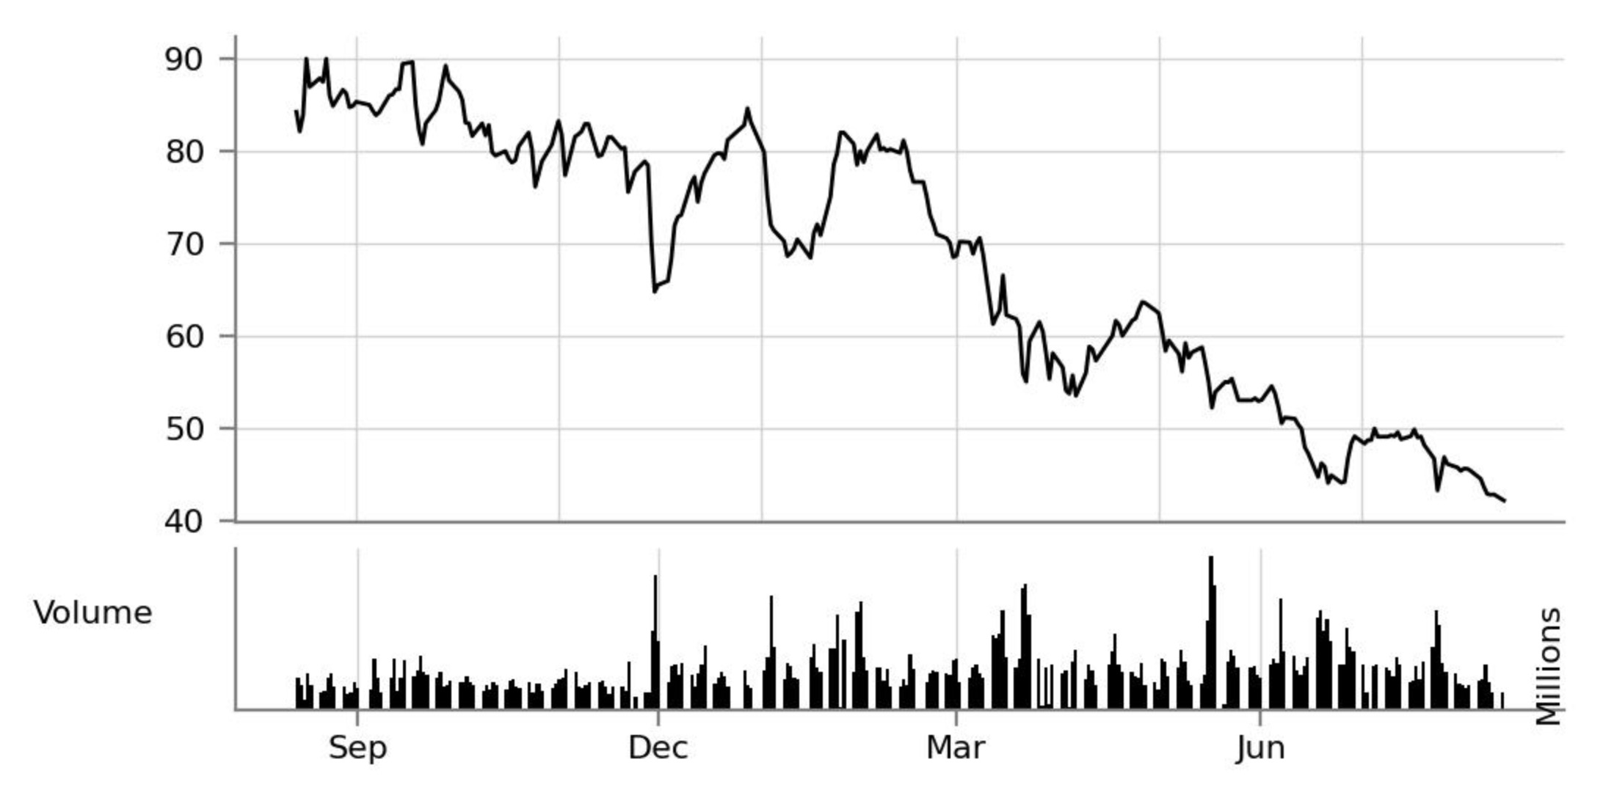

Slide 53
FINANCIAL STATEMENTS · AUDIT
Deloitte
PwC
EY
KPMG
Big Four:
the world's largest audit networks
Each spans: audit · consulting · tax · deals.
Audit — an independent review of a company's financial statements.
WHY AUDIT MATTERS
Investors, banks, and partners can trust the statements
Reduces the risk of errors and manipulation in the numbers
Makes the business more transparent
Vital for large firms, public markets, and deals
An auditor doesn't run the business or guarantee its profit — the job is to verify that the statements honestly reflect the company.
Lectures 5–6 · Financial Statements

Slide 54
FINANCIAL STATEMENTS · CONSULTING
McKinsey
BCG
Bain
The Big Three of
strategy consulting (MBB)
McKinsey & Company
Boston Consulting Group
Bain & Company
Strategy consulting — helping top management make key decisions about the company's future.
TYPICAL QUESTIONS
Which markets to enter? · Which business model? · How to raise profitability? · Buy another company? · How to restructure the org or product line?
WHY IT MATTERS
Shapes CEO-, board-, and owner-level decisions
Grounded in market, economics, and competitor analysis
Used under high uncertainty: growth, crisis, M&A, transformation
If audit answers “can we trust the statements?”, strategy consulting answers “where should the company go next?”
Lectures 5–6 · Financial Statements

Slide 55
FINANCIAL STATEMENTS · RUSSIA
BIG FOUR → RUSSIAN BRAND
MBB → RUSSIA
After 2022:
local brands replace global ones
Deloitte → DRT
Delovye Resheniya i Tekhnologii
McKinsey → Yakov & Partners
ex-McKinsey Russia, local management
PwC → Technologies of Trust
Tekhnologii Doveriya
BCG → exited
no clear official successor
EY → B1
independent local brand
Bain → exited
no clear official successor
KPMG → Kept
Кэпт
Note: “Yakov & Partners” is not a former Big Four firm — it was built on McKinsey's ex-Russian business and strategy alumni.
In audit, the Big Four's Russian offices mostly continued under new local brands. In strategy, it's less symmetric: the clearest successor is Yakov & Partners (ex-McKinsey), while BCG and Bain have no equally obvious official continuations.
Lectures 5–6 · Financial Statements

Slide 56
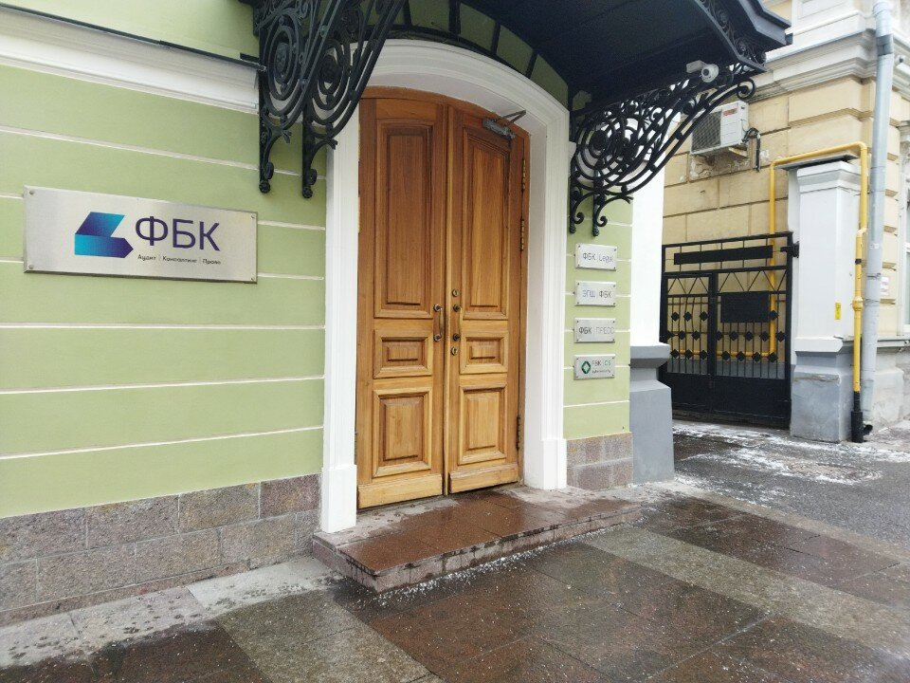

Slide 57
FINANCIAL STATEMENTS
A manager needn't be an accountant, but must read what the statements say. They answer three questions:
Thesis 01
Statements are the language
Question
Statement
Are we earning?
P&L / Income Statement
What do we own & owe?
Balance Sheet
Where does cash move?
Cash Flow Statement
A financial model must describe the business in the language of these three statements.
Lectures 5–6 · Recap, Test Review, Financial Statements

Slide 58


Slide 59
FINANCIAL STATEMENTS
The income statement asks: did the company create profit this period? For a digital product:
Thesis 02
P&L = the period's result
Layer
Digital product
Revenue
Revenue from users
− COGS / variable
− AI / API / server / payment
= Gross profit
= Gross margin
− OpEx → EBIT → net
− team, marketing, admin
P&L isn't just bookkeeping — it's a map of the operating model.
Lectures 5–6 · Recap, Test Review, Financial Statements

Slide 60
RENTAL CASE · STATEMENT 1
P&L item
January
February
March
Rental revenue
80,000
80,000
80,000
P&L —
did we make a profit?
Utilities paid by owner
−6,000
−6,500
−6,000
Maintenance and repairs
−5,000
−15,000
−7,000
Mortgage interest
−15,000
−15,000
−15,000
Depreciation of renovation
−25,000
−25,000
−25,000
Profit before tax
29,000
18,500
27,000
Income tax (13%)
−3,770
−2,405
−3,510
Net profit
25,230
16,095
23,490
TEACHING NOTE
What revenue was earned, and which expenses belong to the period?
February dips on higher maintenance. Income tax (13%) lowers accounting profit and is also a real cash outflow. Depreciation reduces profit but isn't cash out — and we depreciate the renovation, not the apartment.
Lectures 5–6 · Financial Statements · Rental case (₽)

Slide 61
FINANCIAL STATEMENTS
Thesis 03
Balance sheet = a snapshot
The balance sheet is the state of the business on a date: Assets = Liabilities + Equity. A profitable business can still be weak — heavy debt, thin liquidity, large receivables, or too little equity.
Lectures 5–6 · Recap, Test Review, Financial Statements

Slide 62
RENTAL CASE · STATEMENT 2
Balance sheet item
End Jan
End Feb
End Mar
Apartment
13,000,000
13,000,000
13,000,000
Balance sheet —
what we own & owe
Furniture, appliances, property
3,585,000
3,570,000
3,555,000
Renovation, net book value
2,390,000
2,380,000
2,370,000
Cash
216,230
223,325
237,815
Total assets
19,191,230
19,173,325
19,162,815
Mortgage debt
−9,966,000
−9,932,000
−9,898,000
Owner's equity
9,225,230
9,241,325
9,264,815
Total liabilities + equity
19,191,230
19,173,325
19,162,815
TEACHING NOTE
Financial position on a date: assets, liabilities, and the owner's share.
The apartment is a core asset; furniture and renovation decline through depreciation; mortgage debt falls 34,000/month; and equity grows as the business earns profit and repays debt.
Lectures 5–6 · Financial Statements · Rental case (₽)

Slide 63
FINANCIAL STATEMENTS
The cash-flow statement shows where money came from and went:
Thesis 04
Cash flow = real liquidity
Section
Shows
Operating
Cash from core activity
Investing
Buying / selling assets
Financing
Loans, equity, dividends
For startups the main risk isn't paper loss — it's running out of cash before the model stabilizes.
Lectures 5–6 · Recap, Test Review, Financial Statements

Slide 64
RENTAL CASE · STATEMENT 3
Cash flow item
January
February
March
Cash received from tenant
80,000
80,000
80,000
Cash flow —
what actually moved
Utilities paid
−6,000
−6,500
−6,000
Maintenance and repairs paid
−5,000
−15,000
−7,000
Mortgage interest paid
−15,000
−15,000
−15,000
Mortgage principal repaid
−34,000
−34,000
−34,000
Income tax paid
−3,770
−2,405
−3,510
Net cash flow
16,230
7,095
14,490
Cash, start of month
200,000
216,230
223,325
Cash, end of month
216,230
223,325
237,815
January: net profit 25,230 vs. net cash flow 16,230. The 9,000 gap = principal repaid (34,000, cash out, not an expense) − depreciation (25,000, non-cash, added back).
Not accounting profit — real cash in and out of the account.
Lectures 5–6 · Financial Statements · Rental case (₽)

Slide 65
FINANCIAL STATEMENTS
Thesis 05
Profit ≠ cash
A company can show profit yet run short of cash. Sell on credit → revenue and profit are booked, but the cash hasn't arrived. And cash received now isn't always recognized as profit.
Profit is the accounting logic of value creation; cash flow is the logic of survival.
Lectures 5–6 · Recap, Test Review, Financial Statements

Slide 66
FINANCIAL STATEMENTS
The two methods paint different pictures:
Thesis 06
Accrual vs. cash basis
Method
Logic
Accrual
Recognized when earned / incurred
Cash basis
Recognized when money moves
A SaaS may be paid a year upfront: cash now, but revenue recognized gradually as service is delivered.
Lectures 5–6 · Recap, Test Review, Financial Statements

Slide 67
FINANCIAL STATEMENTS
Thesis 07
Revenue ≠ cash received
Revenue can be recognized before money lands, so a model must separate four layers:
Bookings → Billings → Revenue → Cash collected.
A subscription clears, the provider pays out later, a fee is withheld, and revenue is recognized over the service period — central to modelling a subscription business.
Lectures 5–6 · Recap, Test Review, Financial Statements

Slide 68
FINANCIAL STATEMENTS
Thesis 08
Expenses ≠ cash paid
A cost can be incurred before payment, or paid in advance: salary accrued but unpaid, rent prepaid, equipment depreciated, marketing spent now with effect later.
P&L shows resource consumption; cash flow shows actual payments.
Lectures 5–6 · Recap, Test Review, Financial Statements

Slide 69
FINANCIAL STATEMENTS
Thesis 09
Depreciation = non-cash
Depreciation spreads a long-term asset's cost across its useful life. Buy a $12,000 server used over 3 years → recognize $4,000/year rather than $12,000 at once.
It lowers accounting profit but is not a cash outflow in the current period.
Lectures 5–6 · Recap, Test Review, Financial Statements

Slide 70
FINANCIAL STATEMENTS
Thesis 10
Working capital eats cash
Working capital ≈ Receivables + Inventory − Payables. As a company grows it ties up more cash in inventory, customer terms, and supplier prepayments — so growth can hurt cash flow even when P&L looks good.
Growth needs financing; the faster you grow, the closer you watch the cash-conversion cycle.
Lectures 5–6 · Recap, Test Review, Financial Statements

Slide 71
FINANCIAL STATEMENTS
Statements are just numbers until you compute ratios:
Thesis 11
Ratios interpret the numbers
Group
Examples
Profitability
Gross / operating / net margin
Liquidity
Current, quick ratio
Leverage
Debt / Equity, Debt / EBITDA
Returns
ROE, ROA, ROIC
Valuation looks at business quality — margin, durability, leverage, cash conversion — not just absolute figures.
Lectures 5–6 · Recap, Test Review, Financial Statements

Slide 72
FINANCIAL STATEMENTS
Thesis 12
Read statements as a story
Statements aren't tables for the tax office — they tell how a company earns, where margin leaks, how durable its growth is, whether it has enough cash, how much it depends on debt, and where risk hides.
Financial modelling isn't an Excel exercise — it's telling that financial story forward, in numbers.
Lectures 5–6 · Recap, Test Review, Financial Statements

Slide 73

SUMMARY
The key book in finance for non-finance
Lecture 5:
Done so far
Big 4, Big 3
P&L, Balance Sheet, Cash Flow
Accrual and Cash Basis
Depreciation doesn’t eat cash
Ratios interpret the numbers
7
Lecture 1 · Unit Economics

Slide 74
?
WRAP-UP
Questions?
On the topics discussed — and not only.
Lectures 5–6 · Recap, Test Review, Financial Statements

Slide 75
₽
THANK YOU
See you next block
Telegram: @max_popov
Max Popov · Financial Management in Digital Products · Innopolis University

Slide 76
BEFORE WE START
Turn on Meeting Recording
Make sure the recording is running, and only then begin.
Lectures 5–6 · Recap, Test Review, Financial Statements

Slide 77
S
FINANCIAL STATEMENTS · GERASIMENKO
Financial Ratios
12 ideas from Alexey Gerasimenko bridging unit economics → financial modelling.
Lectures 5–6 · Recap, Test Review, Financial Statements

Slide 78
RATIOS & MULTIPLES · WHY THEY MATTER
THE IDEA
A ratio relates two figures from the statements — turning a raw number into a signal you can compare.
Financial
ratios
Net profit ₽25,230 says little alone; Net margin = 31% compares across size, time, and peers.
WHY THEY MATTER
Standardize — compare across companies, periods, and size.
Diagnose — reveal strengths, weaknesses, and trends early.
Bridge to valuation — turn performance into a price.
HOW THEY'RE USED — THE TOOLKIT
Statements give you the numbers — ratios give you the meaning.
Profitability
Liquidity
Leverage
margins
can it pay?
debt load
Efficiency
Returns
Valuation
asset use
ROA · ROE
EV/EBITDA · P/E
Lectures 5–6 · Ratios & Valuation Multiples

Slide 79
RATIOS & MULTIPLES · 10 / 10
FORMULA
P / E
price to earnings
P/E = Equity Value / Net Profit
public company = Market Cap / Net Profit
WHY IT MATTERS
The famous equity multiple — price vs bottom-line profit for shareholders. EV/EBITDA compares across capital structures; P/E prices shareholder earnings.
Value
Interpretation
Low vs peers
Cheap, risky, low-growth, or depressed
High vs peers
Expensive, high-growth, or overvalued
How many years of earnings does an investor pay for the equity?
Negative
Loss-making — P/E not meaningful
Lectures 5–6 · Ratios & Valuation Multiples

Slide 80
RATIOS & MULTIPLES · 06 / 10
FORMULA
ROA
Return on assets
ROA = Net Profit / Average Total Assets
classroom version = Net Profit / Total Assets
WHY IT MATTERS
Key for capital-intensive businesses: the better firm needs fewer assets for the same profit. Links the P&L (profit) to the Balance Sheet (assets).
Value
Interpretation
High
Assets are used efficiently
Low
Many assets for little profit
How much profit does the company generate from each ₽ of assets?
Declining
Asset base growing faster than profit
Lectures 5–6 · Ratios & Valuation Multiples

Slide 81
RATIOS & MULTIPLES · 07 / 10
FORMULA
ROE
Return on equity
ROE = Net Profit / Average Equity
DuPont = Net Margin × Asset Turnover × Leverage
WHY IT MATTERS
The shareholder's view of profitability — but read it carefully: ROE can rise from more debt, not only from a better business.
Value
Interpretation
via margin
Strong business economics
via turnover
Efficient use of assets
On the capital the owner put in, how much profit does it generate?
via leverage
Higher return — and higher financial risk
Lectures 5–6 · Ratios & Valuation Multiples

Slide 82
RATIOS & MULTIPLES · 04 / 10
FORMULA
Net profit
margin
Net Margin = Net Profit / Revenue
where Net Profit = Revenue − all expenses (incl. interest, D&A)
WHY IT MATTERS
The simplest bottom-line measure — it folds in operating cost, D&A, interest, and capital structure. Net profit ≠ cash flow.
Value
Interpretation
High
Strong bottom-line profitability
Low
Revenue is mostly consumed by costs
Out of every ₽ of revenue, how much becomes profit for the owner?
Negative
The company is loss-making
Lectures 5–6 · Ratios & Valuation Multiples

Slide 83
RATIOS & MULTIPLES · 01 / 10
FORMULA
Gross
margin
Gross Margin = Gross Profit / Revenue
where Gross Profit = Revenue − Utilities − Maintenance
WHY IT MATTERS
Shows whether the core model works before D&A, debt, taxes, and overhead. A high margin means room to fund everything else and still profit.
Value
Interpretation
High
The core product/service is economically attractive
Low
Little room left to cover other expenses
Out of every ₽ of revenue, how many kopecks remain after direct costs?
Declining
Direct costs are growing faster than revenue
Lectures 5–6 · Ratios & Valuation Multiples

Slide 84
RATIOS & MULTIPLES · EBITDA
DEFINITION
EBITDA
EBITDA = Net Profit + Interest + Taxes + D&A
or = Revenue − operating cash costs (before D&A)
Earnings Before Interest, Taxes, Depreciation & Amortization
“Earnings before” four things — added back to compare the core operation:
Interest
Taxes
Depreciation
Amortization
financing
tax regime
non-cash
non-cash
WHY IT MATTERS
A proxy for operating cash generation — before financing and tax.
Comparable across firms with different debt and tax.
How much can the core operation earn before financing, tax, and accounting choices?
The main bridge to valuation: Enterprise Value = EBITDA × multiple.
Not cash flow: EBITDA ignores capex, working capital, and debt repayment.
Lectures 5–6 · Ratios & Valuation Multiples

Slide 85
RATIOS & MULTIPLES · 02 / 10
FORMULA
EBITDA
margin
EBITDA Margin = EBITDA / Revenue
where EBITDA = Revenue − operating cash expenses
WHY IT MATTERS
Approximates cash-generating power before financing and tax — and it's the main bridge to valuation: EV = EBITDA × multiple.
Value
Interpretation
High
Strong operating profitability
Low
Weak operating economics
How much operating profit, before D&A, does each ₽ of revenue generate?
Negative
Core operations may not be sustainable
Lectures 5–6 · Ratios & Valuation Multiples

Slide 86
RATIOS & MULTIPLES · 08 / 10
FORMULA
Net debt /
EBITDA
Net Debt / EBITDA
where Net Debt = Financial Debt − Cash
WHY IT MATTERS
The standard leverage gauge for banks, investors, credit analysts, and PE. Thresholds vary by industry — stable utilities carry more than cyclical startups.
Value
Interpretation
0× / neg
No net debt, or cash exceeds debt
1–2×
Moderate leverage
How many years of EBITDA would it take to repay net debt?
3–4×
Meaningful debt burden
5×+
High leverage, elevated financial risk
Lectures 5–6 · Ratios & Valuation Multiples

Slide 87
RATIOS & MULTIPLES · 09 / 10
FORMULA
EV /
EBITDA
EV / EBITDA = Enterprise Value / EBITDA
where EV = Equity Value + Net Debt (Mkt Cap + Debt − Cash)
WHY IT MATTERS
The most common valuation multiple — it values the whole business regardless of debt-vs-equity funding. Bridge: 8× on ₽1M EBITDA → ₽8M EV.
Value
Interpretation
Low vs peers
Cheap, risky, or low-growth
High vs peers
Expensive, high-quality, or high-growth
How many years of EBITDA does a buyer pay for the whole business?
Rising
Market pays more per ₽ of EBITDA
Lectures 5–6 · Ratios & Valuation Multiples

Slide 88
RATIOS & MULTIPLES · 05 / 10
FORMULA
Cash
conversion
Cash Conversion = Net Cash Flow / EBITDA
WHY IT MATTERS
Businesses fail from lack of cash, not lack of accounting profit. Working capital, capex, and debt repayment all erode conversion.
Value
Interpretation
> 1.0
Cash stronger than EBITDA (working-capital inflow)
≈ 1.0
EBITDA converts well into cash
Does accounting profit actually turn into money?
< 1.0
Absorbed by working capital, capex, or financing
Negative
Burns cash despite accounting profit
Lectures 5–6 · Ratios & Valuation Multiples

Slide 89
DONE SO FAR
Homework: the safe-growth threshold (g_safe)
Lectures 5-6:
Recap
The Key Book on Finance
3 Financial Statements
Big 4, Big 3
Real Estate Rental Case + Car Rental Case
Financial Ratios
7
Lecture 3 · Unit Economics + Prioritization

Slide 90
?
WRAP-UP
Questions?
On the topics discussed — and not only.
Lectures 5–6 · Recap, Test Review, Financial Statements

