Slide 1
7
INNOPOLIS UNIVERSITY · SUMMER 2026
Financial Management
in Digital Products
Unit Economics · Financial Modelling · Business Valuation
Lecture 7–8 — Recap · GPU Compute Rental Case
Max Popov · Course Instructor

Slide 2
BEFORE WE START
Turn on Meeting
Recording
Make sure the recording is running, and only then begin.
Lectures 7–8 · Financial Modelling

Slide 3
TODAY
1
Previous Lecture (5-6) Overview
What we'll cover
2
What you should already know
3
GPU Compute Rent Case
4
Key Rate
5
Business Valuation
6
Business Valuation Real Life Case
Lecture 1 · Unit Economics

Slide 4
R
RECAP · LECTURES 1–6
Previous Lecture Overview
Ten ideas that carry the whole course into financial modelling.
Lectures 7–8 · Financial Modelling

Slide 5

PREVIOUS LECTURE
Homework: the safe-growth threshold (g_safe)
Lectures 5-6:
Recap
The Key Book on Finance
3 Financial Statements
Big 4, Big 3
Real Estate Rental Case + Car Rental Case
Financial Ratios
7
Lecture 3 · Unit Economics + Prioritization

Slide 6
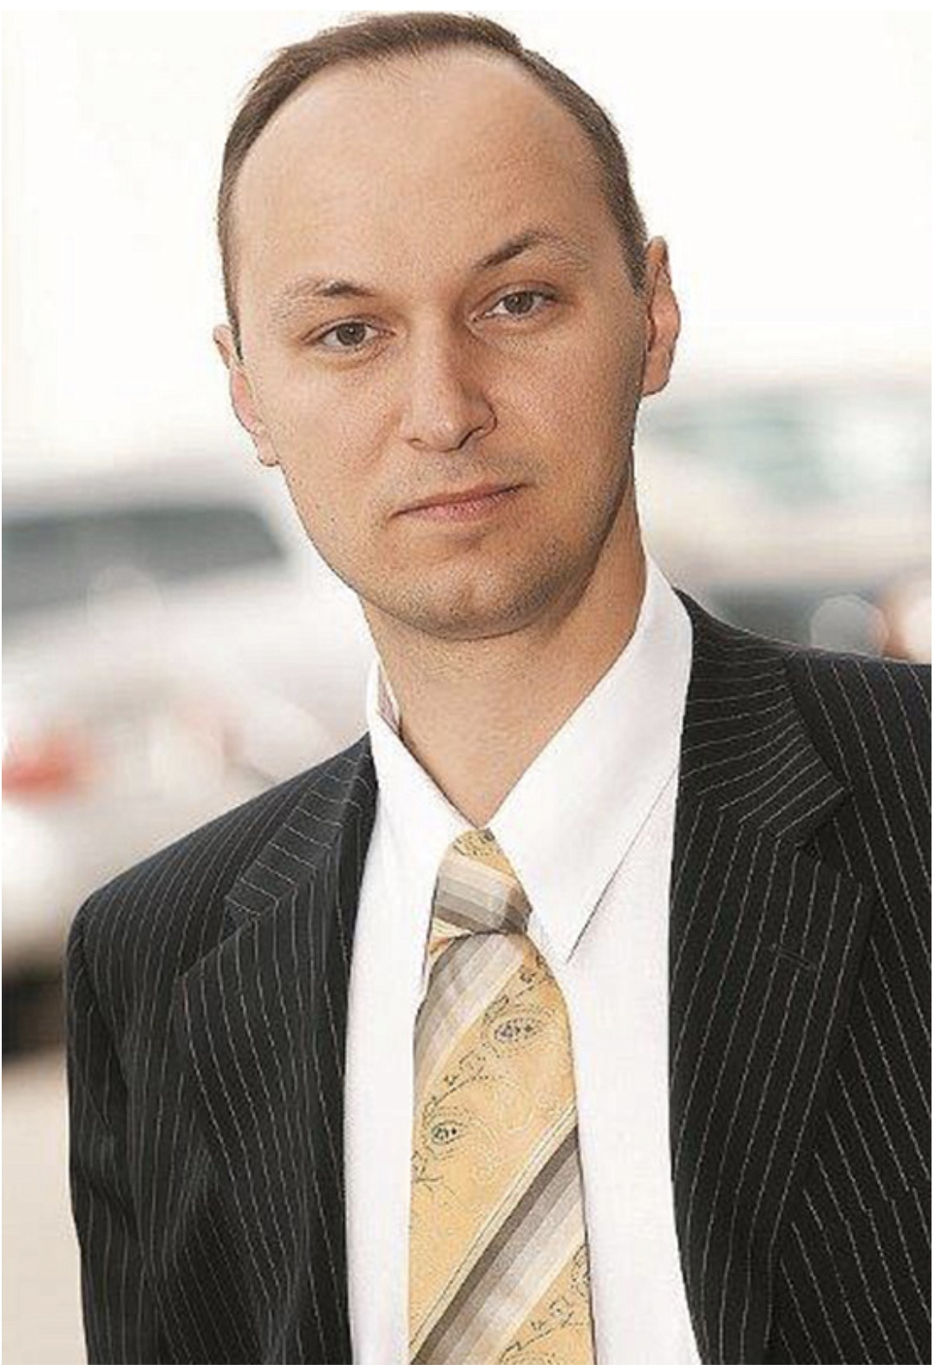


Slide 7


Slide 8
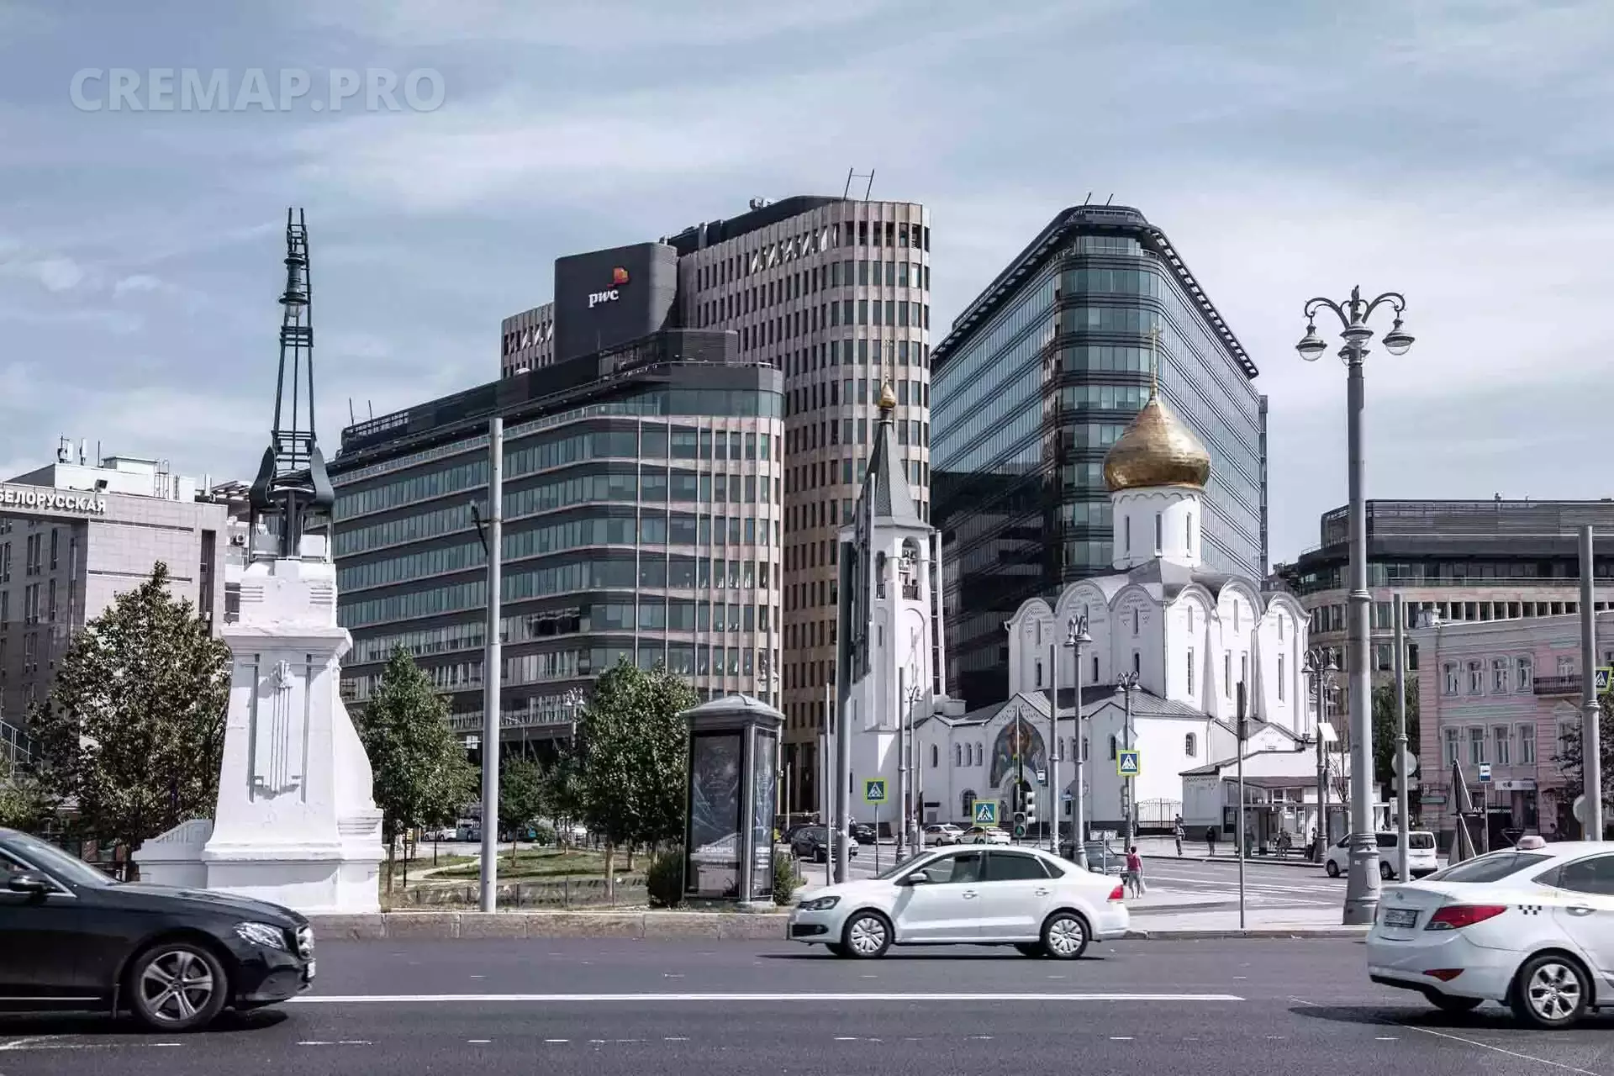

Slide 9
R
RECAP · LECTURES 1–6
What you should already know
Ten ideas that carry the whole course into financial modelling.
Lectures 7–8 · Financial Modelling

Slide 10
RECAP 1 · WHERE WE ARE
Two Instruments of Financial Analysis available for us so far
Unit Economics
Financial Model
Are we earning or loosing on each unit? How many units should we sell to earn X amount of money?
What we own, what we owe, how much do we earn and loose as a business, how money moves.
Lectures 7–8 · Financial Modelling

Slide 11
RECAP 2 · THREE ANGLES
One business, three financial angles
P&L
Balance Sheet
Cash Flow
Rent − utilities, repair, interest, depreciation, tax. Did it earn profit?
Apartment, furniture, cash vs mortgage debt, equity. What is owned / owed?
Rent in; utilities, repair, interest, principal, tax out. What money moved?
Interest is a P&L expense; principal is cash only; depreciation hits profit, not cash.
Lectures 7–8 · Financial Modelling

Slide 12
RECAP 3 · SIGNALS
Ratios interpret the numbers
Profitability
Gross / EBITDA / net margin — does revenue earn enough?
Cash conversion
Cash flow ÷ EBITDA — does profit become cash?
Returns
ROA, ROE — does the asset / equity base generate profit?
Leverage
Net Debt ÷ EBITDA — is the debt load manageable?
Valuation
EV/EBITDA, P/E — how much do investors pay for earnings?
A ratio only means something compared: across time · against peers · against risk · against the business model.
Lectures 7–8 · Financial Modelling

Slide 13
RECAP 4 · LIQUIDITY
Profit ≠ cash
Item
In P&L?
In Cash Flow?
Revenue earned, not yet collected
yes
no, until paid
Depreciation
yes (expense)
no cash now
Loan principal repayment
no
yes (outflow)
Upfront customer payment
not fully now
yes, now
GPU link: depreciation reduces profit but the cash was already spent upfront when the node was bought.
Lectures 7–8 · Financial Modelling

Slide 14
RECAP 5 · SAFE GROWTH
Growth can be unsafe even when LTV > CAC
The model
20%
Conservative safe rule of thumb
The cash-gap mechanism
CAC is paid upfront
LTV returns gradually over time
Fast growth → the cash gap keeps expanding instead of stabilising and recovering.
25%
Still safe in the full cohort model
≈33.3%
Approximate true threshold
34%+
Unsafe — cash gap keeps growing
Lectures 7–8 · Financial Modelling

Slide 15
RECAP 6 · THE UNIT
Unit economics is about the right unit
Subscription
one paying customer
Classic question
Does one customer generate enough LTV to cover CAC?
Marketplace
one transaction / order
Consulting
one project / contract
Asset-rental question
Rental business
one asset
Does one asset generate enough cash flow to repay capex before it loses value?
GPU compute
one GPU node
Lectures 7–8 · Financial Modelling
Lectures 7–8 · Financial Modelling

Slide 16
RECAP 7 · HEALTH CHECK
CAC and LTV: the basic check
CAC
LTV
Cost to acquire one paying customer
Contribution a customer brings over lifetime
Contribution margin
Payback
Unit revenue − variable costs
Time to recover CAC from contribution
LTV<CAC → growth scales the loss · LTV>CAC → may work · ≈3× often healthy — but you also need payback speed, cash timing, retention and margin.
Lectures 7–8 · Financial Modelling

Slide 17
RECAP 8 · ASSUMPTIONS
Models are built from funnels and assumptions
Funnel
How many clicks become paid?
A model is only as good as its assumptions
Conversion
Share moving to next step
No data yet? Use:
market benchmarks · competitor data · expert estimates · small experiments · conservative scenarios
Retention
How long they keep paying
Variable cost
Cost per user / request / payment
Benchmark
Assumption before real data exists
Lectures 7–8 · Financial Modelling
Lectures 7–8 · Financial Modelling

Slide 18
RECAP 9 · PM LENS
A PM does not only ask “can we build it?”
Feature lens
Product lens
“Can we build this?”
“Should we build or scale this?”
Stops at feasibility.
Ties the decision to revenue, retention, CAC, LTV, cost to serve, payback.
Lecture 7 uses the same logic for an investment: not “can we buy GPUs?” but “should we, given cash flows and risk?”
Lectures 7–8 · Financial Modelling

Slide 19


Slide 20
RECAP 10 · FOUNDATION
Growth alone can lie
The dot-com lesson: users, revenue and growth can look impressive while the economics of one unit are broken.
More users
can mean more losses
More revenue
can hide worse margins
More activity
can raise variable costs — growth can destroy cash faster
Lectures 7–8 · Financial Modelling

Slide 21
G
CASE · LECTURE 7
GPU compute: buy it, rent it out
Turn capital expenditure into a rental cash-flow stream.
Lectures 7–8 · Financial Modelling

Slide 22
GPU CASE · SETUP
Buy GPU capacity → rent it out
Buy a GPU node
Closed / controlled infrastructure
Customers rent compute hours
Revenue vs depreciation
→
→
→
Inside the node
Why a “closed contour”
GPUs — main capex, sets price & obsolescence
CPU — coordinates workload & data
RAM — datasets & model state
Storage / power / cooling — hidden cost layer
Data sensitivity — personal data, secrets, source code
152-ФЗ — control over where data is processed
Trust & geopolitics — “where does our data go, who can access it?”
Lectures 7–8 · Financial Modelling
Lectures 7–8 · Financial Modelling

Slide 23
GPU CASE · THE TEMPTATION
The market looked highly profitable
Gross annual yield
What 120% means
≈120%
Annual gross rental revenue ÷ initial equipment cost — income before electricity, hosting, commission, idle time, taxes and depreciation.
per year
Example: 10M ₽ kit → 12M ₽ / year → ≈ 1M ₽ / month gross.
120% gross yield ≠ 120% net return. It is the temptation — the rest of the case asks whether it is real.
Lectures 7–8 · Financial Modelling

Slide 24
GPU CASE · READ THE NUMBER
120% per year: huge — or a hidden trap?
A lot — if…
Not enough — if…
revenue is stable
utilization stays high
costs are controlled
equipment stays valuable for years
utilization falls
rental prices collapse
electricity & hosting eat margin
GPUs become obsolete quickly
Don’t ask “is 120% bigger than 5, 15 or 30%?” Ask: what risk and depreciation is this 120% compensating me for?
Lectures 7–8 · Financial Modelling

Slide 25
GPU CASE · BENCHMARKS
What does 120% compete against?
lower yield · lower risk → higher yield · higher obsolescence risk
≈ 120%
≈ 30%
GPU rental
high obsolescence risk
≈ key rate
Car rental
depreciates, idle, repairs
≈ 5%
Deposits / OFZ
Real estate
interest & inflation risk
The market does not give yield for free. If GPU rental shows 120%, what hidden risk is being priced in?
durable, may hold value
Lectures 7–8 · Financial Modelling

Slide 26
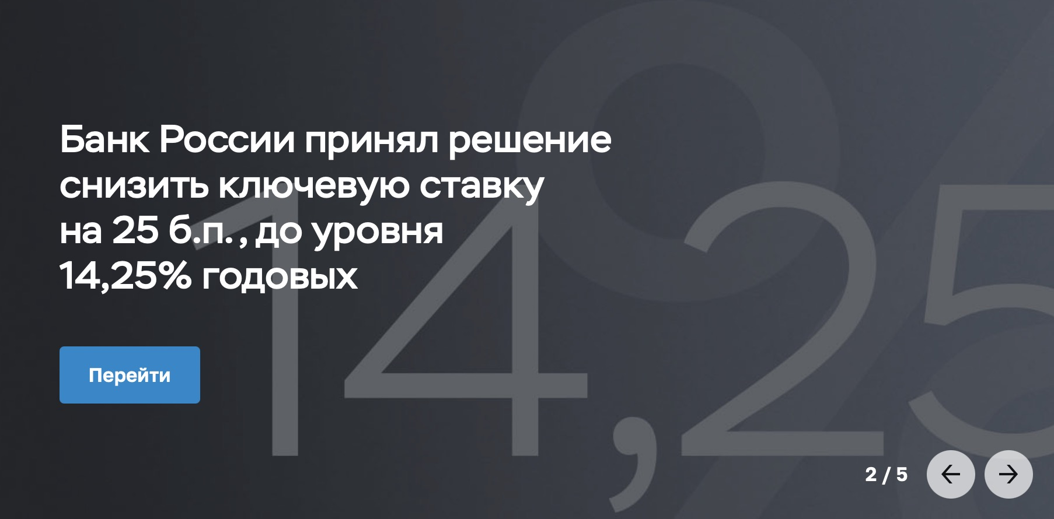

Slide 27
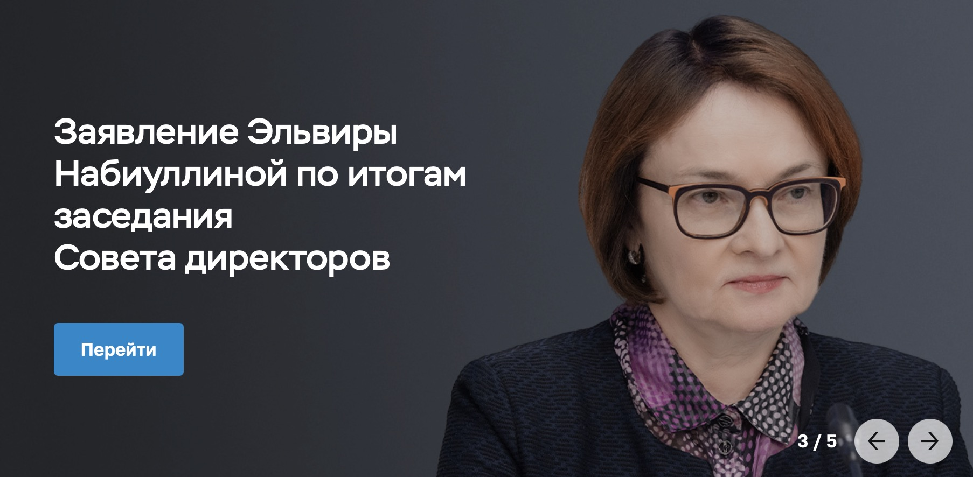

Slide 28
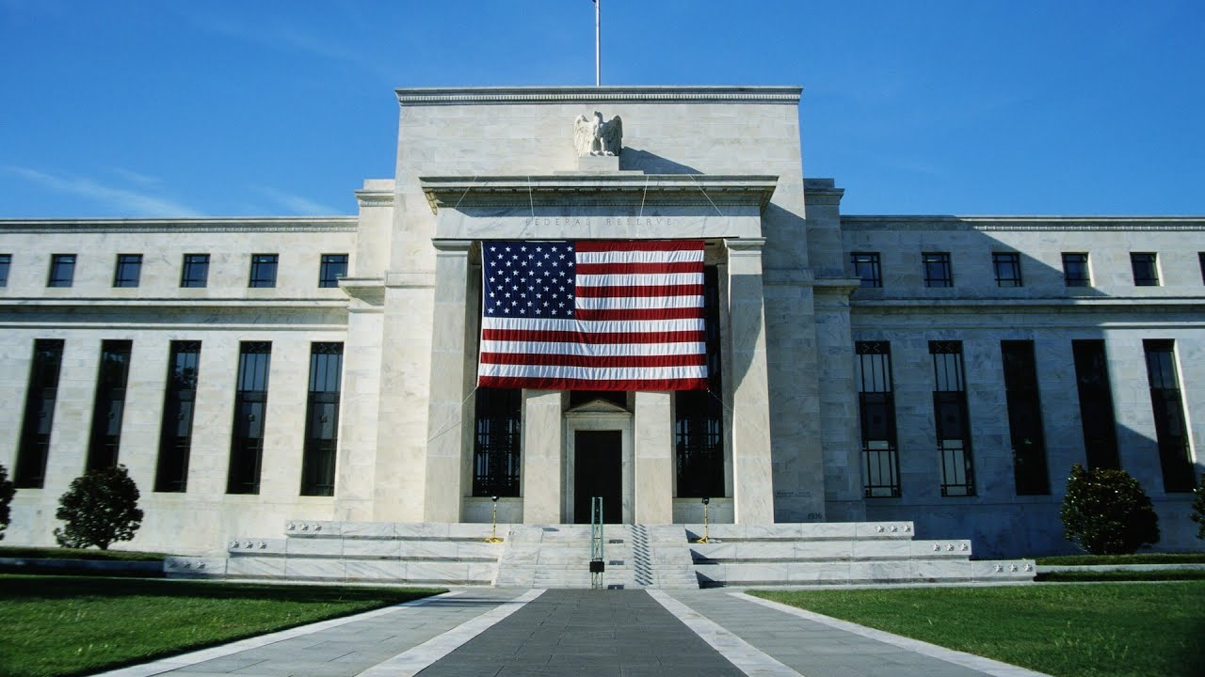

Slide 29


Slide 30
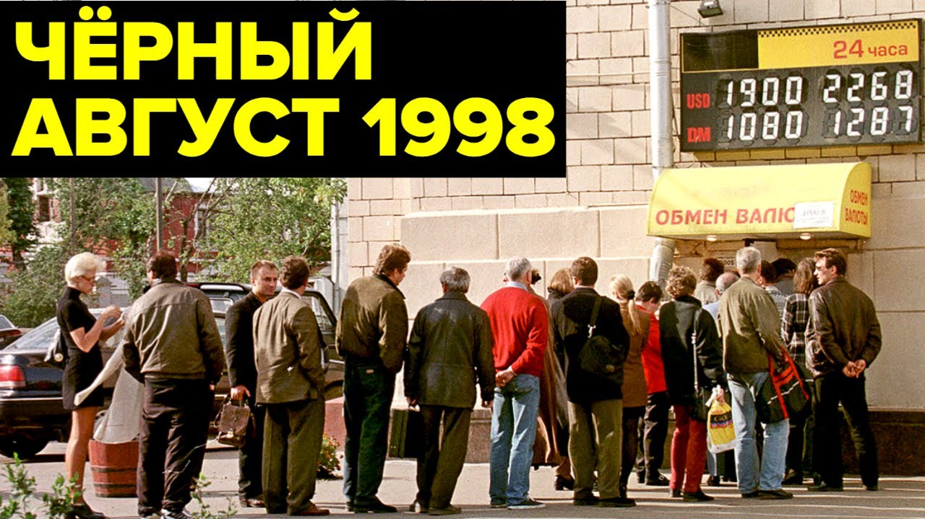

Slide 31
GPU CASE · THE KEY RISK
120% is huge — unless the kit goes to zero
Durable asset
Fast obsolescence
Stays relevant for years and keeps resale value → 120% is extremely attractive: capex repaid fast while the asset is still worth money.
Competitive for ~1 year, then near zero → 120% is barely enough: revenue must cover the whole capex before value disappears.
Drives obsolescence: new GPU generations · falling rental prices · newer accelerators demanded · energy efficiency · workload shifts · sanctions & supply.
Lectures 7–8 · Financial Modelling

Slide 32
GPU CASE · THE UNIT SHIFTS
Now we model one unit: one GPU node
Old unit · customer
New unit · GPU node
CAC → customer → LTV → payback
Capex → node → rental − opex → residual value
Does one customer pay back acquisition cost?
Does one node pay back its capex before it loses value?
In this simplified model: CAC = 0 (marketplace demand, no paid acquisition) · horizon = 3 years · residual value matters.
Lectures 7–8 · Financial Modelling

Slide 33
GPU CASE · UNIT ECONOMICS
One GPU node — 3-year base case
Capex
8.6M ₽
Revenue / mo
792k ₽
A100×8 7.11 · DDR4 0.44 · G492 0.96 · CPU 0.09
66% utilization of 1.2M ₽ at 100%
Opex / mo
228k ₽
Residual (3y)
4.3M ₽
rack rent 200k · repair reserve 28k
50% of initial node cost
564k ₽
≈15.3 mo
≈16.0M ₽
≈186%
Monthly cash flow
Payback
3-yr profit
Simple ROI
Lectures 7–8 · Financial Modelling

Slide 34
GPU CASE · TRUE RETURN
Simple average ROI is misleading
Naive path
Compound path
186% ÷ 3 = 62% / year ✗
8.6M × (1+r)³ = 24.6M
r ≈ 41.9% / year ✓
24.6M
17.3M
12.2M
8.6M
Y0
Y1
Y2
Y3
CAGR — the true constant annual return — not a multi-year ROI divided by years. IRR (monthly cash flows) comes in Lecture 8.
Lectures 7–8 · Financial Modelling

Slide 35
₽
COURSE SECTION
Оценка бизнеса
или стартапа
Сравнительный метод и мультипликаторы
Lecture 7-8 · Business Valuation

Slide 36
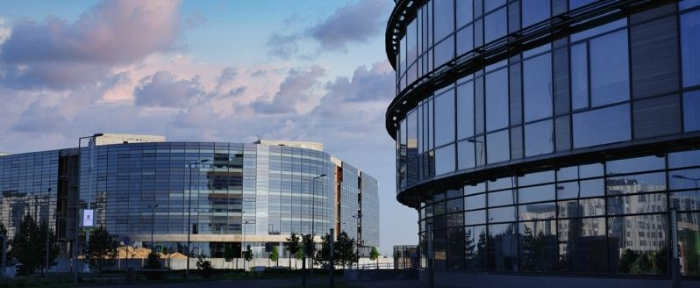

Slide 37
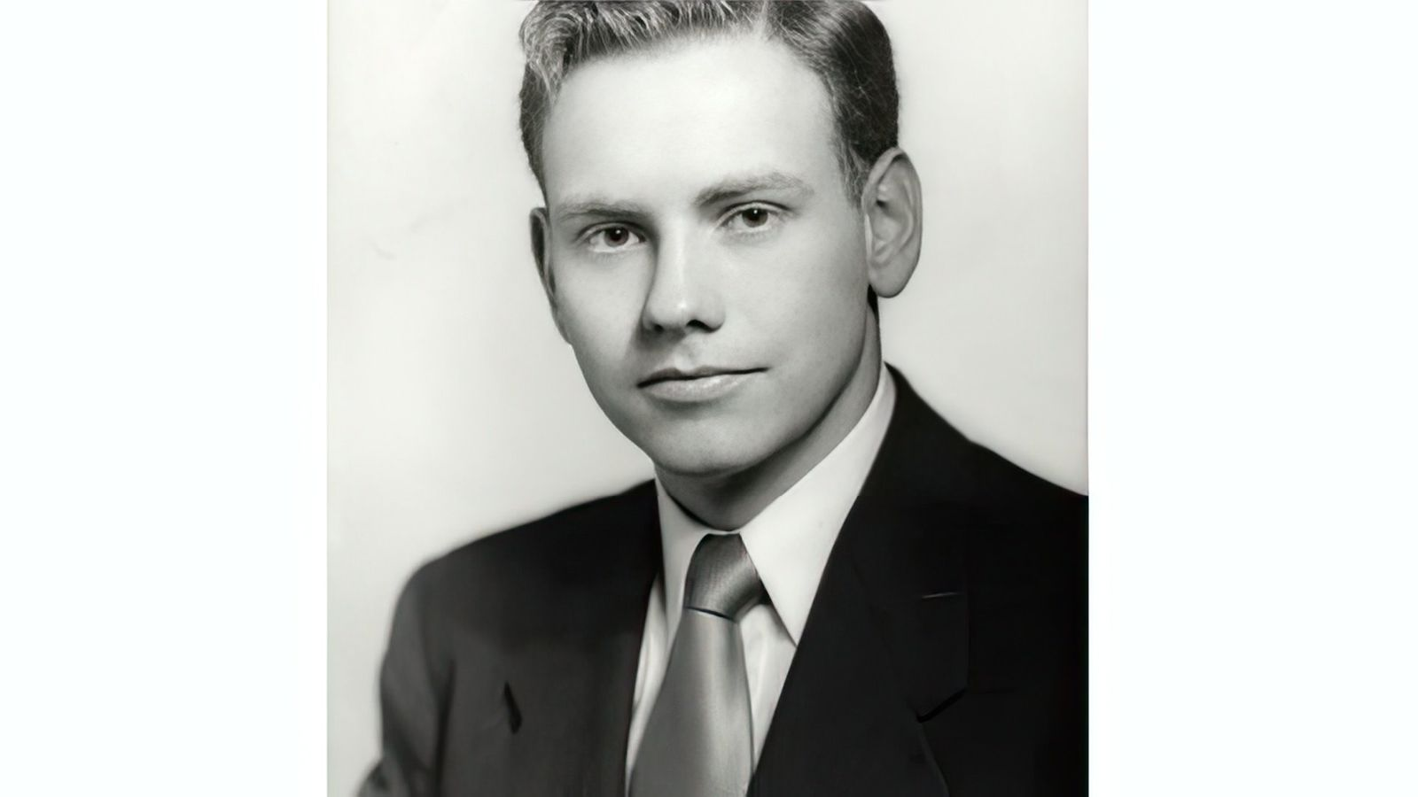
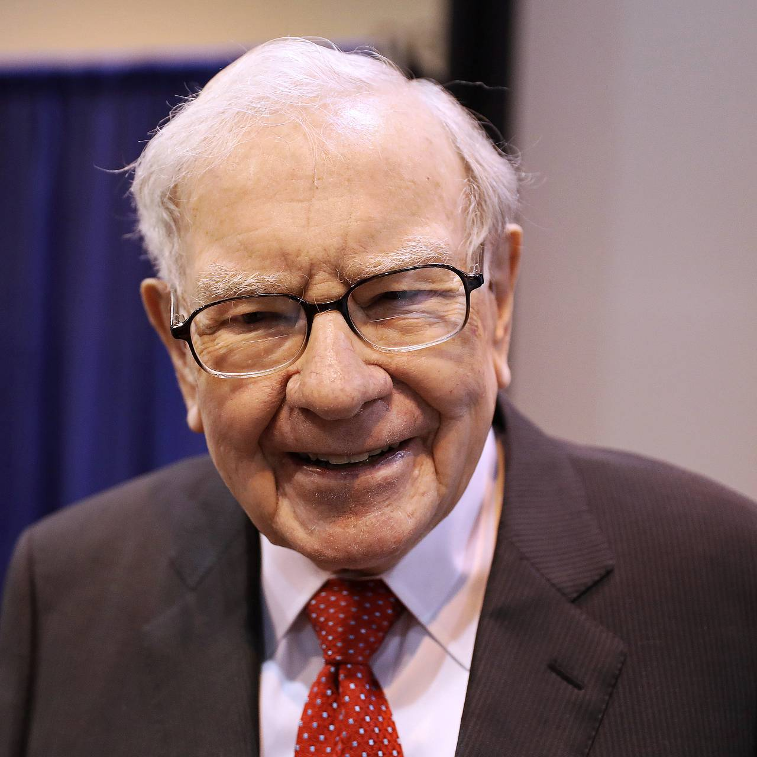

Slide 38
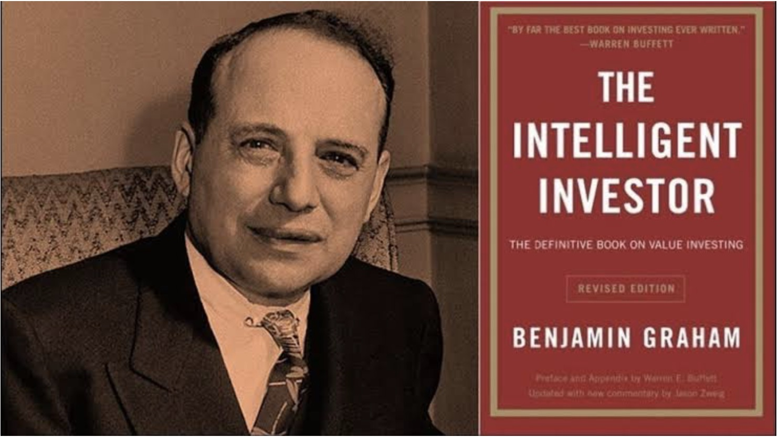

Slide 39


Slide 40
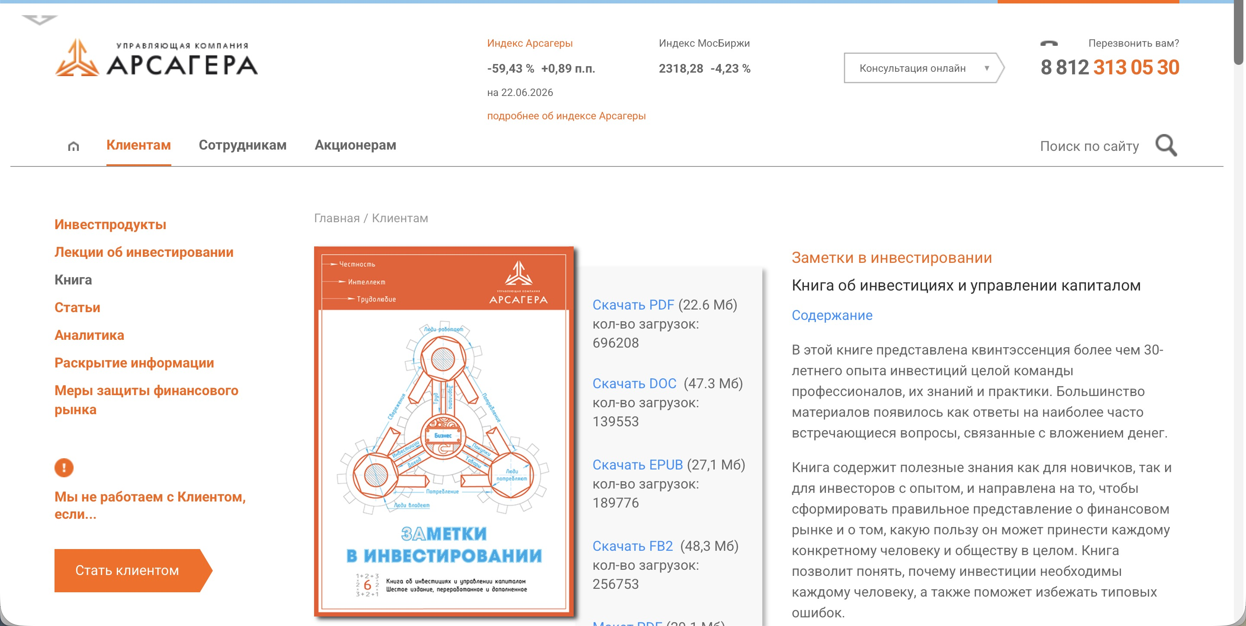

Slide 41
ВВЕДЕНИЕ
Какие вы знаете методы оценки?
Методы
оценки
1
Затратный
Lecture 7-8 · Business Valuation

Slide 42
ВВЕДЕНИЕ
Какие вы знаете методы оценки?
Методы
оценки
1
Затратный
2
Сравнительный
Lecture 7-8 · Business Valuation

Slide 43
ВВЕДЕНИЕ
Какие вы знаете методы оценки?
Методы
оценки
1
Затратный
2
Сравнительный
3
Дисконтирование денежных потоков
Lecture 7-8 · Business Valuation

Slide 44
ВВЕДЕНИЕ
Какие вы знаете методы оценки?
Методы
оценки
1
Затратный
2
Сравнительный
3
Дисконтирование денежных потоков (DCF-модель)
Lecture 7-8 · Business Valuation

Slide 45
≈
МЕТОД · СРАВНЕНИЕ
Сравнительный метод
Оцениваем компанию по аналогам и рыночным мультипликаторам.
Lecture 7-8 · Business Valuation

Slide 46
СРАВНИТЕЛЬНЫЙ МЕТОД
Ваши варианты? →
С чем
сравниваем?
Lecture 7-8 · Business Valuation

Slide 47
СРАВНИТЕЛЬНЫЙ МЕТОД
1
Аналогичные компании
С чем
сравниваем?
Lecture 7-8 · Business Valuation

Slide 48
СРАВНИТЕЛЬНЫЙ МЕТОД
1
Аналогичные компании
С чем
сравниваем?
2
Фондовый рынок
Lecture 7-8 · Business Valuation

Slide 49
СРАВНИТЕЛЬНЫЙ МЕТОД
1
Аналогичные компании
С чем
сравниваем?
2
Фондовый рынок
3
Ключевая ставка
Lecture 7-8 · Business Valuation

Slide 50
СРАВНИТЕЛЬНЫЙ МЕТОД
По каким
параметрам?
По каким параметрам сравниваем компании?
→ Мультипликаторы
Lecture 7-8 · Business Valuation

Slide 51
МУЛЬТИПЛИКАТОР
Цена /
выручка
P/S
PRICE / SALES
Капитализация / Выручка
Lecture 7-8 · Business Valuation

Slide 52
ИТ-СЕКТОР РФ
Компания
2024
2026
Астра
9.8
1.8
Сравнение
по P/S
IVA Technologies
7.9
1.9
HeadHunter
7.3
3.0
Аренадата
5.8
2.0
Позитив
5.4
1.7
Диасофт
4.2
6.3
ЦИАН
3.4
2.7
Яндекс
1.5
1.0
Делимобиль
1.4
0.3
VK
—
0.8
Источник: Smart-Lab, 24.06.2026 (последняя годовая отчётность)
Lecture 7-8 · Business Valuation

Slide 53
МУЛЬТИПЛИКАТОР
Цена /
прибыль
P/E
PRICE / EARNINGS
Капитализация / Прибыль
Lecture 7-8 · Business Valuation

Slide 54
ИТ-СЕКТОР РФ
Компания
2024
2026
Яндекс
44.2
10.5
Сравнение
по P/E
Астра
26.5
5.8
ЦИАН
23.0
15.7
HeadHunter
17.2
6.0
Аренадата
15.7
6.6
Диасофт
12.7
6.4
Позитив
12.3
7.4
IVA Technologies
10.9
4.2
VK
−1.7
−5.5
Делимобиль
—
−2.4
Источник: Smart-Lab, 24.06.2026 (последняя годовая отчётность)
Lecture 7-8 · Business Valuation

Slide 55
МУЛЬТИПЛИКАТОР
Прибыль /
цена
E/P
EARNINGS / PRICE
Прибыль / Цена
Lecture 7-8 · Business Valuation

Slide 56
ИТ-СЕКТОР РФ
Компания
2024
2026
VK
−58%
−18.2%
Сравнение
по E/P
IVA Technologies
9.1%
23.8%
Позитив
8.1%
13.5%
Диасофт
7.8%
15.6%
Аренадата
6.3%
15.2%
HeadHunter
5.8%
16.7%
ЦИАН
4.3%
6.4%
Астра
3.7%
17.2%
Яндекс
2.2%
9.5%
Делимобиль
—
−41.7%
Источник: Smart-Lab, 24.06.2026 (последняя годовая отчётность)
Lecture 7-8 · Business Valuation

Slide 57
НЕФТЕГАЗ РФ
Компания
2024
2026
Сравнение
по E/P
Башнефть
52%
25.0%
Лукойл
24%
3.1%
Роснефть
24%
8.8%
Газпром Нефть
24%
11.4%
Татнефть
22%
13.7%
Новатэк
18%
6.3%
Газпром
—
45.5%
Источник: Smart-Lab, 24.06.2026 (последняя годовая отчётность)
Lecture 7-8 · Business Valuation

Slide 58
МУЛЬТИПЛИКАТОР
Прибыль /
цена
E/P
EARNINGS / PRICE
Идеально сравнивать с ключевой ставкой ЦБ.
Lecture 7-8 · Business Valuation

Slide 59
МУЛЬТИПЛИКАТОР
Цена /
баланс
P/B
PRICE / BOOK VALUE
Капитализация / Балансовая стоимость
Lecture 7-8 · Business Valuation

Slide 60
ПРИМЕР
Компания
2024
2026
Сравнение
по P/B
ГАЗПРОМ
0.2
0.1
Яндекс
9.7
9.0
Источник: Smart-Lab, 24.06.2026 (последняя годовая отчётность)
Lecture 7-8 · Business Valuation

Slide 61
МУЛЬТИПЛИКАТОРЫ
ROE
ROA
Что ещё
бывает?
Рентабельность EBITDA
Net Debt / EBITDA
EV / EBITDA
Темпы роста выручки
Lecture 7-8 · Business Valuation

Slide 62
ПРАКТИКА
Данные компании
ПОСЧИТАЙТЕ
Закрепим
Выручка
1 000 ₽
P/S
Опер. прибыль
700 ₽
P/E
E/P
Чист. прибыль
300 ₽
P/B
Имущество
1 000 ₽
ROE
Долг
1 000 ₽
EV
Капитализация
900 ₽
EV / EBITDA
Посчитайте мультипликаторы по данным компании.
Рент. EBITDA
Lecture 7-8 · Business Valuation

Slide 63
KS
РАЗБОР
Кейс
Оценка реальной компании на практике.
Lecture 7-8 · Business Valuation

Slide 64

КЕЙС · КОМПАНИЯ
Сайт
компании
С чего начинаем разбор — сайт и позиционирование компании.
Lecture 7-8 · Business Valuation

Slide 65
PR
КЕЙС · ИСТОЧНИКИ
Презентация
Что говорит о себе компания.
Lecture 7-8 · Business Valuation

Slide 66
КЕЙС · РИСКИ
1
Группа юр. лиц
Специфика
2
Основное имущество (земля и здания) на другом юр. лице
3
Занижение прибыли
4
Занижение выручки
5
Непрозрачный вывод средств
Lecture 7-8 · Business Valuation

Slide 67
₽
КЕЙС · ИСТОЧНИКИ
Отчётность
Что показывают цифры на самом деле.
Lecture 7-8 · Business Valuation

Slide 68
TODAY
Previous Lecture (5-6) Overview
Done So Far
What you should already know
GPU Compute Rent Case
Key Rate
Business Valuation
Business Valuation Real Life Case
7
Lecture 7-8 · Business Valuation

Slide 69
NEXT TIME
1
UE + Fin.Models + Business Valuation
What we'll cover
2
Кейс «Цифровые привычки»
3
Кейс “Kazan Express” / «Магнит Маркет» / “UZUM”
Lecture 1 · Unit Economics

Slide 70
?
WRAP-UP
Questions?
On the topics discussed — and not only.
Lectures 7–8 · Financial Modelling

