Slide 1
9
INNOPOLIS UNIVERSITY · SUMMER 2026
Financial Management
in Digital Products
Unit Economics · Financial Modelling · Business Valuation
Lecture 9-10 — Digital Habits, Outsource Development, From Services to Products
Max Popov · Course Instructor

Slide 2
BEFORE WE START
Turn on Meeting
Recording
Make sure the recording is running, and only then begin.
Lecture 9-10 — Digital Habits, Outsource Development, From Services to Products

Slide 3
TODAY
1
В прошлых сериях…
What we'll cover
2
История компании «Цифровые привычки»
3
Юнит-Экономика «заказной разработки»
4
Юнит-Экономика B2B продукта
5
Pre-IPO компании «Цифровые привычки»
6
Практическое задание
Lecture 9-10 — Digital Habits, Outsource Development, From Services to Products

Slide 4
Write down 10 words or concepts that stayed with you after the course. Whatever comes to mind first — no filtering.
STEP 1 · WARM-UP
Ten words
that stuck
1.
6.
2.
7.
3.
8.
4.
9.
5.
10.

Slide 5
STEP 2 · 12 MIN
Pick the 5 most important of your 10. For each, fill one row:
Build
your map
Concept
What it helps
you understand
How it's useful
to you personally
1
2
3
4
5

Slide 6
STEP 3 · 5 MIN
In a single sentence — write down your own:
The final
formula
The main lesson of this course for me:
______________________________________

Slide 7
STEP 4 · IN PAIRS
Swap sheets with the person next to you.
Compare with
your neighbor
Your sheet
Neighbor's sheet
Then pick the single strongest takeaway from the two sheets — or agree that each of you keeps your own.

Slide 8
STEP 5 · SUBMIT
Post your final takeaway on the course site:
Upload your
final answer
max-ppv.ru/lectures9-10/takeaways.html
One link, one submission per person.

Slide 9
G
CASE · LECTURE 9
PRE-IPO Группы компаний «Цифровые привычки»
Юнит-Экономика аутсорса разработки
Lecture 9-10 — Digital Habits, Outsource Development, From Services to Products

Slide 10


Slide 11
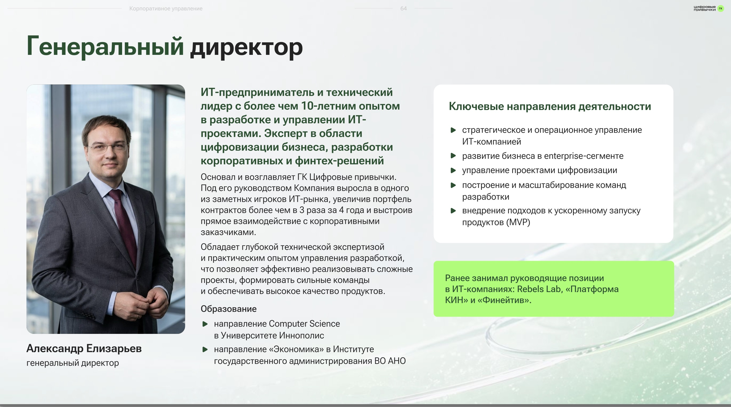

Slide 12
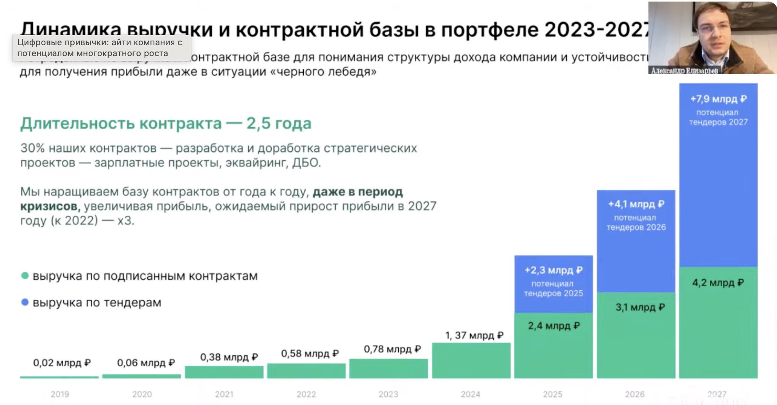
Какие среднегодовые темпы роста выручки?

Slide 13
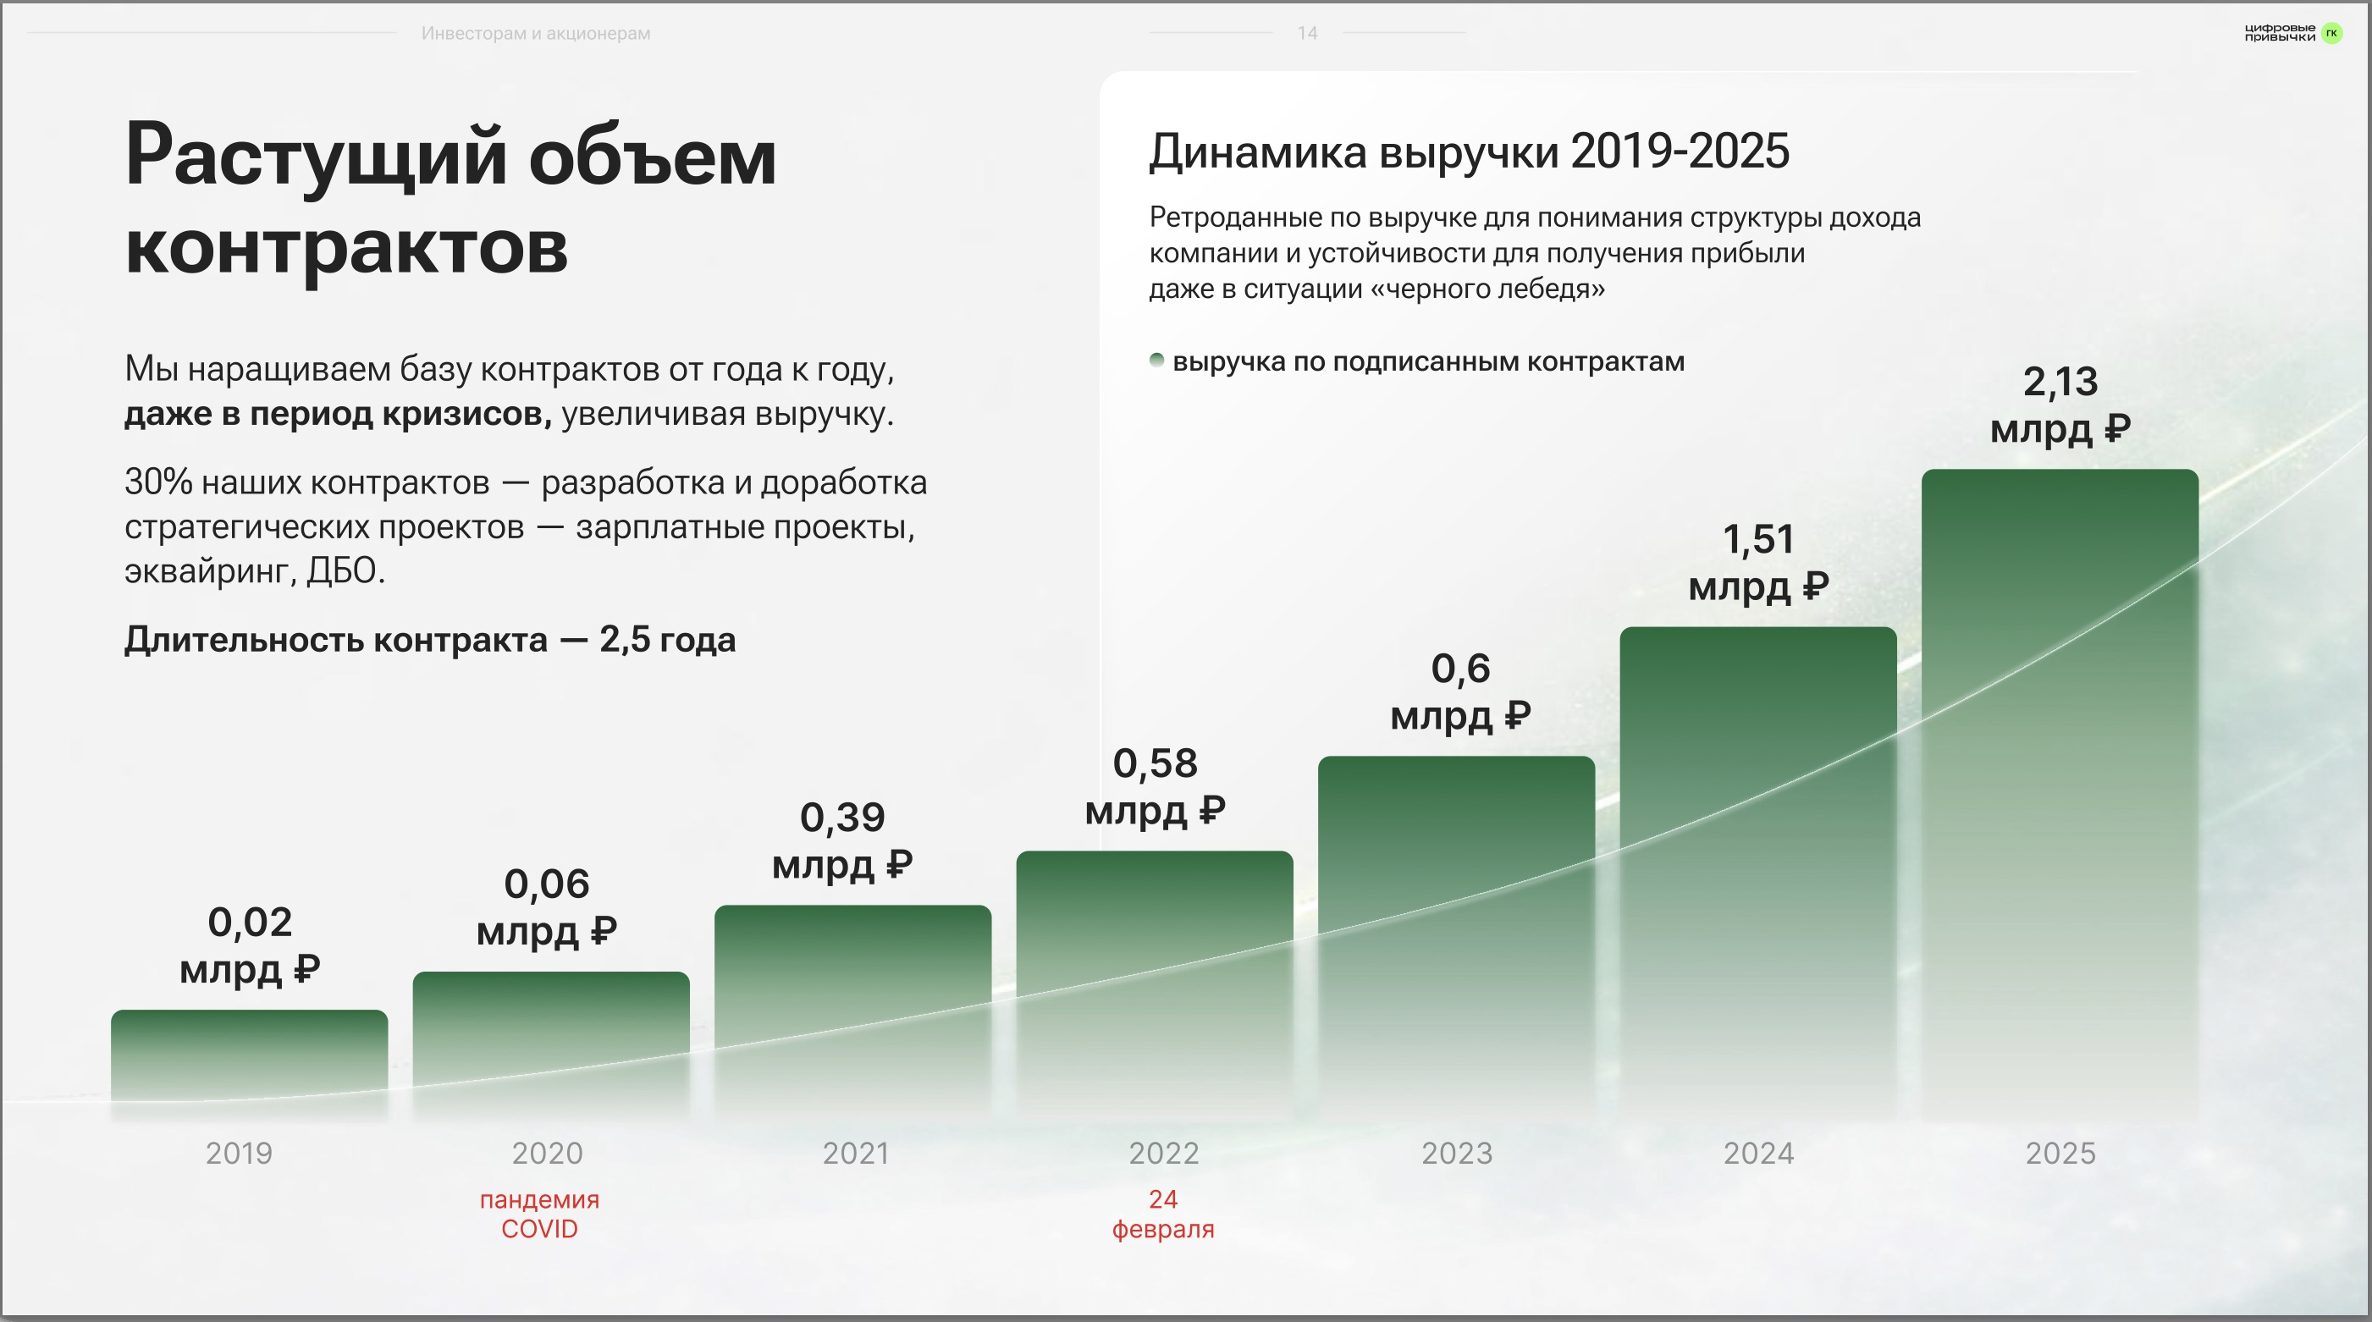
Какие среднегодовые темпы роста выручки?

Slide 14
VALUATION
PEG = (P/E) / g
P/E, normalized
for growth
P/E alone can't tell you if a stock is expensive. Dividing it by the growth rate shows what you pay for each point of growth.
PEG < 1
PEG = 1
PEG > 1
Cheap for its growth
Fairly priced
Growth already in the price
g = growth rate, in % per year
Example: a P/E of 30 with 30% growth → PEG = 1.0 — fairly priced for that growth.

Slide 15
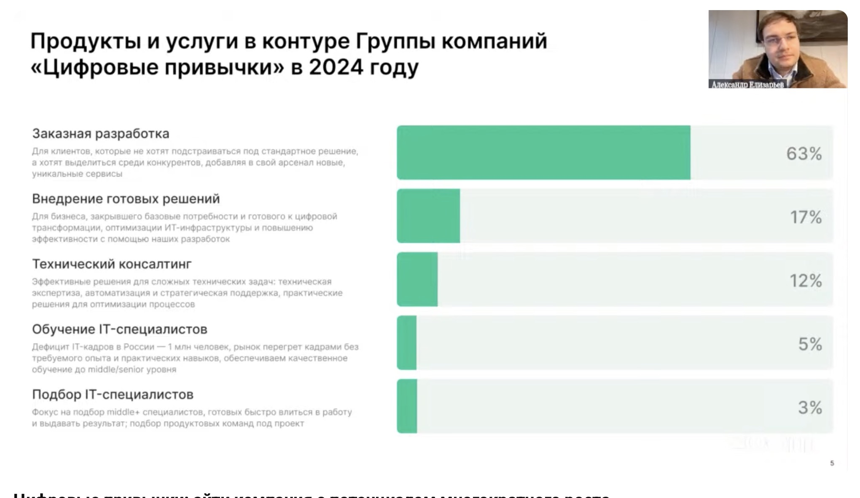

Slide 16
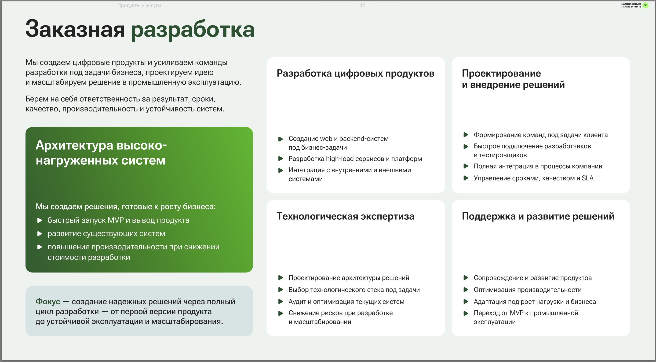
Что есть юнит в заказной разработке?

Slide 17
One hour sold to the client at ₽10,000 — where the margin actually lands
OUTSOURCING
Unit economics
of one hour
Item
Per hour, ₽
Revenue
Billing rate (to client)
10,000
Total revenue
10,000
Costs
Developer pay (for the hour)
2,000
Developer Salary Taxes
800
Team lead, QA, Taxes
1,200
Account Management + Taxes
1,500
Sales + Taxes
2,000
Administrative
1,000
Total costs
8,500
Margin per hour
1,500
Unit = 1 billable hour
The point: selling hours is linear and low-margin. Building a product once and selling it many times is what re-shapes the unit economics.

Slide 18
DIGITAL HABITS
1
FINTECH FOR BANKS & RETAIL
Own products,
three groups
Retail Banking · Finative
Finative Kassa
White-label digital banking (DBO)
Cloud POS & fiscal checkout
2
DEV & DATA TOOLING
CodeAche
Digital Asset
Quantum Hash
Code quality & tech-debt control
DataOps — instant DB clones
DSPM — sensitive-data map (K8s)
3
IT TALENT ECOSYSTEM
KINN
Headbridge
AI assembly of IT teams
AI virtual internship (EdTech)
Work done by hand,
turned into products
sold many times.
Same pattern each time: work first done by hand on outsourcing, then packaged and sold many times.

Slide 19
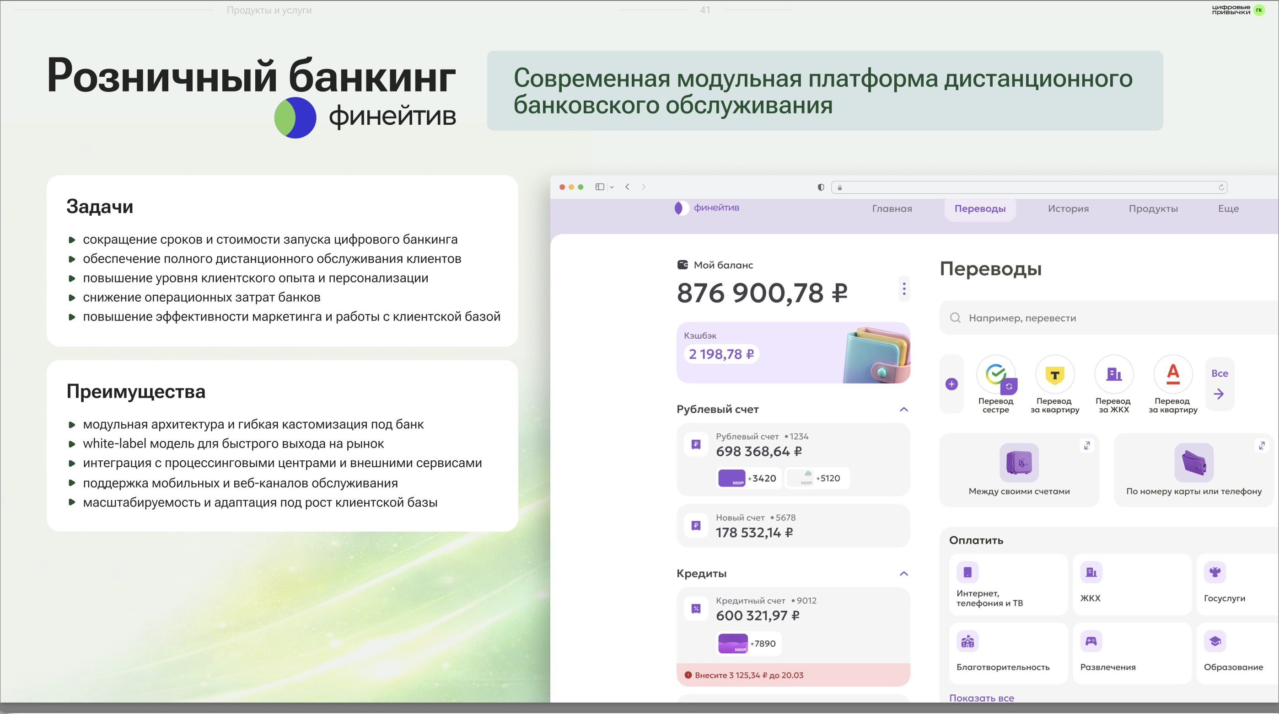
https://finative.ru

Slide 20
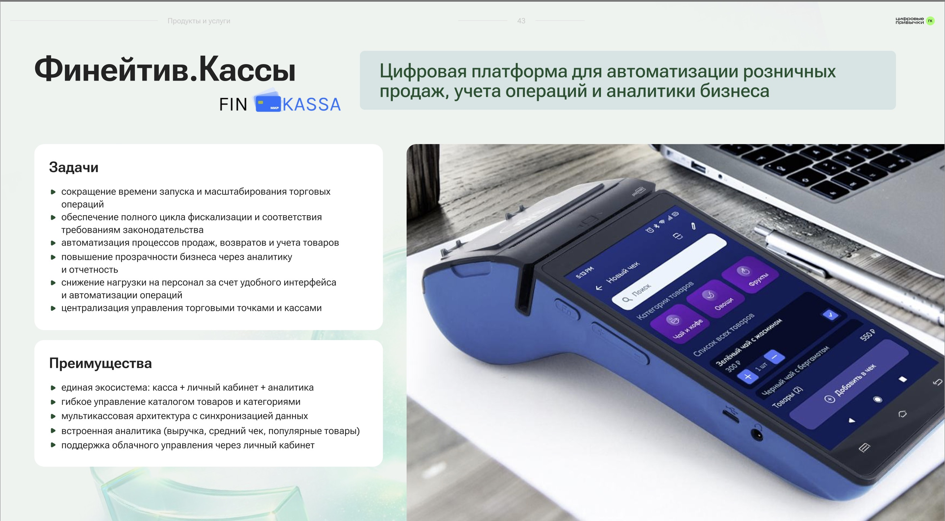
https://fin-kassa.com

Slide 21
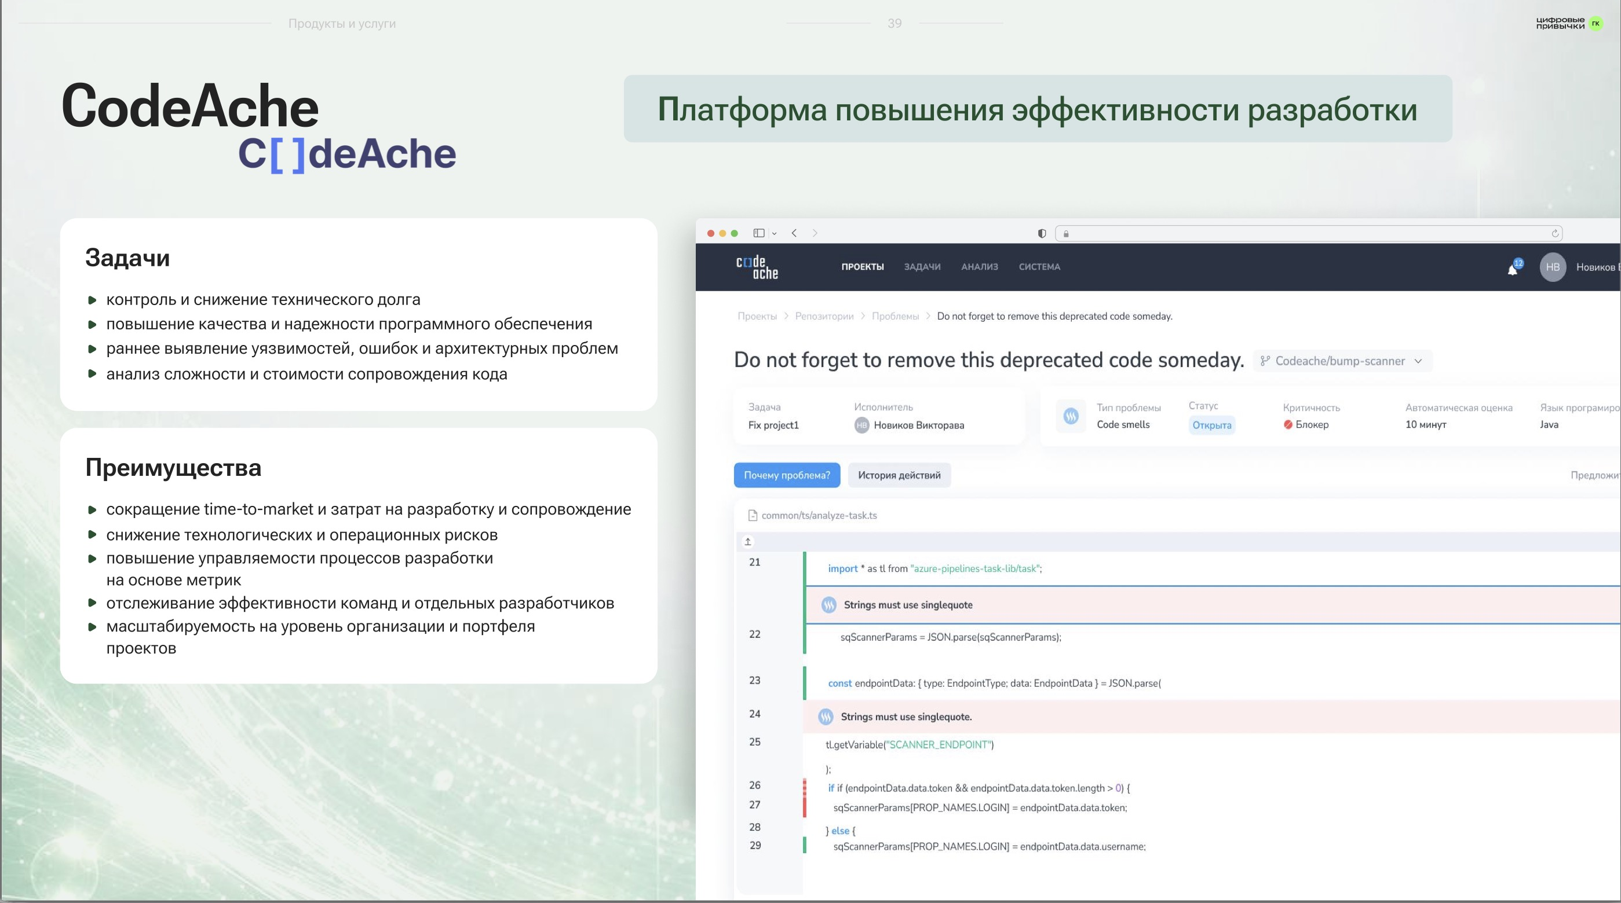
https://codeache.org

Slide 22
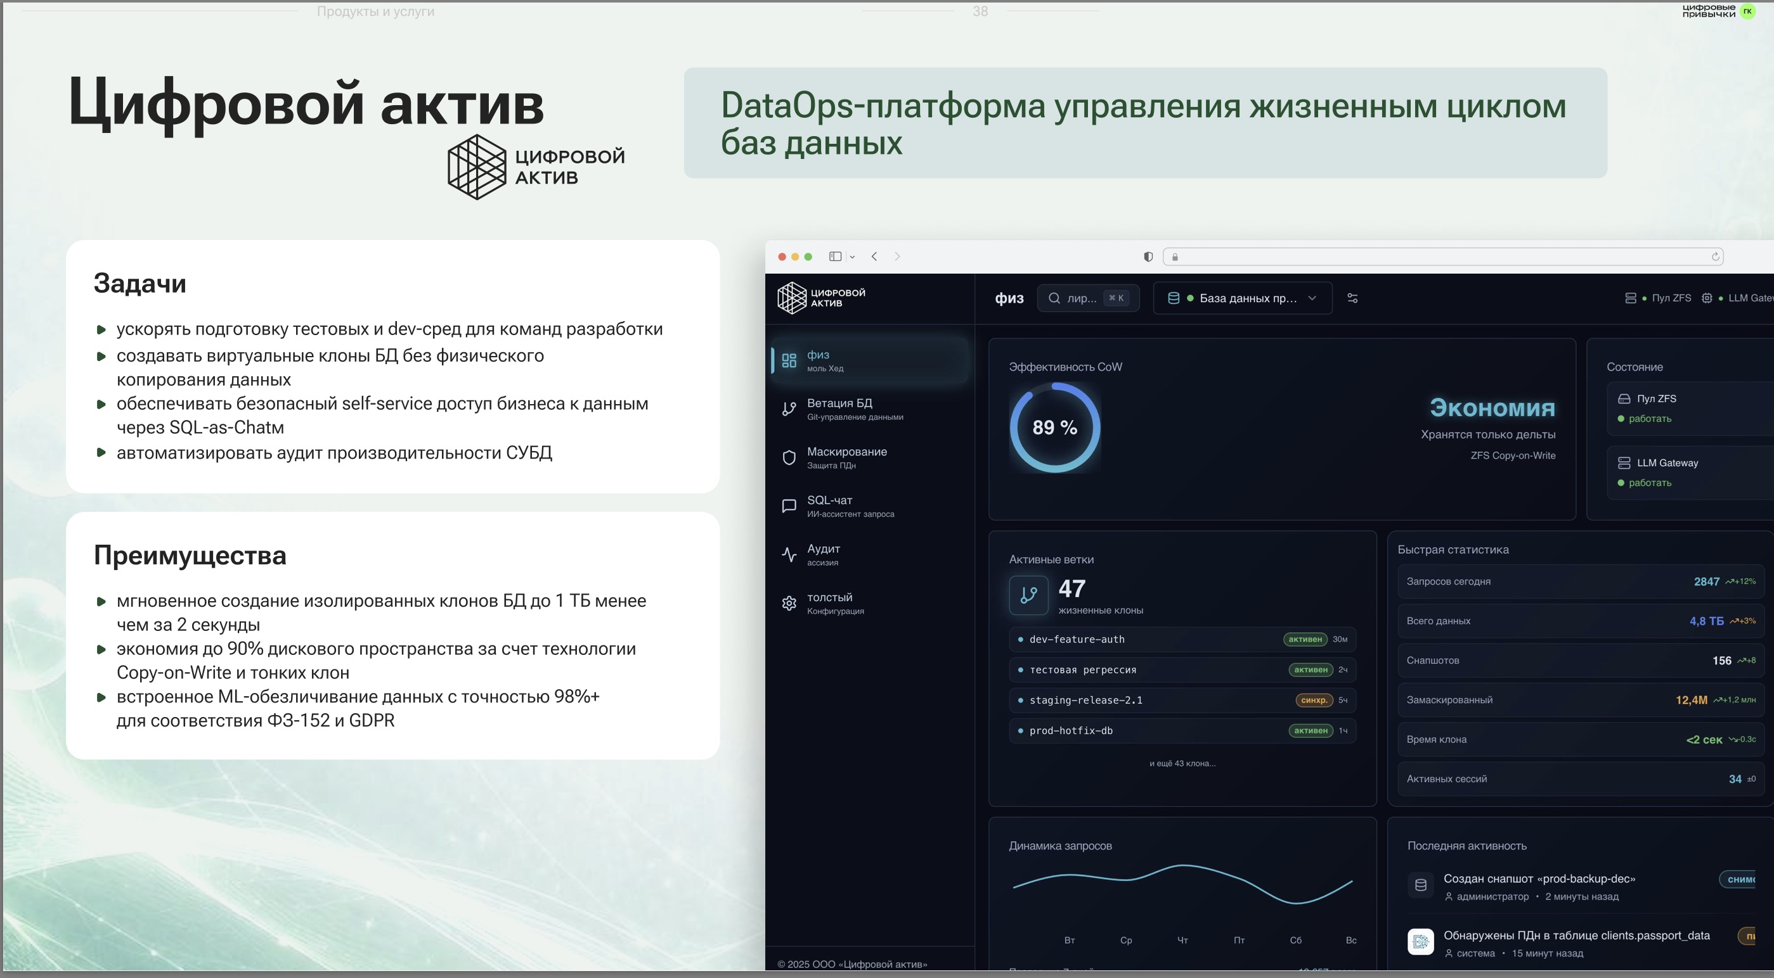

Slide 23
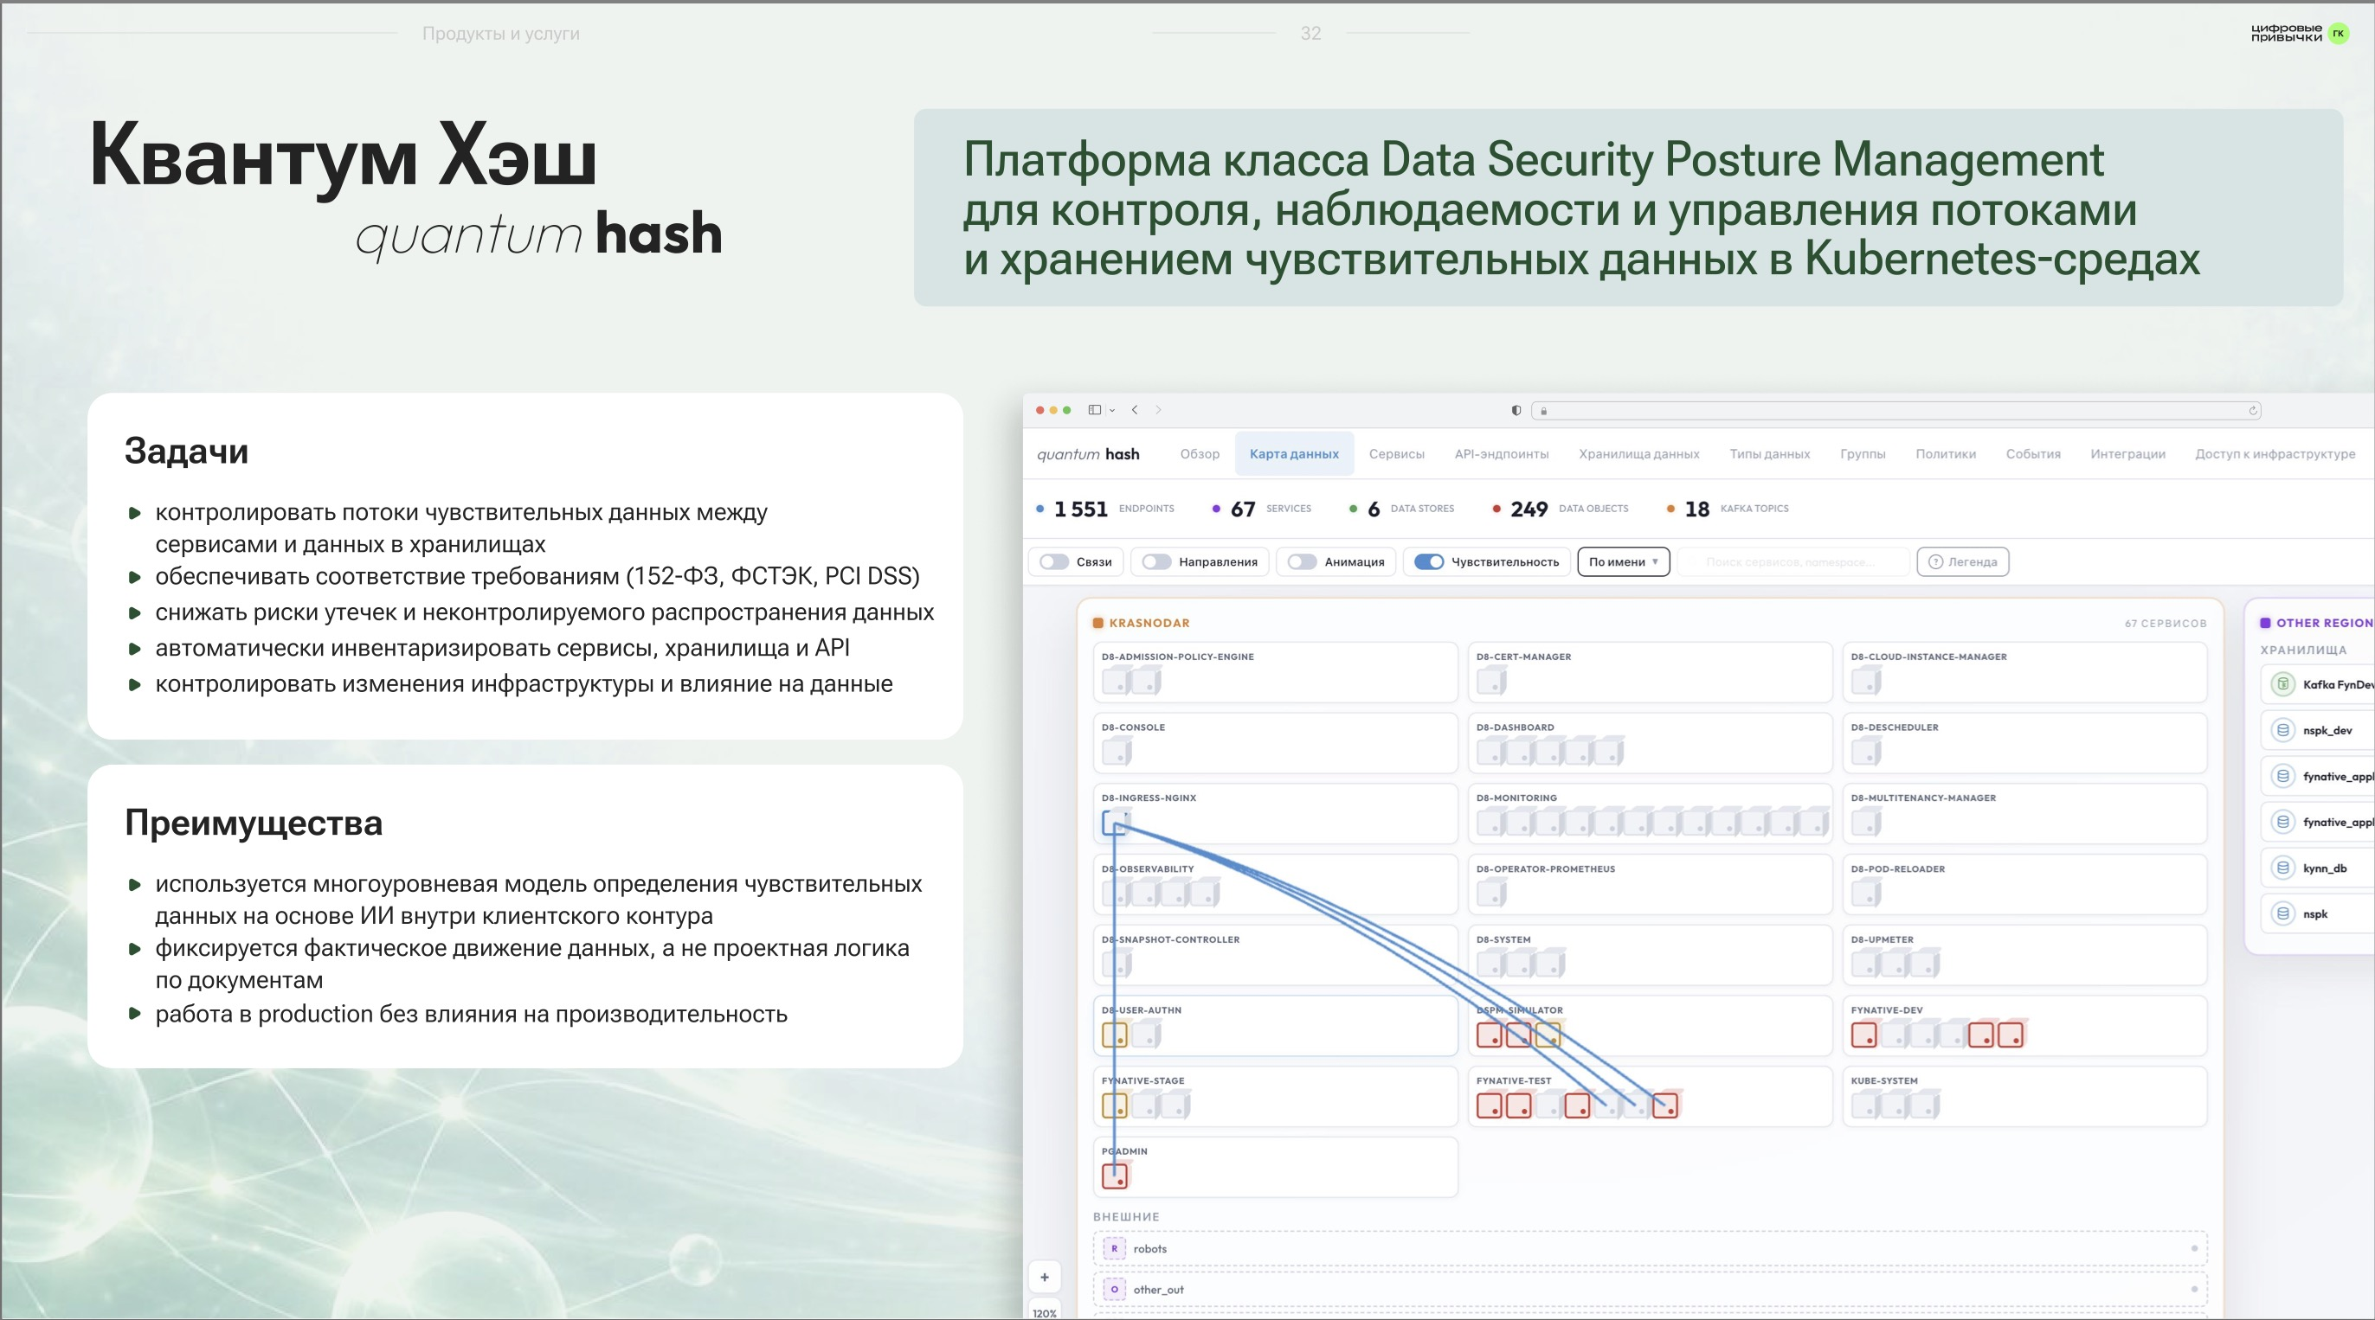
https://quantum-hash.com

Slide 24
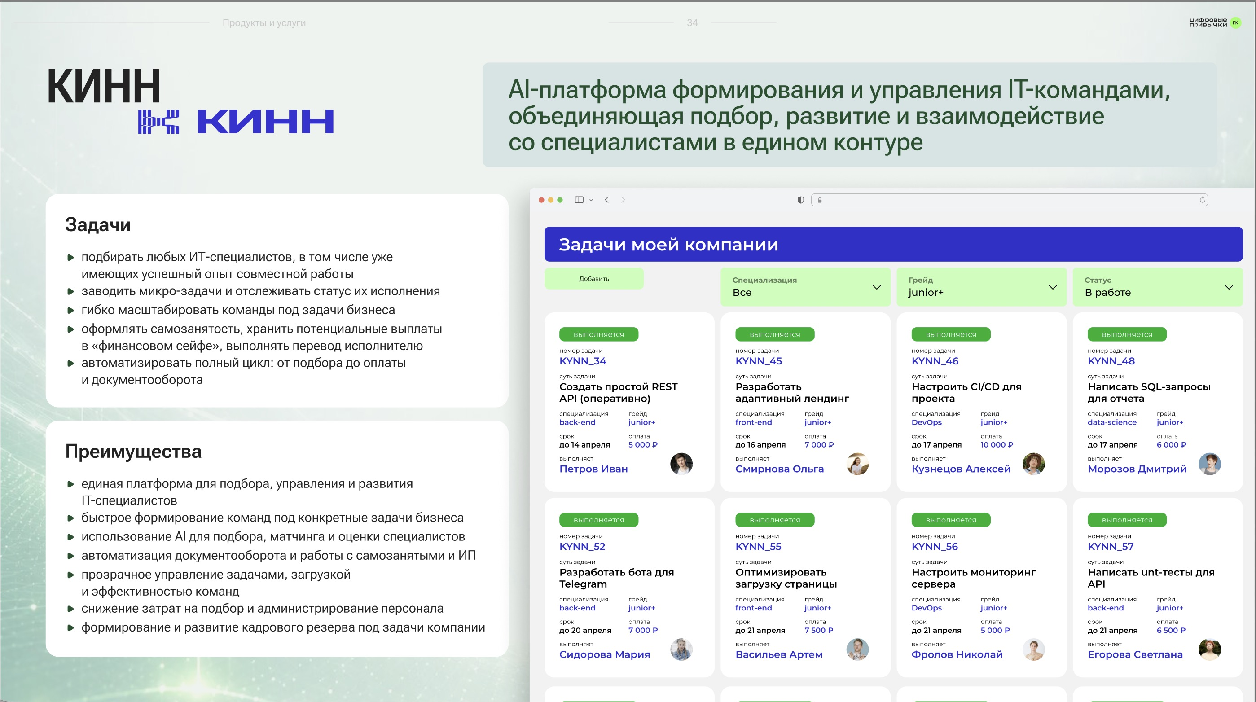
https://kynn.ru

Slide 25
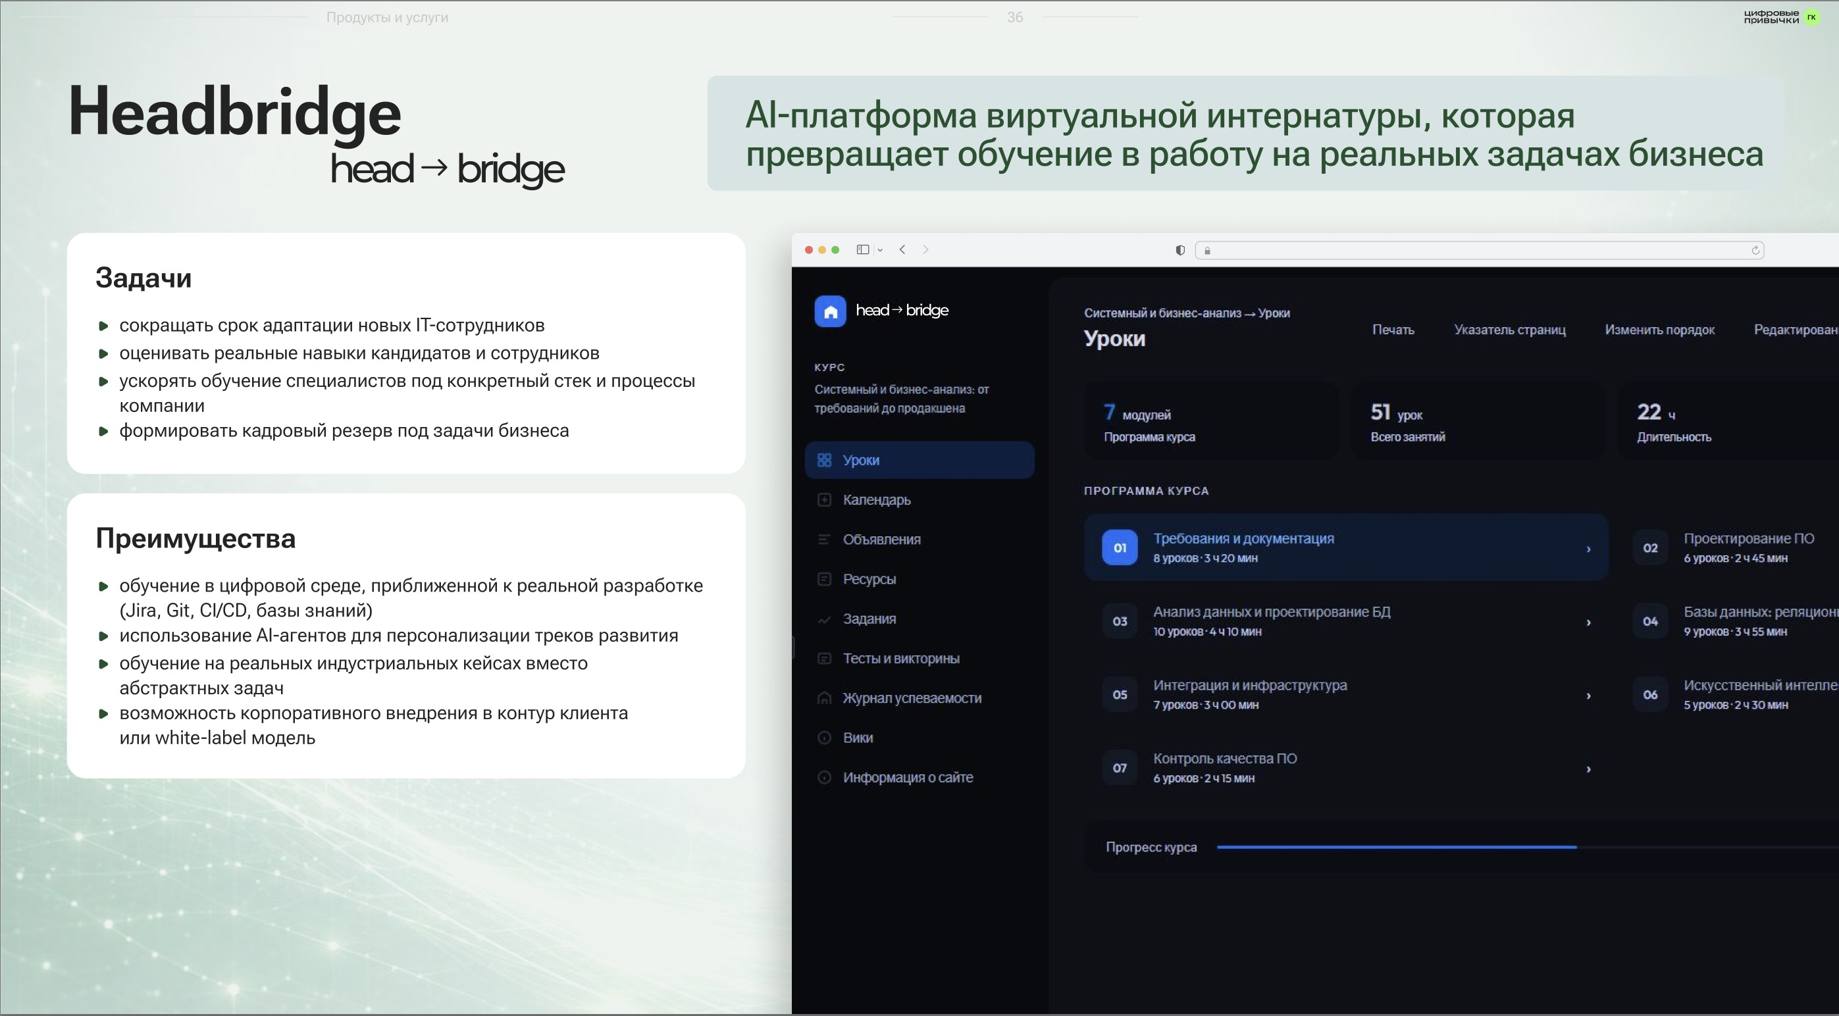
https://headbridge.ru

Slide 26
https://finative.ru

Slide 27
https://fin-kassa.com

Slide 28
One-time development cost: ₽15M · each extra sale then costs ≈ ₽0
DIGITAL PRODUCT
Build once,
sell many
times
Barely covers
Healthy
At scale
15 × ₽1M = ₽15M
20 × ₽1M = ₽20M
60 × ₽1M = ₽60M
profit ₽0
profit ₽5M
profit ₽45M
0%
25%
75%
margin
margin
margin
Same product, same one-time cost — only the number of sales changes. Unlike selling hours, margin grows with scale.
Unit = one product sale

Slide 29
DIGITAL HABITS · FINANCIALS
Real IFRS financial statements — the numbers behind the case.
IFRS 2024
Open the full IFRS 2024 statements
consolidated group accounts · click to open
МСФО, consolidated at group level — the reporting used to price the pre-IPO.

Slide 30
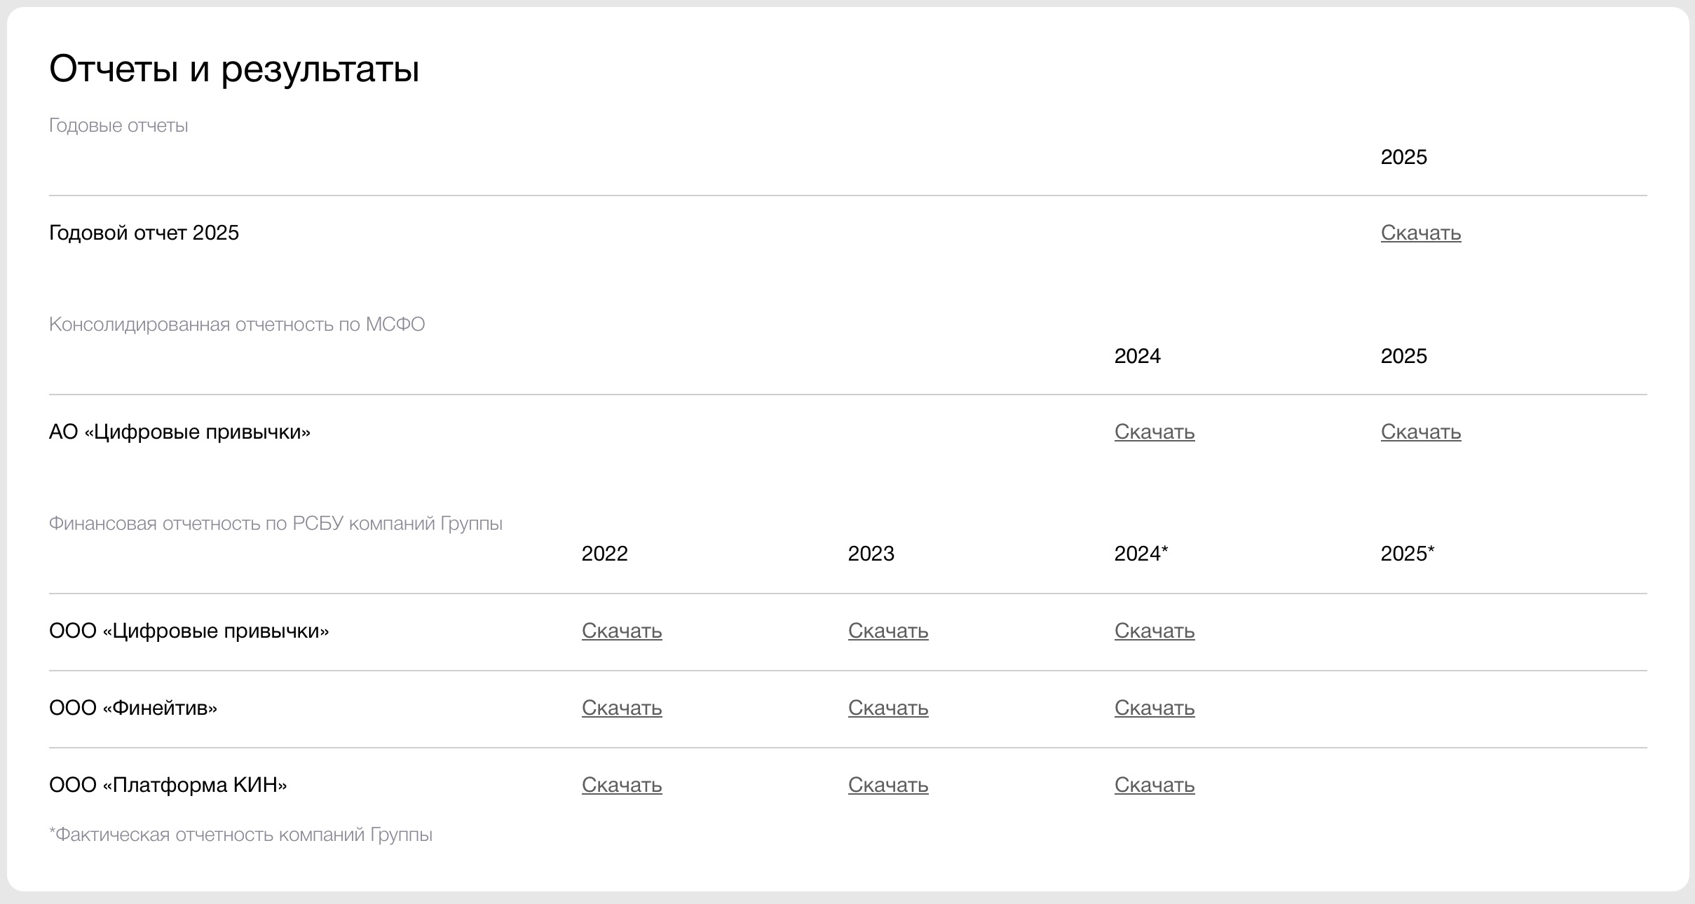
https://dhabits.ru/investors/

Slide 31
How the ₽5.4 bn valuation is built — two ways to the same number.
VALUATION
Pre-IPO
valuation
Component
Shares × price
Value
Pre-money
150M × ₽30
₽4.5 bn
+ Cash raised
30M × ₽30
₽0.9 bn
= Post-money
180M × ₽30
₽5.4 bn
Both roads meet at ₽5.4 bn: price × shares after pre-IPO (₽30 × 180M) equals pre-money ₽4.5 bn plus ₽0.9 bn raised.
Sources: Longterminvestments; TAdviser.

Slide 32
DIGITAL HABITS · FINANCIALS
First full IFRS report — the picture after pre-IPO.
IFRS 2025
Open the full IFRS 2025 statements
consolidated group accounts · click to open
The post-deal reporting: what the company looks like once the pre-IPO capital is in.

Slide 33
FINAL · SUBMIT
Make the practice on the course site:
Practical Task
max-ppv.ru/lectures9-10/digital-habits.html
One link, one submission per person.

Slide 34

TODAY
В прошлых сериях…
Done So Far
История компании «Цифровые привычки»
Юнит-Экономика «заказной разработки»
Юнит-Экономика B2B продукта
Pre-IPO компании «Цифровые привычки»
Практическое задание
7
Lecture 9-10 — Digital Habits, Outsource Development, From Services to Products

Slide 35
?
WRAP-UP
Questions?
On the topics discussed — and not only.
Lecture 9-10 — Digital Habits, Outsource Development, From Services to Products

